Slide 1
1st and 2nd Grade
August 9, 2013

Slide 2
Learning Targets
I can identify how the process of planning lessons with the modules differs from planning lessons using other resources.
I can analyze the Overview and Topic Openers from each module to identify the progression of the instruction over the course of the fall semester.
I can share thinking and work done while planning for module lessons to facilitate the planning process.

Slide 3
Instructional Shifts
Remains
Shift 1
Focus
Focus
Remains
Shift 2
Coherence
Coherence
Fluency
Combine to Form
Shift 3
Shift 4
Shift 5
Shift 6
Deep Understanding
Rigor
Applications
Dual Intensity
Notes:
Start with the standards… why…
The authors of the Common Core State Standards tell us that the “standards are not intended to be new names for old ways of doing business. They are a call to take the next step.” (CCSSM, page 5) Student Achievement Partners, the writers of the Common Core State Standards, has described some examples of the “old ways of doing business,” articulating the kind of instruction to avoid.
In order to move away from these old ways, a new approach to mathematics education was needed. This new plan was articulated in the form of the Instructional Shifts, which describe how to implement the Standards as they were intended so that all students will be career and college ready when they leave high school.
NOTE TO FAILITATOR: If your audience is not familiar with these Instructional Shifts, take time to discuss each one.
These shifts have been a driving force in creating A Story of Units.
Each grade-level focuses on the major work.
Material is organized into coherent topics, emphasizing natural connections that exist both within and across grades.
A balance of rigor is maintained in the daily lesson components as well as in the assessments.
Practice standards are meaningfully connected to the content standards.
TIME ALLOTTED FOR THIS SLIDE:
3 minutes
MATERIALS NEEDED:
X

Slide 4
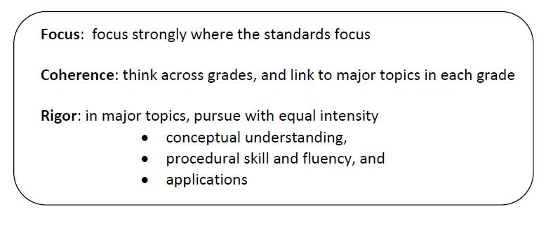
Curriculum Modules: Designed to Address the Shifts
Notes:
Throughout the NTI, as you examine these modules, you will find the same careful and intense balance of rigor that you saw in previous modules.
You might recall that our sessions during both the November NTI and the February NTI were structured around rigor. Both times, we presented a three-part Rigor Breakdown series, where each session focused on one component of rigor and provided examples from the featured modules.
During this NTI our attention to rigor may be less explicit in that you will not see the familiar structure of the Rigor Breakdown series. While our explicit focus is on examining modules, attention to rigor is embedded in those sessions and will continue to be a natural part of discussion. We anticipate that you will recognize and share examples of rigor as they are uncovered.
THIS SESSION WILL BE IMMEDIATELY FOLLOWED BY A SESSION ON ASSESSMENT IN A STORY OF UNITS.
TIME ALLOTTED FOR THIS SLIDE:
3 minutes
MATERIALS NEEDED:
X

Slide 5
Philosophy and Workflow of A Story of Units
Lesson Objectives
Common Core Standards: The Progressions
A Story of Units: Curriculum Map
Module Overviews
and Assessments
Topic Openers
Elementary Mathematics
Notes:
From the field of mathematics, learning progressions have been clearly defined for us in the Common Core Learning Standards. From those, we developed a framework for the P-5 curriculum. This is illustrated in the curriculum map and articulated in the accompanying grade-level descriptions of the Curriculum Overview. From this established sequence of modules, overview and assessments are created. Each topic is then fully developed to include daily objectives that describe a teaching sequence towards mastery.
TIME ALLOTTED FOR THIS SLIDE:
3 minutes
MATERIALS NEEDED:
X

Slide 6
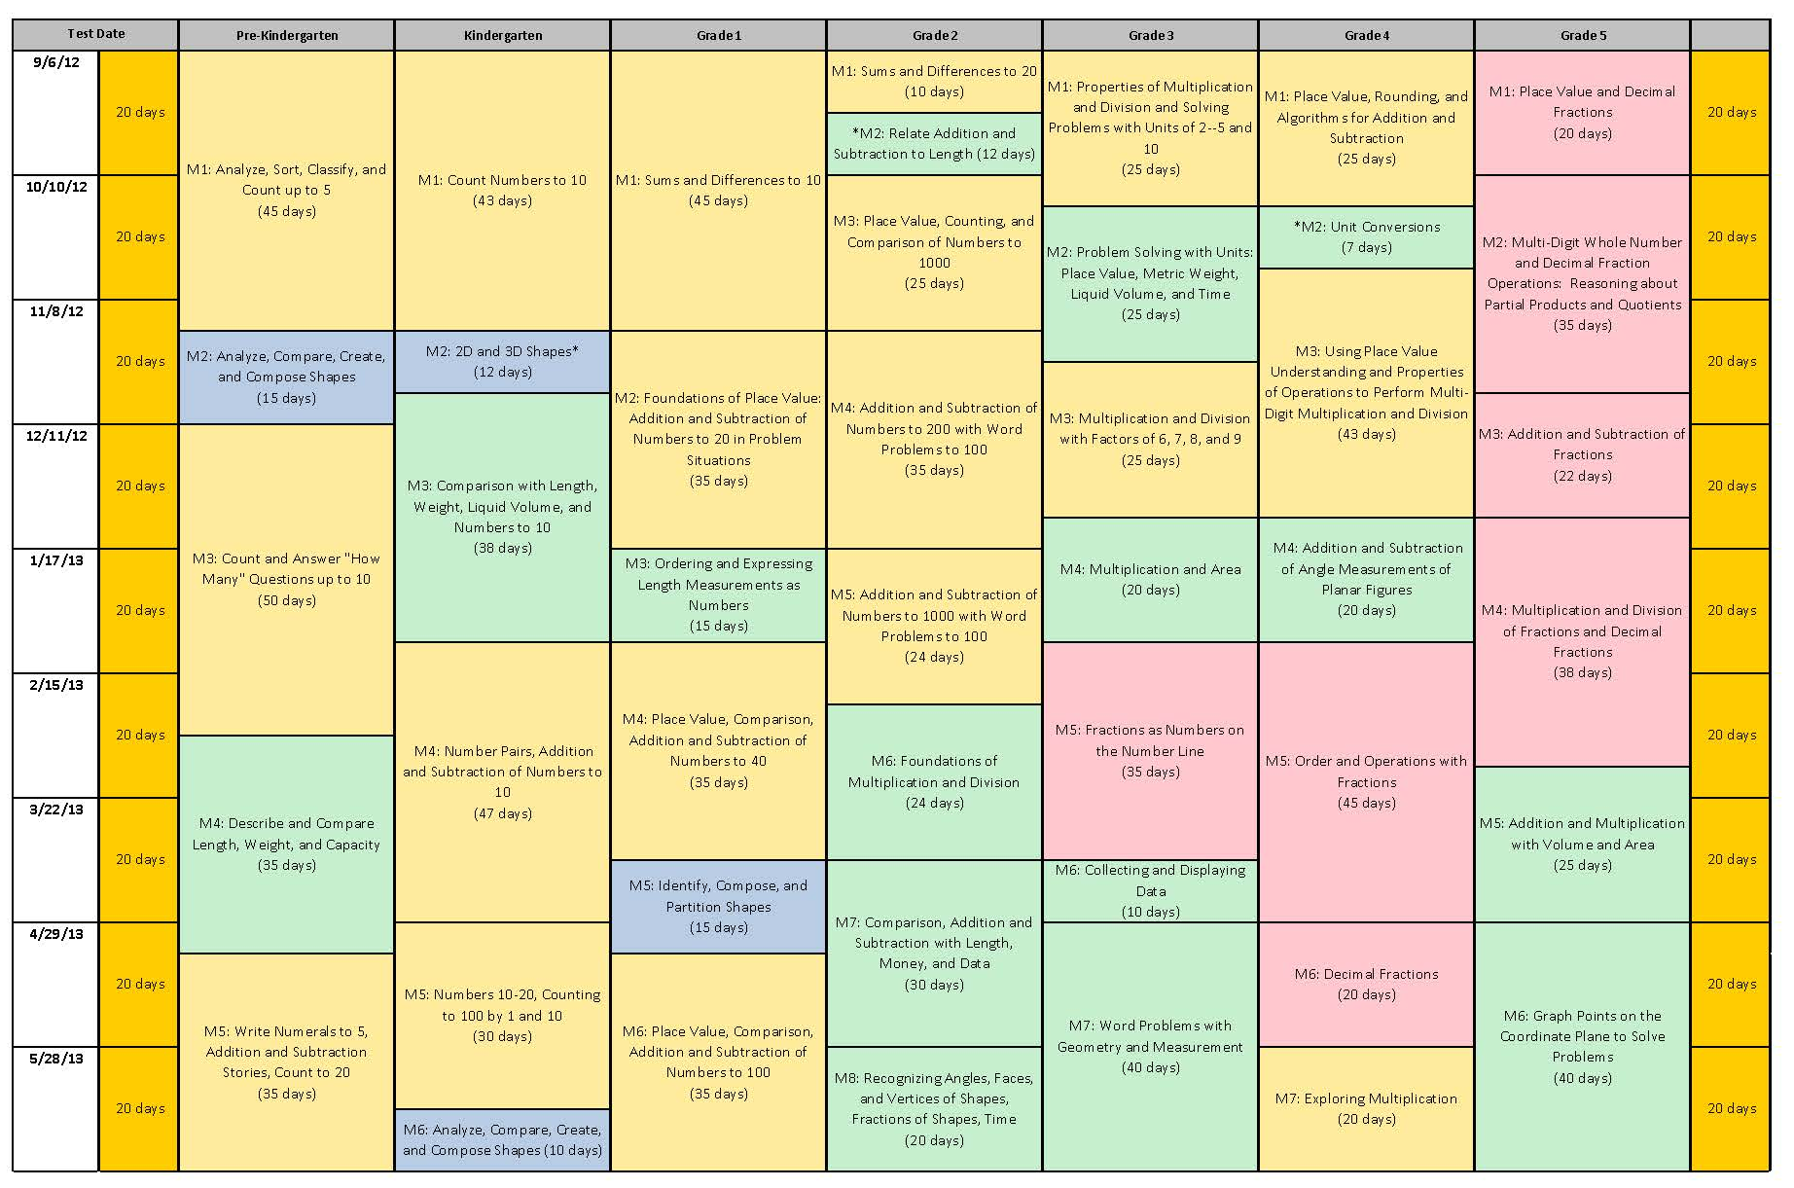
A Story of Units
Notes:
Slides 10-13, Facilitator will describe the tight alignment to the Standards, the progression of mathematics, and intentionality that support and unify the P-5, 6-8, and 9-12 curricula being developed by the Common Core, Inc. team.
Facilitate a discussion about this progression from A Story of Units to A Story of Ratios to A Story of Functions.
TIME ALLOTTED FOR THIS SLIDE:
1 minutes
MATERIALS NEEDED:
X

Slide 7
Modules for the Fall
Getting Ready for September:
  G1–M1 Module 1 Sums and Differences to 10
  G1-M2 Introduction to Place Value Through Addition and Subtraction Within 20
  G2–M1 Sums and Differences to 20
  G2–M2 Relate Addition and Subtraction to Length
Notes:
The focus of this NTI is centered around the first module for each grade, K through 5. Listed here are the seven new modules that are now complete and are currently being posted on EngageNY. In your binder, we have provided material that will be useful in our discussions about preparing for implementation of A Story of Units. This includes the Module Overview, Assessments, and Topic Openers for each of these seven modules.
Review binder and agenda.
TIME ALLOTTED FOR THIS SLIDE:
4 minutes
MATERIALS NEEDED:
X

Slide 8
Seeing the Focus and Coherence
Read the Overview for Module 1 of your grade.
Answer the questions for your Topic.
Meet with your team and share your Topic responses in order.

Slide 9
Seeing the Focus and Coherence
Read the Overview for Module 2 of your grade and the other grade.
Where do you see connections to the work that you will be doing in Module 1?
How can this connections help you as you prepare to implement the modules?

Slide 10
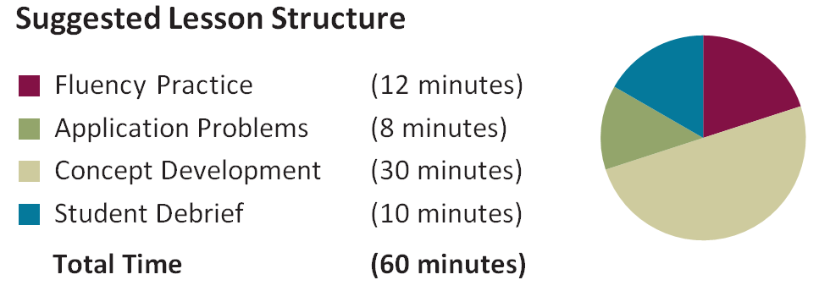
  Informal Assessment within Lesson Components
Notes:
1 minute is allotted for this slide
Informal assessments are found in many of the lesson components and allow the teacher to know how students are progressing and to make immediate instructional decisions

Slide 11
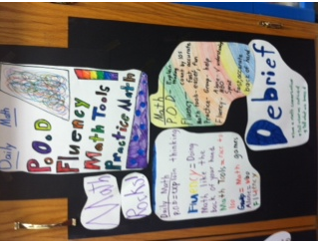
Are students aware of the purpose of each portion of the lesson ?
Empower students to join you in the learning process.
Invest time into helping students understand how they should approach their learning
Lisa Tryon’s class- Orchard Park

Slide 12


Slide 13
Grade 1 Module 1 Lesson 14
Counting On (Level 2 Strategy)
4

Slide 14
Grade 1 Module 1 Lesson 14
Counting On (Level 2 Strategy)
6

Slide 15
Grade 1 Module 1 Lesson 14
Counting On (Level 2 Strategy)
4 + 3 = □

Slide 16
Finding Patterns
Concept Development
Problem Set
Debrief

Slide 17
The Debrief
Same total?
Notes:
2 minutes are allotted for this slide.
Circulate, observe, listen as students during both phases of the error correction process.
Question with those observations in mind.
Be alert to the ways in which today’s objectives strengthen yesterday’s.
(Elicit from students that the digits in a product can be found through whole number multiplication. The actual product can be deduced through estimation based logic and/or composing smaller units into larger units.)

Slide 18
Assessment
Assess
Analyze
Plan
Teach
Complete End-of-Module Assessment
Label each question with the module standard it addresses.
Notes:
15 minutes is allotted for this slide.
After 10 minutes have the participants share with a partner about the assessment for 3 minutes.

Slide 19
Plan
Write down at least one question you would ask each student to either:
  Further assess
  Advance their thinking
Notes:
3 minutes

Slide 20
Application- Read, Draw, Write (RDW)
Mathematicians and teachers suggest a simple process applicable to all grades:
1) Read.
2) Draw and Label.
3) Write a number sentence. (equation)
4) Write a word sentence. (statement)
MP1
MP2

Slide 21
Application- Read, Draw, Write (RDW)
The more students participate in reasoning through problems with a systematic approach, the more they internalize those behaviors and thought processes.
  What do I see?
  Can I draw something?
  What conclusions can
  I make from my drawing?
Modeling with Interactive Questions
Guided Practice
Independent Practice

Slide 22
Planning

