Slide 1
3rd and 4th Grade
July 26, 2013

Slide 2
Learning Targets
I can identify how the process of planning lessons with the modules differs from planning lessons using other resources.
I can analyze the Overview and Topic Openers from each module to identify the progression of the instruction over the course of the fall semester.
I can share thinking and work done while planning for module lessons to facilitate the planning process.

Slide 3
Instructional Shifts
Remains
Shift 1
Focus
Focus
Remains
Shift 2
Coherence
Coherence
Fluency
Combine to Form
Shift 3
Shift 4
Shift 5
Shift 6
Deep Understanding
Rigor
Applications
Dual Intensity
Notes:
Start with the standards… why…
The authors of the Common Core State Standards tell us that the “standards are not intended to be new names for old ways of doing business. They are a call to take the next step.” (CCSSM, page 5) Student Achievement Partners, the writers of the Common Core State Standards, has described some examples of the “old ways of doing business,” articulating the kind of instruction to avoid.
In order to move away from these old ways, a new approach to mathematics education was needed. This new plan was articulated in the form of the Instructional Shifts, which describe how to implement the Standards as they were intended so that all students will be career and college ready when they leave high school.
NOTE TO FAILITATOR: If your audience is not familiar with these Instructional Shifts, take time to discuss each one.
These shifts have been a driving force in creating A Story of Units.
Each grade-level focuses on the major work.
Material is organized into coherent topics, emphasizing natural connections that exist both within and across grades.
A balance of rigor is maintained in the daily lesson components as well as in the assessments.
Practice standards are meaningfully connected to the content standards.
TIME ALLOTTED FOR THIS SLIDE:
3 minutes
MATERIALS NEEDED:
X

Slide 4
Curriculum Modules: Designed to Address the Shifts
Notes:
Throughout the NTI, as you examine these modules, you will find the same careful and intense balance of rigor that you saw in previous modules.
You might recall that our sessions during both the November NTI and the February NTI were structured around rigor. Both times, we presented a three-part Rigor Breakdown series, where each session focused on one component of rigor and provided examples from the featured modules.
During this NTI our attention to rigor may be less explicit in that you will not see the familiar structure of the Rigor Breakdown series. While our explicit focus is on examining modules, attention to rigor is embedded in those sessions and will continue to be a natural part of discussion. We anticipate that you will recognize and share examples of rigor as they are uncovered.
THIS SESSION WILL BE IMMEDIATELY FOLLOWED BY A SESSION ON ASSESSMENT IN A STORY OF UNITS.
TIME ALLOTTED FOR THIS SLIDE:
3 minutes
MATERIALS NEEDED:
X

Slide 5
Philosophy and Workflow of A Story of Units
Lesson Objectives
Common Core Standards: The Progressions
A Story of Units: Curriculum Map
Module Overviews and Assessments
Topic Openers
Elementary Mathematics
Notes:
From the field of mathematics, learning progressions have been clearly defined for us in the Common Core Learning Standards. From those, we developed a framework for the P-5 curriculum. This is illustrated in the curriculum map and articulated in the accompanying grade-level descriptions of the Curriculum Overview. From this established sequence of modules, overview and assessments are created. Each topic is then fully developed to include daily objectives that describe a teaching sequence towards mastery.
TIME ALLOTTED FOR THIS SLIDE:
3 minutes
MATERIALS NEEDED:
X

Slide 6
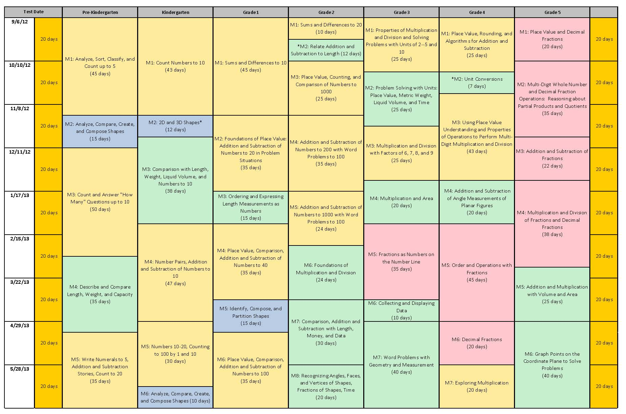
A Story of Units
Notes:
Slides 10-13, Facilitator will describe the tight alignment to the Standards, the progression of mathematics, and intentionality that support and unify the P-5, 6-8, and 9-12 curricula being developed by the Common Core, Inc. team.
Facilitate a discussion about this progression from A Story of Units to A Story of Ratios to A Story of Functions.
TIME ALLOTTED FOR THIS SLIDE:
1 minutes
MATERIALS NEEDED:
X

Slide 7
Modules for the Fall
Getting Ready for September:
GK–M1 Count Numbers to 10
G1–M1 Module 1 Sums and Differences to 10
G2–M1 Sums and Differences to 20
G2–M2 Relate Addition and Subtraction to Length
G3–M1 Properties of Multiplication and Division and Solving Problems with Units of 2–5 and 10
G4–M1 Place Value, Rounding, and Algorithms for Addition and Subtraction
G5–M1 Place Value and Decimal Fractions
Notes:
The focus of this NTI is centered around the first module for each grade, K through 5. Listed here are the seven new modules that are now complete and are currently being posted on EngageNY. In your binder, we have provided material that will be useful in our discussions about preparing for implementation of A Story of Units. This includes the Module Overview, Assessments, and Topic Openers for each of these seven modules.
Review binder and agenda.
TIME ALLOTTED FOR THIS SLIDE:
4 minutes
MATERIALS NEEDED:
X

Slide 8
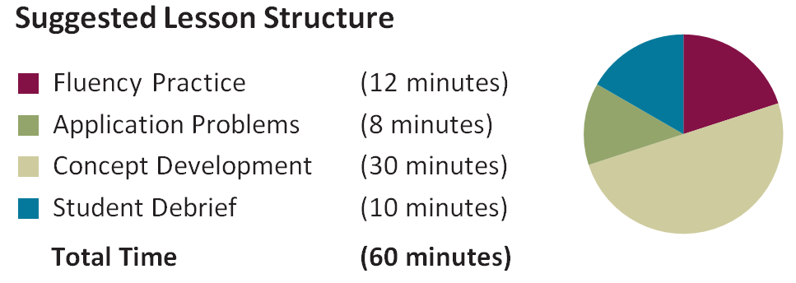
Informal Assessment within Lesson Components
Are students aware of the purpose of each portion of the lesson ?
Notes:
1 minute is allotted for this slide
Informal assessments are found in many of the lesson components and allow the teacher to know how students are progressing and to make immediate instructional decisions

Slide 9
Grade 3- Module 2 Lesson 10
There are 1,000 milliliters in 1 liter of water. You are measuring 100 milliliters each time. Think back to yesterday. How many times will you need to measure and mark 100 milliliters of water to make 1 liter?

Slide 10
Fluency
Grade 3- Module 1 Topic C Lesson 10
2 x 7 =____

Slide 11
Application- Read, Draw, Write (RDW)
Mathematicians and teachers suggest a simple process applicable to all grades:
1) Read.
2) Draw and Label.
3) Write a number sentence. (equation)
4) Write a word sentence. (statement)
MP1
MP2
Grade 3- X Grade 5 - IV

Slide 12
Application- Read, Draw, Write (RDW)
The more students participate in reasoning through problems with a systematic approach, the more they internalize those behaviors and thought processes.
What do I see?
Can I draw something?
What conclusions can I make from my drawing?
Modeling with Interactive Questions
Guided Practice
Independent Practice

Slide 13
Application
Grade 3- Module 1 Topic C Lesson 10
A guitar has 6 strings.
How many strings are there on 3 guitars?
Write a multiplication sentence to solve.
(Try to model this problem with a number bond)

Slide 14
Concept Development Problem Set Debrief
Grade 3- Module 1 Topic C Lesson 10

Slide 15
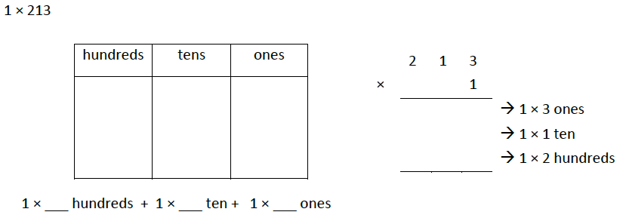
Grade 4 Module 3 Topic C
Multiplication of Up to Four-Digit by Single-Digit Numbers
What methods will students use to record their work in Topic C?
What clarification does the footnote 1 provide for the multiplication algorithm?
Notes:
What methods will students use to record their work in Topic C? (Distributive property, number disks, partial products, standard algorithm, area model.)
What clarification does the footnote 1 provide for the multiplication algorithm? (The standard algorithm for multiplication is not expected to be mastered until Grade 5 – 5.NBT.5. Students are introduced, being supported by place value strategies to prepare them from Grade 5 multiplication.)
Answer to problem:
2×2 hundreds + 2×1 ten + 2×3 ones
4 hundreds + 2 tens + 6 ones
400 + 20 + 6
426
TIME ALLOTTED FOR THIS SLIDE:
3 minutes
MATERIALS NEEDED:
G4 M3 Module Overview
Module 3 Topic Analysis Handout

Slide 16
Grade 4 Module 1 Topic C
Vertical Number Lines

