Slide 1
A Story of Units
Module 2
Notes:
NOTE THAT THIS SESSION IS DESIGNED TO BE 195 MINUTES IN LENGTH
Turnkey Materials Provided in Addition to PowerPoint:
Grade 4—Module 2
Grade 4 – Module 2 Student Sample Assessment Responses
Grade 4 – Module 3 Overview
Grade 4 – Module 2 Solutions Strategies Handout
Grade 4 – Module 3 Topic Analysis Handout
Geometric Measurement Progression document
Personal White Boards
Additional Suggested Resources:
Number and Operations in Base 10 Progression document
Operations and Algebraic Thinking Progression document
A Story of Units: A Curriculum Overview for Grades P-5
How to Implement A Story of Units
This Module Focus follows an opening session providing a update on the Curriculum Overview/Map of A Story of Units. At the previous NTI, sessions were dedicated to introducing the beginning module for each grade-level for Kindergarten through Grade 5. In this session, participants will explore the “next” module of their chosen grade-level, examining the mathematics of the module and analyzing the progression of concepts across the module.
TIME ALLOTTED FOR THIS SLIDE:
1 minute THE TIMES FOR ALL SLIDES NEED TO TOTAL 195 MINUTES
MATERIALS NEEDED:
X

Slide 2
Session Objectives
Draw connections between the progression documents and the careful sequence of mathematical concepts that develop within each module.
Articulate how the topics and lessons promote mastery of the focus standards and how the module addresses the major work of the grade.
Prepare to implement the module and make appropriate instructional choices to meet the needs of students while maintaining the balance of rigor that is built into the curriculum.
Notes:
Our objectives for this session are to explore Grade 4–Module 2 in order to:
Draw connections between the Geometric Measurement Progression and the careful sequence of mathematical concepts that develop within each module.
Articulate how the topics and lessons promote mastery of the focus standards and how the module addresses the major work of the grade.
Prepare to implement the module and make appropriate instructional choices to meet the needs of students while maintaining the balance of rigor that is built into the curriculum.
As we move through this session, please ask questions that will help with your immediate understanding of the material. If you have questions that relate to your broader understanding of A Story of Units or how to implement the curriculum in your school or district, please write those on a sticky note along with your name and place the note on the parking lot. We will look at those questions during the lunch break and address them with the group if they are applicable to all or with you if they are specific to your situation.
TIME ALLOTTED FOR THIS SLIDE:
2 minutes
MATERIALS NEEDED:
Geometric Measurement Progression

Slide 3
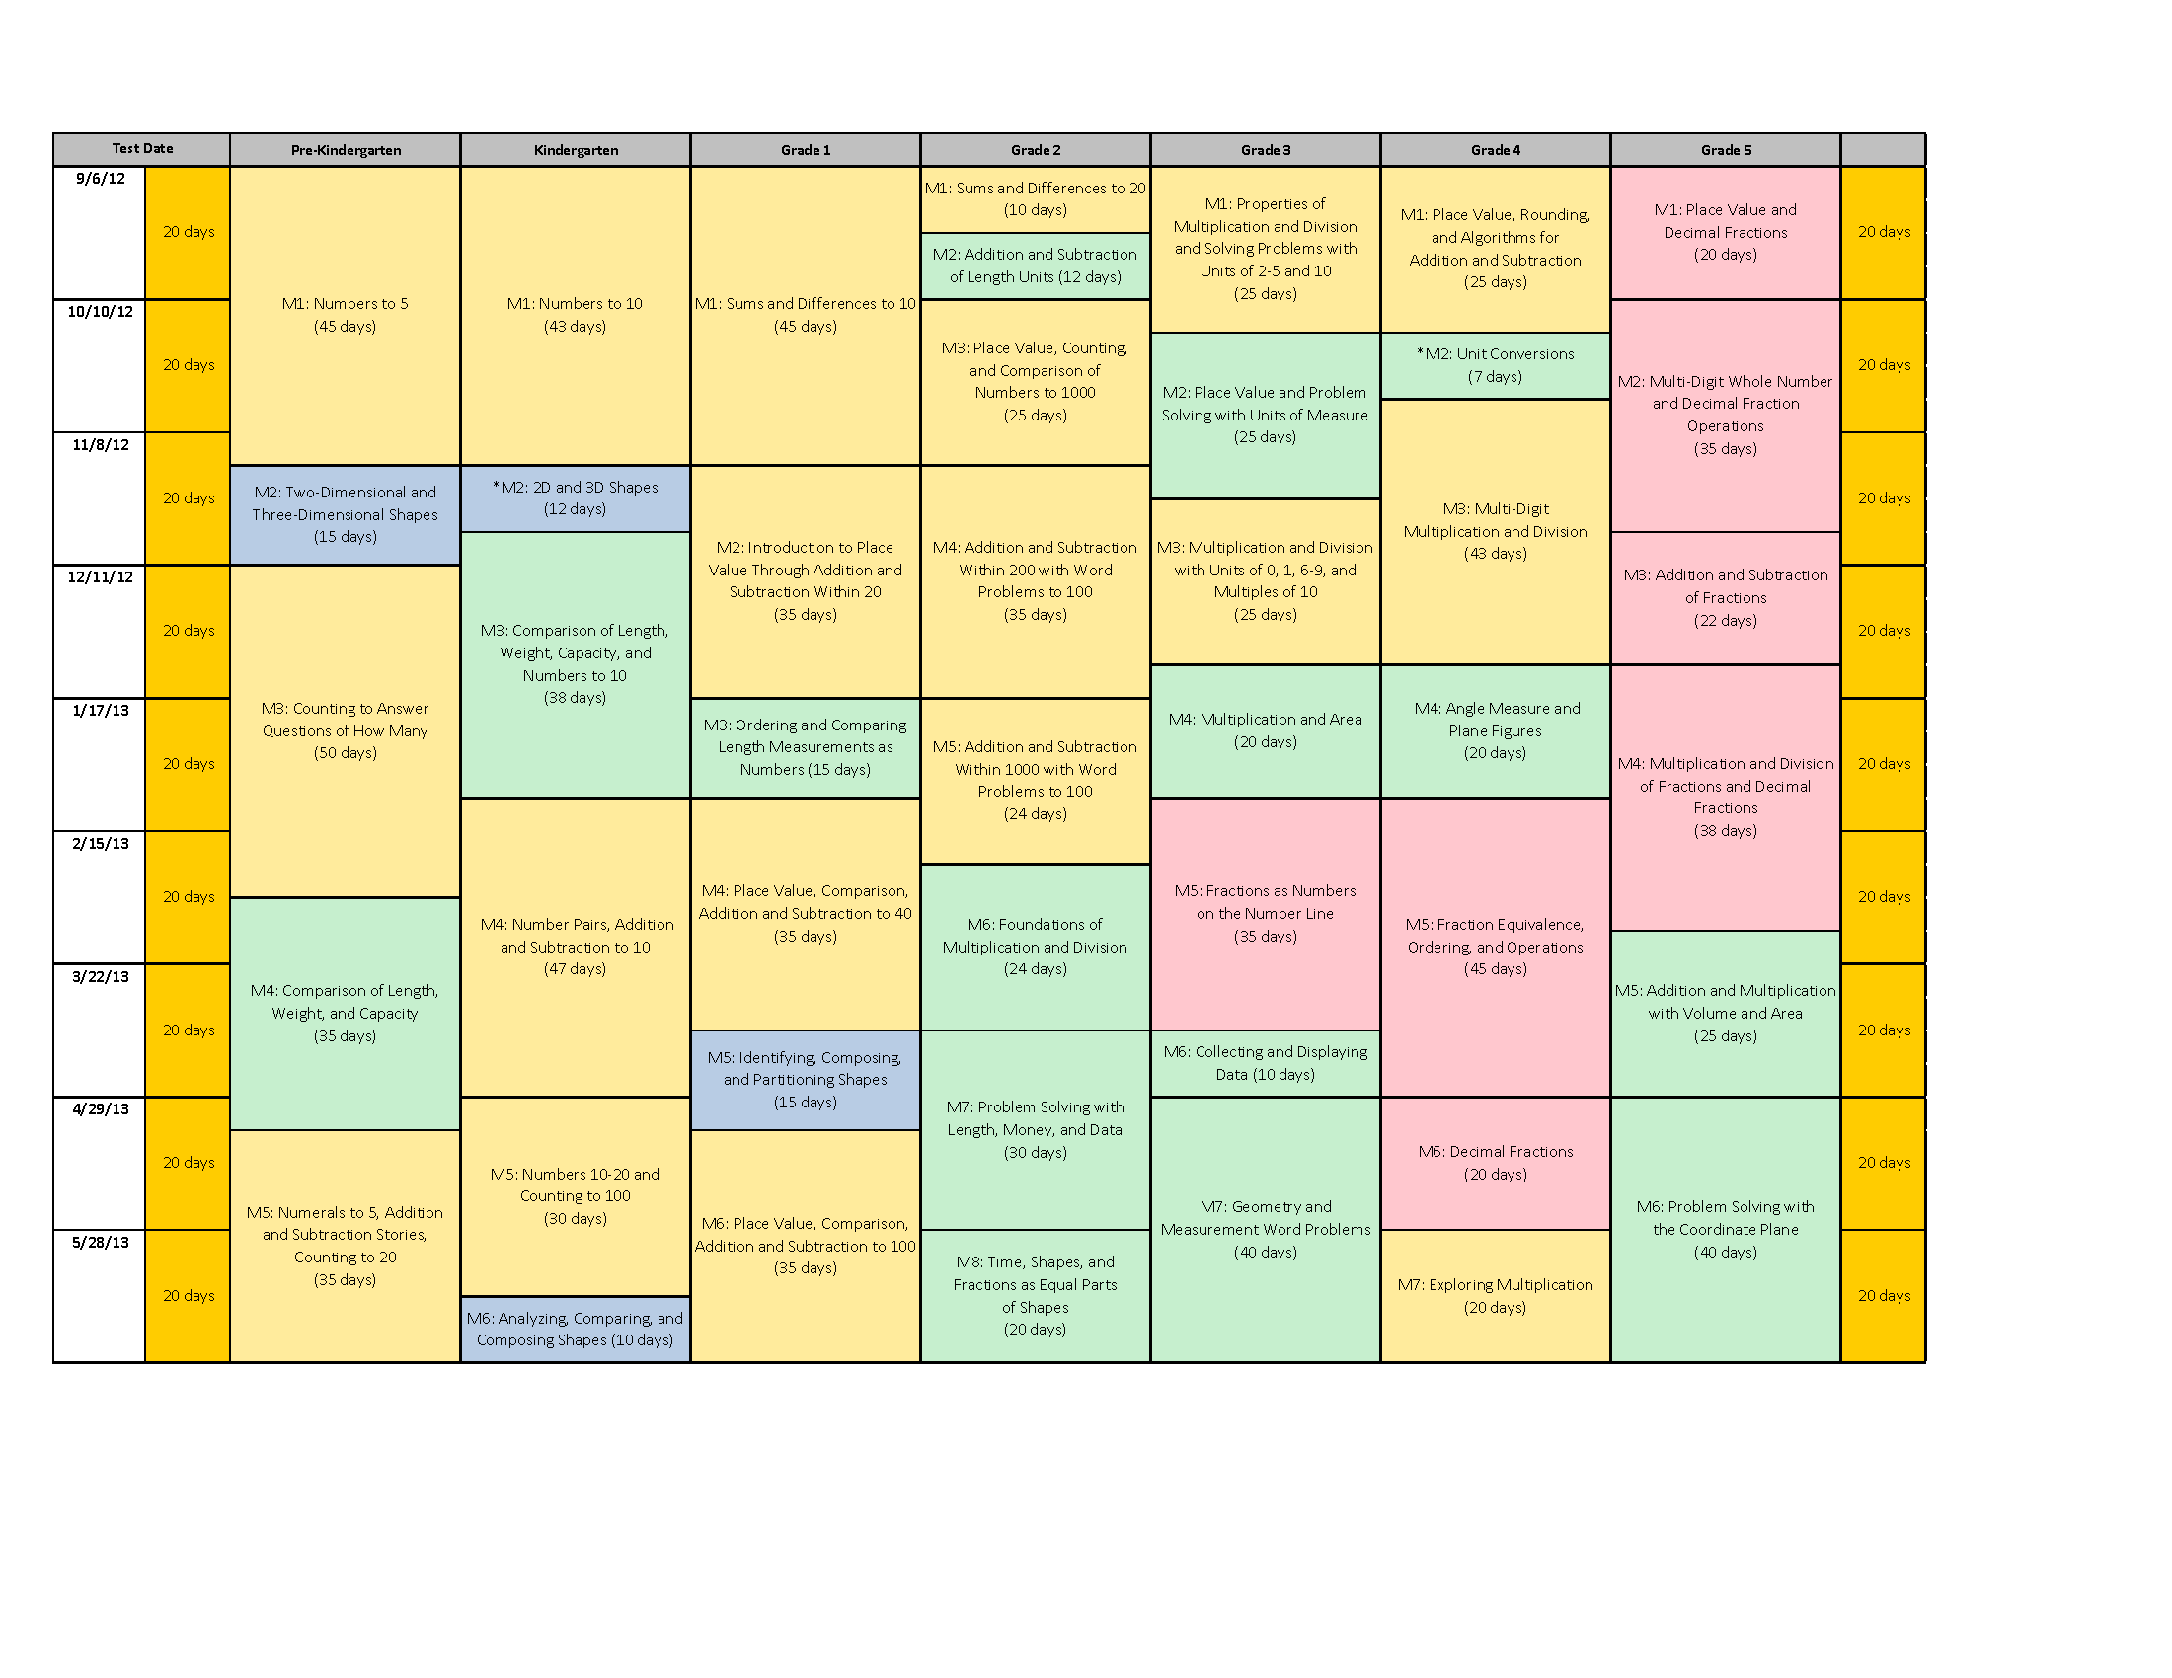
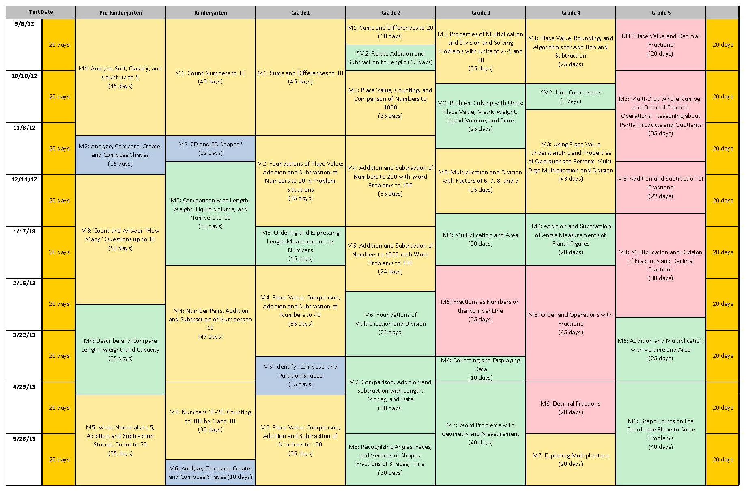
Notes:
This curriculum map is found on page 3 of A Story of Units: A Curriculum Overview for Grades P-5. For those of you who participated in the May NTI, you’ll recall that we deeply examined the first module of Grade 4. In this session, we will continue that deep examination of the next module.
NOTE TO FACILITATOR: Take a moment to share briefly the following information about this module.
What is the title of this module? (Unit Conversions and Problem Solving with Metric Measurement)
How many instructional days are allotted for this module? (7)
What modules, prior to this one, might prepare students for success in this module? (G2 M2)
What modules, beyond this one, might build on the concepts of this module? (G5 M1 & M4)
TIME ALLOTTED FOR THIS SLIDE:
2 minutes
MATERIALS NEEDED:
Curriculum Map

Slide 4
Curriculum Map (pg 48)
What is taught in this module, and what will be reserved for later units?

Slide 5
Progression Study
Read the Geometric Measurement Progression page 20.
Highlight the information relevant to the content of this module.
Which measurement concepts are students expected to learn in Grade 4?
Notes:
As a foundation for our study of this module, we’re going to first take some time to examine a portion of the Geometric Measurement Progression document that describes the mathematical concepts that will be developed throughout the lessons.
You’ll have about 5 minutes to read through the document independently. As you read, highlight measurement concepts Grade 4 students are expected to learn. Then you’ll have an opportunity to discuss your thoughts with others at your table.
As you think about what you are reading reflect on your role and what this information may mean for how you support your colleagues- consider resources such as time, money and people.
For example, do I need to look at my PD schedule, do I need to shift the planning times for teachers, do I need to order more math materials?
Allow participants 5 minutes to read independently. Then advance to the next slide for a turn and talk.
TIME ALLOTTED FOR THIS SLIDE:
10 minutes
MATERIALS NEEDED:
Geometric Measurement Progression Document

Slide 6
Progression Study
Which measurement concepts are students expected to learn in Grade 4?
What appears to be missing from this Progression that you would expect to find when teaching about measurement?
Notes:
Which measurement concepts are students expected to learn in Grade 4?
Turn and talk with a partner at your table, and then you’ll have an opportunity to share your thoughts with the group.
What appears to be missing from this Progression that you would expect to find when teaching about measurement?
Turn and talk with a partner at your table, and then you’ll have an opportunity to share your thoughts with the group.
Allow 2 minutes for participants to turn and talk about their reflections. Then, facilitate a discussion.
TIME ALLOTTED FOR THIS SLIDE:
5 minutes
MATERIALS NEEDED:
Geometric Measurement Progression Document

Slide 7
Building off of Module 1
What did the students learn in Module 1 that is being practiced in this module?

Slide 8
Review of Module Structure
Module Overview
Topic
L1
Topic
L4
Topic
L5
L2
L3
L6
L7
L8
Notes:
For those of you who may be unfamiliar with A Story of Units, I’ll take just a moment to review the organizational structure of the modules that make up A Story of Units:
Each grade contains 5-8 modules. Modules are comprised of topics, topics break into concepts, and concepts become lessons. Modules and topics will vary in length depending on the concepts addressed in each. In 1st through 5th grades, every lesson is designed for a 60 minute instructional period; in Kindergarten, lessons are designed for a 50 minute period; Pre-kindergarten lessons are designed for a 25 minute period.
This graphic illustrates the breakdown of the module structure. Each component, moving from the Overview to the Lesson, provides a more specific level of information. As you plan to implement A Story of Units, each of these components will be important to your understanding of the instructional path of the module.
The Standards, both Content and Practice, come to life through the lessons. Rigorous problems are embedded throughout the module. We will spend time in the upcoming sessions exploring this further.
TIME ALLOTTED FOR THIS SLIDE:
1 minute
MATERIALS NEEDED:
X

Slide 9
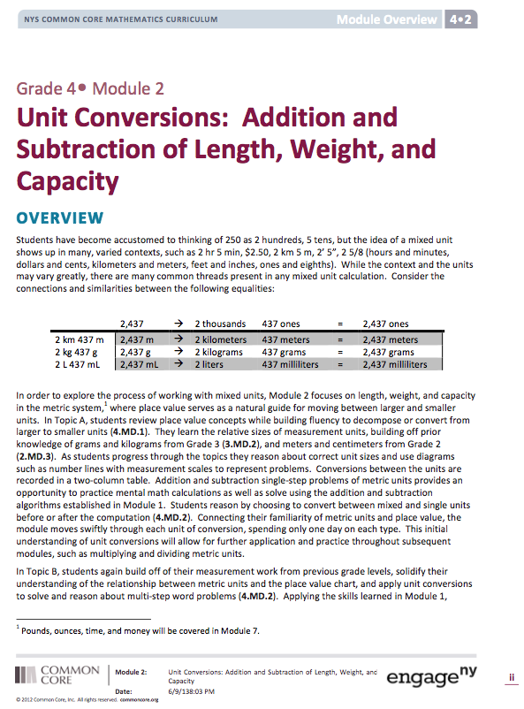
Module Overview
Read the descriptive narrative.
Make note of important information that will help educators understand the content and prepare to implement this module.
Notes:
Each Overview contains multiple components to help educators understand more clearly the focus of the module. These components include:
Descriptive narrative
Distribution of Instructional Minutes
Focus Grade Level Standards, Foundational Standards, and Standards for Mathematical Practices
Overview of Module Topics and Lesson Objectives
Terminology
Suggested Tools and Representations
Scaffolds
Assessment Summary
(CLICK TO ADVANCE FIRST BULLET) Take 8 minutes to read the Module Overview independently.
(CLICK TO ADVANCE SECOND BULLET) As you read, mark important information that will help build understanding of the content in preparation to implement this module. You might do so using a symbol, such as a star, or by highlighting essential portions.
TIME ALLOTTED FOR THIS SLIDE:
9 minutes
MATERIALS NEEDED:
Grade 4 Module Overview

Slide 10
Module Overview
How does this Module compare to your past experiences with this content?
How does each component of the Module Overview prepare you to implement this material in your classroom?
Turn and talk with others at your table about your observations.
Notes:
Turn and talk with others at your table. Share your observations and ask them to do the same.
NOTE TO FACILITATOR: Allow 2 minutes for participants to turn and talk about their review of the Overview and their response to the information provided there. Then facilitate a discussion in the remaining 5 minutes using the following talking points:
Which standards are the focus of this module? (4.MD.1, 4.MD.2)
How is each standard addressed by the content of this module? (4.MD.1 is addressed in Topic A. 4.MD.2 is addressed in Topic A and B to apply measurement concepts)
Which standards are foundational to this module? (2.NBT.1, 3.MD.2, 4.OA.3, 4.NBT.4) This corresponds with the information we saw in the Distribution of Instructional Minutes diagram.) These are standards with which students are expected to be familiar. This list is provided to assist teachers in helping students build on previous understandings, making logical connections across grades. In addition, and especially while the implementation of the CCLS is new, teachers should be prepared to address any gaps that may exist in these foundational understandings.
Which Mathematical Practices are addressed in this module? (MP.1, 7, and 8) While it is certainly hoped that teachers will continue to promote all practices on a regular basis as opportunities arise, these practices listed in the Overview are particularly appropriate for the lessons in this module. In addition to the information provided in this list, activity-specific suggestions are provided in the lessons themselves.
How are these MPs expected to come to life in this module? (See examples from the Overview.)
How does the Terminology provided inform instruction for this module? (It helps the teacher focus the instruction. Only metric units are taught (km, m, cm, mL, L, g, kg). Note: Mixed units are foundational for fractions and strengthen place value understanding.)
How do these Tools and Representations support instruction in this module? (Rulers, scales, and beakers provide a visual connection to the units. Number lines and 2-column tables allow students to see the patterns of unit conversions. Tape diagrams visually support the understanding of a word problem.)
What do you know about the assessment included in this module? (This module has only 1 assessment. It assesses both standards taught in the module and follows the instruction of Topics A and B.)
How might you use this information in your role? ( It is a quick summary of what teachers will do for the next few weeks and can be shared with parents and the community, it also summarizes what conversations should be happening in grade level meetings and what resources teachers may be requesting for their classrooms, it can be shared with other teachers in the school for the purpose of thematic unit planning.)
TIME ALLOTTED FOR THIS SLIDE:
8 minutes
MATERIALS NEEDED:
Module Overview

Slide 11
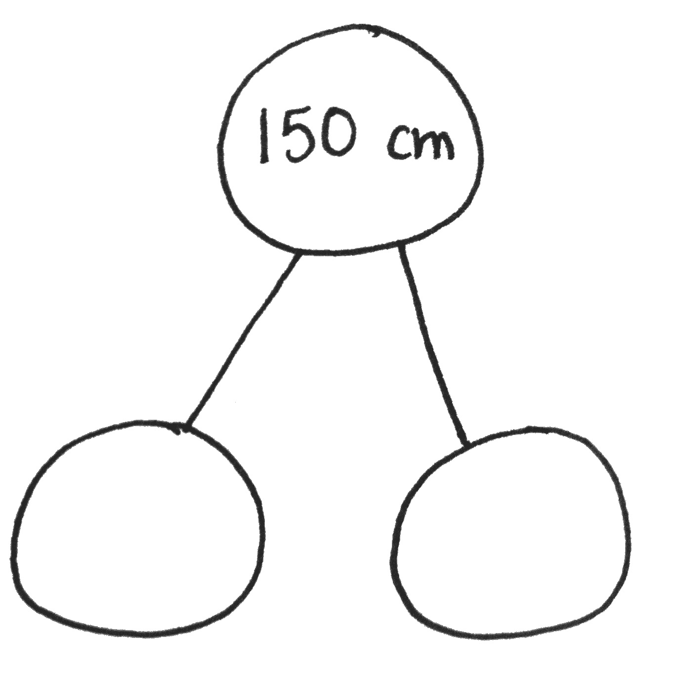
Module Mathematics in Practice
Notes:
Before we look at the module assessments, let’s complete some fluency exercises to get our brains in the measurement mode.
Complete the fluency “Meter and Centimeter Number Bonds” from Lesson 1.
T: (Project a number bond with 150 centimeters written as the whole and 1 meter as one of the parts.) How many centimeters are in 1 meter? (100 centimeters)
T: (Beneath 1 m, write 100 cm.) On your white boards, write a number bond filling in the missing part. (Write a number bond with a whole of 150 cm and parts 1 m and 50 cm.)
Repeat process with wholes of 180 cm, 120 cm, 125 cm, 105 cm, and 107 cm.
Note: Bring to life the prior conversations from the Module Overview and terminology as you demonstrate a number bond and mixed units.
TIME ALLOTTED FOR THIS SLIDE:
3 minutes
MATERIALS NEEDED:
Personal White Boards

Slide 12
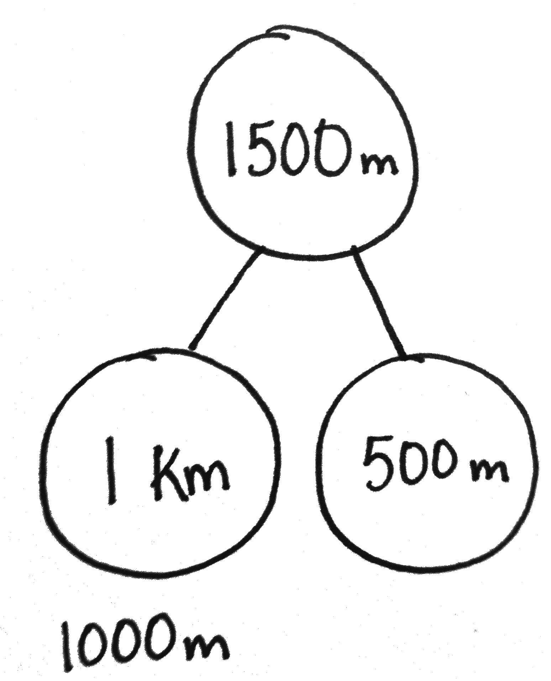
Module Mathematics in Practice
500 m
Notes:
Here is a fluency that we created, modeling after the previous fluency, to remind you of the kilometer to meter conversion in preparation for our discussion with the mathematics of this module. Remember fluencies are a wonderful and easy tool to revise for the needs in your classroom for purposes of review.
T: (Project a number bond with 1,500 meters written as the whole and 1 kilometer as one of the parts.) How many meters are in 1 kilometer? (1,000 meters)
T: (Beneath 1 km, write 1000 m.) On your white boards, write a number bond filling in the missing part. (Write a number bond with a whole of 1,500 m and parts 1 km and 500 m.)
Repeat process with wholes of 2800 m, 5200 m, 6,635 m, 2050 m, and 4007 m.
Note: Bring to life the prior conversations from the Module Overview and terminology as you demonstrate a number bond and mixed units.
TIME ALLOTTED FOR THIS SLIDE:
2 minutes
MATERIALS NEEDED:
Personal White Boards

Slide 13
Module Assessments
Complete the End of Module Assessment.
Label each problem with the standard it assesses.
Notes:
Now that you know the focus of the module, let’s examine how students will be assessed on their mastery of these skills and concepts. Turn to the first page of the assessment. Consider each item and determine which standards are being addressed and how.
Principals- Consider the implications of this data (quantitative and qualitative) for the professional development needs of the staff, the resources needed to support struggling students, the conversations held in the data analysis meetings. You will want to make notes on ideas you have as a result of your observations to use in later sessions tomorrow.
Allow participants 10 minutes to complete this standards-alignment assessment. Then facilitate a discussion of the ways in which this assessment task measures the skills and understanding that are addressed in this module. Have participants identify the ways in which a strong understanding of the assessment prepares educators to implement the lessons in this module.
TIME ALLOTTED FOR THIS SLIDE:
10 minutes
MATERIALS NEEDED:
Module Assessment and Module Standards

Slide 14
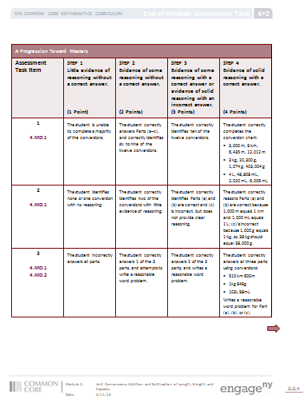
Module Assessments: Rubrics
Notes:
Read through the top level of the rubric. Note how the rubric is structured with the levels of performance described for each assessment question.
Take 2 minutes and read through the rubric.
TIME ALLOTTED FOR THIS SLIDE:
3 minutes
MATERIALS NEEDED:
End of Module Assessment Rubric

Slide 15
Module Assessments: Scoring Sample Student Work
Score the assessment assigned to your table using the Rubric.
Discuss the scores at your table.
How can the Levels of Performance and the Step descriptions assist a teacher in assessing student understanding?
Notes:
(Click to advance the bullet.) There are 3 sample student assessments. Each table has a post-it with the name Mary, Kelly, or Erin. Please read through the responses for your student and score them using the Rubric. Each question can have a value of 1, 2, 3, or 4. Use about 4 minutes.
(Click to advance the bullet.) Once everyone at your table has scored the sample assessment, discuss the scores at your table. Remember to use clear evidence from the student work in conjunction with the Rubric’s Levels of Performance and the Step descriptions. Use about 3 minutes.
Ask for the scores of each problem for each assessment. Talk through any large discrepancies shortly, keeping the pace of the presentation. Use about 3 minutes.
(Click to advance the bullet.) The discuss how this Rubric can assist teachers in assessing student understanding.
TIME ALLOTTED FOR THIS SLIDE:
10 minutes
MATERIALS NEEDED:
End of Module Assessment Rubric

Slide 16
Module Assessments: Reflection
How could this rubric be used?
Notes:
TIME ALLOTTED FOR THIS SLIDE:
3 minutes
MATERIALS NEEDED:
X
How could this rubric be used to give students feedback on complex tasks?

Slide 17
AGENDA
Study of the Progression Document
Examination of Module Overview and Assessments
Exploration of Selected Lessons
Bringing the Module to Life
Notes:
Welcome back! Now that we are familiar with the module overview and assessments, let’s begin our examination of the topics and lessons.
TIME ALLOTTED FOR THIS SLIDE:
1 minute
MATERIALS NEEDED:
X

Slide 18
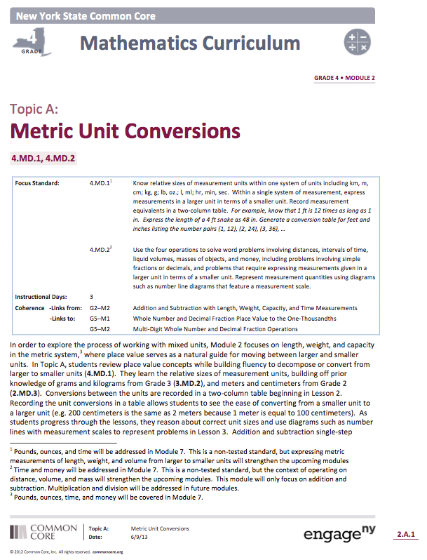
Topic Openers
Read the descriptive narrative.
Make note of important information that will help educators implement these lessons.
Notes:
Within a given topic, the lessons work together to build strong understanding of a set of related concepts.
(CLICK TO ADVANCE FIRST BULLET) Take 5 minutes to review both Topic Openers. Be prepared to share insights to the group about the topic openers that you read.
(CLICK TO ADVANCE SECOND BULLET) As you read, mark important information that will help educators implement these lessons. Again, you might choose to use a symbol or series of symbols, or you might simply highlight essential portions.
Allow 5 minutes for participant to read and discuss the topic openers. Then have volunteers from each table report to the group on each of the topic openers sequentially, so that a clear picture of the progression of the module unfolds.
NOTE TO FACILITATOR: Consider assigning topics to the tables ahead of time in order to simplify this process. You might do this just by putting a sticky note with the letter assignment on each table basket. Specify whether participants should work independently, with a partner, or as a table.
TIME ALLOTTED FOR THIS SLIDE:
6 minutes
MATERIALS NEEDED:
Grade 4 Module 2 Topic Openers A and B

Slide 19
Topic Openers
How does Topic A lay the foundation for the work in Topic B?
How do Topic Openers A and B allow teachers to understand the vertical alignment amongst grade levels?
How are the Topic Openers useful as a planning tool for this model?
Notes:
Turn and talk with others at your table about the collection of topic openers. Share your observations and ask them to do the same.
Allow 3 minutes for participants to turn and talk about the topic openers. Then facilitate a whole-group discussion about the following questions:
How does Topic A lay the foundation for the work in Topic B? (Topic A addressed the relationship between the different units and tools for modeling conversions. Topic B applies the conversions and shares the connections they have to place value.)
How do Topic Openers A and B allow teachers to understand the vertical alignment amongst grade levels? (Coherence Links list the connections to prior and future modules. Measurement lessons are not typically thought to link to a place value module, such as to G5-M1 and M2.)
How are the Topic Openers useful as a planning tool for this module? (The narrative takes the information from the overview and zooms in to summarize the topic and lay a clear outline of a set of lessons.)
TIME ALLOTTED FOR THIS SLIDE:
5 minutes
MATERIALS NEEDED:
X

Slide 20
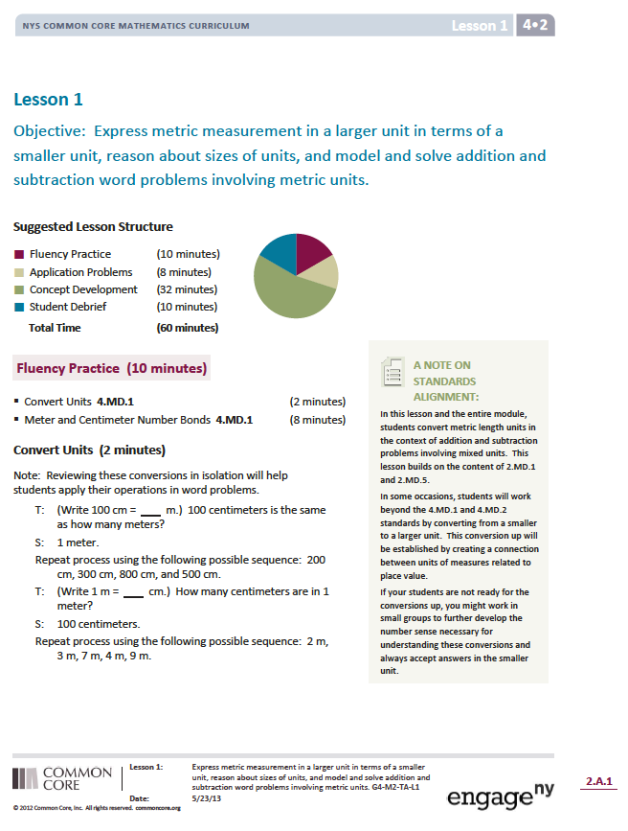
Lesson Study
Fluency Practice
Application Problems
Concept Development
Student Debrief
Notes:
Now that we’ve used the Topic Openers to gain more specific understanding of this module, let’s move on to examine the lessons from the module. For those of you may not be familiar with A Story of Units, I’d like to point out that most lessons are comprised of four components: Fluency Practice, Application Problem, Concept Development, and the Student Debrief. These components work together to achieve rigor and lead toward the culminating assessment.
Note that within the Concept Development students are given a time frame to work on the Problem Set. These problems are revisited during the Debrief portion in order to help students see patterns in the mathematics and think more deeply about their work.
TIME ALLOTTED FOR THIS SLIDE:
1 minute
MATERIALS NEEDED:
X

Slide 21
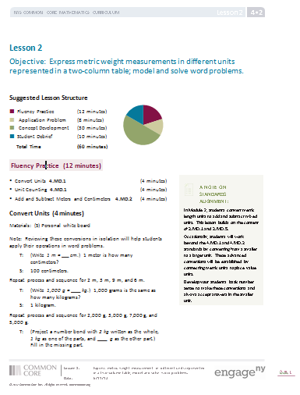
Lesson 1-3 Unit conversions with metric measurements of length, weight, and capacity.
Application of Module 1: addition and subtraction; algorithms and strategies
New Terms: kilometer, milliliter, mass, mixed units
2-column table used to show conversions
Number line used as a strategy for counting up or down.
Simplifying strategies are encouraged.
Standards alignment
Notes:
We selected all the lessons in this module to demonstrate how the lessons build on each other.
Lessons1-3
Revisit the idea that this module is an opportunity to apply addition and subtraction algorithms and strategies, including tape diagrams for modeling word problems.
Talk briefly about the terminology introduced in this module and the representations used to work with metric conversions.
2 column tables allow students to see side-by-side conversions for each type of measurement.
Number lines are used to align mixed units and the smaller unit when adding and subtracting.
Simplifying strategies are ways of solving a problem that may not require the use of an algorithm. Think of these as written representations of mental math.
Standards alignment: Discuss how note on page 1 of lessons 1-3 does mention extending past the G4 standard of converting larger to smaller units. It will be discussed later how to revise the lessons to only match the G4 standard.
TIME ALLOTTED FOR THIS SLIDE:
3 minutes
MATERIALS NEEDED:
X

Slide 22
Lesson 1
2- column tables
Distance
km | m
1
2
3
7
10
Notes:
Lesson 1 is the first experience students have with converting metric units. We use what they know from Grade 2 with centimeters and meters and teach the new vocabulary word, kilometer, by asking students to think about lengths of familiar objects like the width of a door, width of a staple, or the distance around a soccer field 4 times.
Next students compare sizes and note the relationship between meters and kilometers using conversion equivalencies, represented in a 2-column table.
(CLICK TO ADVANCE THE TABLE.) Take 1 minute to complete this table.
(CLICK TO ADVANCE EACH ANSWER IN THE TABLE.) Review the answers with participants.
Think about how this table reflects 4.MD.1. (It states explicitly to use a table to record measurement equivalencies.)
How could you make the table more complex? (Replace a kilometer measurement with a blank, but give the meter measurement for one or more rows.)
How could you provide more scaffolding? (Give an example for the first, and possibly the second, rows.)
TIME ALLOTTED FOR THIS SLIDE:
4 minutes
MATERIALS NEEDED:
X

Slide 23
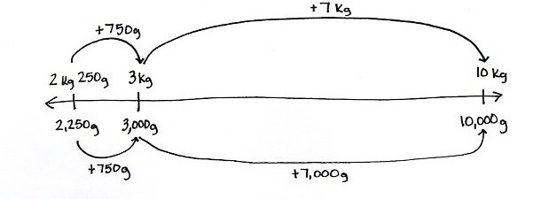
Lesson 2
10 kg – 2 kg 250g
Number Lines
Notes:
Using a number line reinforces the equivalencies between two measurement unit, for example grams and kilograms. This number line shows 10 kilograms is equivalent to 10,000 grams. A number line can be used for a counting up or counting down strategy.
(CLICK TO ADVANCE THE SLIDE.) This number line shows a counting up strategy. The student starts with 2 kg 250 g or 2,250 grams.
(CLICK TO ADVANCE THE SLIDE.) Mental math tells us only 750 more grams are needed to reach a nearest unit that is easier to count with, like 3 kilograms or 3,000 grams.
(CLICK TO ADVANCE THE SLIDE.) Mental math again tells us only 7 kilograms or 7,000 grams are needed to reach the original amount of 10 kilograms.
(CLICK TO ADVANCE THE SLIDE.) Students add the partials sums to find the difference between 10 kilograms and 2 kilograms 250 grams.
TIME ALLOTTED FOR THIS SLIDE:
2 minutes
MATERIALS NEEDED:

Slide 24
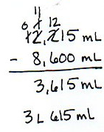
Lesson 3
Label the strategy modeled in each solution.
Problem 1:
Algorithm with mixed units
Algorithm using smaller units
Special Strategy, one unit at a time
Special Strategy, number line
Special Strategy, counting up
Notes:
Students come prepared with many strategies, which can be shared during a debrief or within the context of a problem solving lesson, like lessons 1 through 3.
Here are 5 different ways we have modeled within the lessons on how students may solve addition and subtraction problems with metric units.
(CLICK TO ADVANCE THE SLIDE.) Label the strategies modeled in each solution.
Provide a brief discussion where participants share out the strategy modeled.
(CLICK TO ADVANCE THE SLIDE.) The answer is “Algorithm using smaller units.”
This may be the preferred method of students for solving. They are recently familiar with the subtraction algorithm from Module 1.
TIME ALLOTTED FOR THIS SLIDE:
2 minutes
MATERIALS NEEDED:
Handout: 5 solutions to solving a metric subtraction problem.

Slide 25
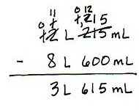
Lesson 3
Label the strategy modeled in each solution.
Problem 2:
Algorithm with mixed units
Algorithm using smaller units
Special Strategy, one unit at a time
Special Strategy, number line
Special Strategy, counting up
Notes:
Students come prepared with many strategies, which can be shared during a debrief or within the context of a problem solving lesson, like lessons 1 through 3.
Here are 5 different ways we have modeled within the lessons on how students may solve addition and subtraction problems with metric units.
Label the strategies modeled in Problem 2.
Provide a brief discussion where participants share out the strategy modeled.
(CLICK TO ADVANCE THE SLIDE.) The answer is “Algorithm with mixed units.”
This may also be the preferred method of students for solving. They are recently familiar with the subtraction algorithm from Module 1.
TIME ALLOTTED FOR THIS SLIDE:
2 minutes
MATERIALS NEEDED:
Handout: 5 solutions to solving a metric subtraction problem.

Slide 26
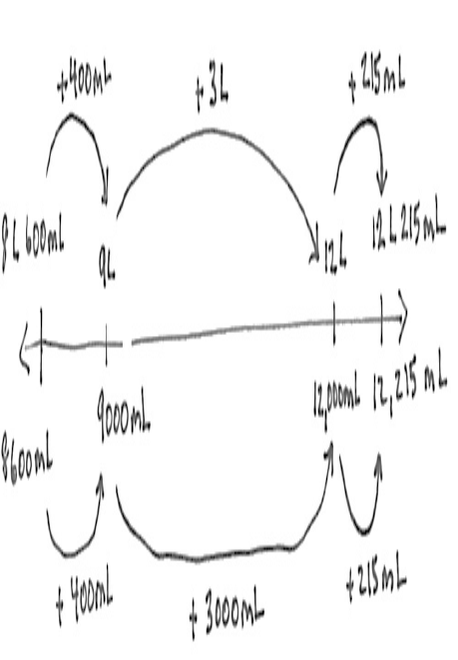
Lesson 3
Label the strategy modeled in each solution.
Problem 3:
Algorithm with mixed units
Algorithm using smaller units
Special Strategy, one unit at a time
Special Strategy, number line
Special Strategy, counting up
Notes:
Students come prepared with many strategies, which can be shared during a debrief or within the context of a problem solving lesson, like lessons 1 through 3.
Here are 5 different ways we have modeled within the lessons on how students may solve addition and subtraction problems with metric units.
Label the strategies modeled in Problem 3.
Provide a brief discussion where participants share out the strategy modeled.
(CLICK TO ADVANCE THE SLIDE.) The answer is “Special strategy, number line.”
TIME ALLOTTED FOR THIS SLIDE:
2 minutes
MATERIALS NEEDED:
Handout: 5 solutions to solving a metric subtraction problem.

Slide 27
Lesson 3
Label the strategy modeled in each solution.
Problem 4:
Algorithm with mixed units
Algorithm using smaller units
Special Strategy, one unit at a time
Special Strategy, number line
Special Strategy, counting up
Notes:
Students come prepared with many strategies, which can be shared during a debrief or within the context of a problem solving lesson, like lessons 1 through 3.
Here are 5 different ways we have modeled within the lessons on how students may solve addition and subtraction problems with metric units.
Label the strategies modeled in Problem 4.
Provide a brief discussion where participants share out the strategy modeled.
(CLICK TO ADVANCE THE SLIDE.) The answer is “Special strategy, counting up.”
TIME ALLOTTED FOR THIS SLIDE:
2 minutes
MATERIALS NEEDED:
Handout: 5 solutions to solving a metric subtraction problem.

Slide 28
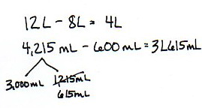
Lesson 3
Label the strategy modeled in each solution.
Problem 5:
Algorithm with mixed units
Algorithm using smaller units
Special Strategy, one unit at a time
Special Strategy, number line
Special Strategy, counting up
Notes:
Students come prepared with many strategies, which can be shared during a debrief or within the context of a problem solving lesson, like lessons 1 through 3.
Here are 5 different ways we have modeled within the lessons on how students may solve addition and subtraction problems with metric units.
Label the strategies modeled in Problem 5.
Provide a brief discussion where participants share out the strategy modeled.
(CLICK TO ADVANCE THE SLIDE.) The answer is “Special strategy, one unit at a time.”
Remember students are creative in their methods for solving. Teachers will see different methods than the ones presented in the lessons. Teachers can decide what methods are best to use as direct instruction within each lesson. Perhaps one room is ready to investigate multiple means of special strategies, where another classroom is ready to explore only the algorithms in depth.
TIME ALLOTTED FOR THIS SLIDE:
2 minutes
MATERIALS NEEDED:
Handout: 5 solutions to solving a metric subtraction problem.

Slide 29
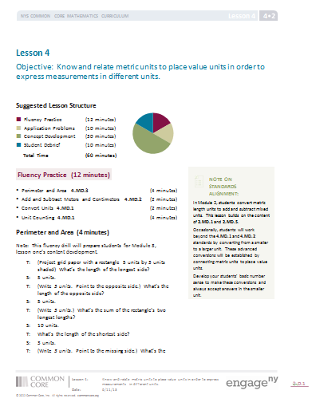
Lesson 4: Know and relate metric units to place value units in order to express measurements in different units.
Connect metric units to place value units.
Compare and order measurements
Notes:
By the time the students get to Lesson 4 they have had some experience with the patterns in metric conversion. Lesson 4 helps the students connect these patterns to what they know about place value. The students then use their place value understanding to compare and order measurements.
TIME ALLOTTED FOR THIS SLIDE:
1 minute
MATERIALS NEEDED:
Lesson 4

Slide 30
Lesson 4
What do you notice about the relationship between
grams and kilogram?
1 kilogram = 1,000 grams
Write your answer as an equation.
1 kg = 1,000 x 1g
Notes:
So what do you notice about the relationship between grams and kilograms (write on whiteboards)
Now let’s take that information a step farther. Write your answer as an equation. (on whiteboards)
Repeat writing an equation to show the relationship between
Kilometer and meter
Liter and milliliter
Thousand and one
TIME ALLOTTED FOR THIS SLIDE:
4 minutes
MATERIALS NEEDED:
Lesson 4
Personal white boards

Slide 31
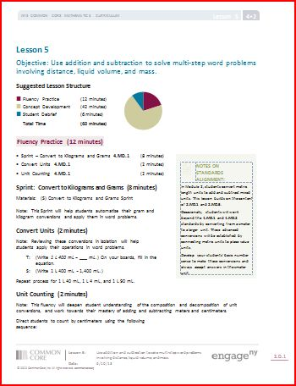
Lesson 5: Use addition and subtraction to solve multi-step word problems involving distance, liquid volume, and mass.
Apply what students learned in Lessons 1-4
Structured to use the Problem Set within the Concept Development
Utilize the RDW strategy
Notes:
Lesson 5 is the culminating lesson of Module 2. Completion of the lesson requires application of the concepts developed during Lessons 1-4. Lesson 5 is designed such that the Problem Set is used as part of the Concept Development. Students complete Problems 1-4 in a structured way during the Concept Development and then complete Problems 5 and 6 independently.
Discuss structure of the lesson (RDW). (3 min.)
TIME ALLOTTED FOR THIS SLIDE:
3 minutes
MATERIALS NEEDED:
Lesson 5

Slide 32
Lesson 5:
Problem Set- Problem 1
The potatoes Beth bought weighed 3 kilograms 420 grams. Her onions weighed 1050 g less than the potatoes. How much did the potatoes and onions weigh altogether?
Notes:
Allow 2 minutes to draw a model of Problem 1.
Allow 1 minute for participants to share their models with one other person. Were the models the same?
Allow 2 minutes for two participants to share their models with the whole group. Give time for others to ask questions.
Allow 2 minutes to solve the problem and to discuss prior knowledge needed to solve the problem. How does it build from prior lessons?
TIME ALLOTTED FOR THIS SLIDE:
7 minutes
MATERIALS NEEDED:
Lesson 5

Slide 33
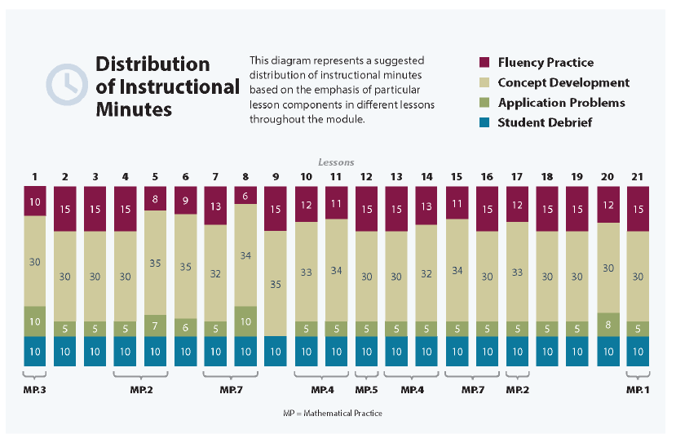
Balanced, Rigorous Instruction
Notes:
All four lesson components provide opportunities to nurture the Standards of Mathematical Practice and are critical in maintaining the balance of rigor. Certainly educators will need to make instructional choices when implementing these lessons, but attention to each component is key.
TIME ALLOTTED FOR THIS SLIDE:
1 minute
MATERIALS NEEDED:
X

Slide 34
Biggest Takeaways
How do these lessons compare to your past experiences with mathematics instruction?
Turn and talk with a partner at your table about your reflections.
Notes:
Take one minute to reflect on this session. . How do these lessons compare to your past experiences with mathematics instruction? How would you adapt/enhance your answers to the questions on the Module Overview Handout after our Lesson Study work? What are the implications for the supports and resources your colleagues will need to fully implement this curriculum with fidelity? Jot down your thoughts. Then you will have time to share your thoughts
Give participants 1 minute for silent, independent reflection.
(Click to advance to the next bullet.) Turn and talk with a partner at your table about your reflections.
Allow 2 minutes for participants to turn and talk about their reflections. Then, facilitate a discussion that leads into the key points on the next slide.
TIME ALLOTTED FOR THIS SLIDE:
4 minutes
MATERIALS NEEDED:
X

Slide 35
Key Points
Measurement provides a context to apply addition and subtraction skills and strategies.
Measurement provides a context to strengthen place value patterns and number theory.
Students are encouraged to track their thinking through written work (simplifying strategies vs. mental math).
Notes:
Let’s review key points from our examination of these lessons:
TIME ALLOTTED FOR THIS SLIDE:
1 minute
MATERIALS NEEDED:
X

