Slide 1
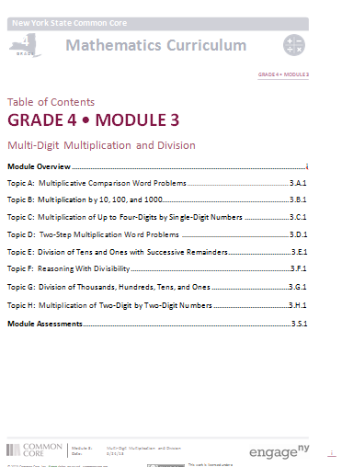
Module 3
Multi-Digit Multiplication and Division
Notes:
Module 3 is an in depth focus on multiplication and division. Although Grade 4 students are not required to use the algorithm, students are slowly introduced to the algorithm for multiplication and division. Before students learn the algorithms, models such as place value disks and the area model are used to represent the mathematics. Students build upon their Grade 3 knowledge of multiplication and division in this module, using the facts and experience with “groups of” to multiply up to 4-digit by 1 digit and 2 digit by 2-digit numbers and divide up to 4 digit by 1 digit numbers.
TIME ALLOTTED FOR THIS SLIDE:
1 minutes
MATERIALS NEEDED:
X

Slide 2
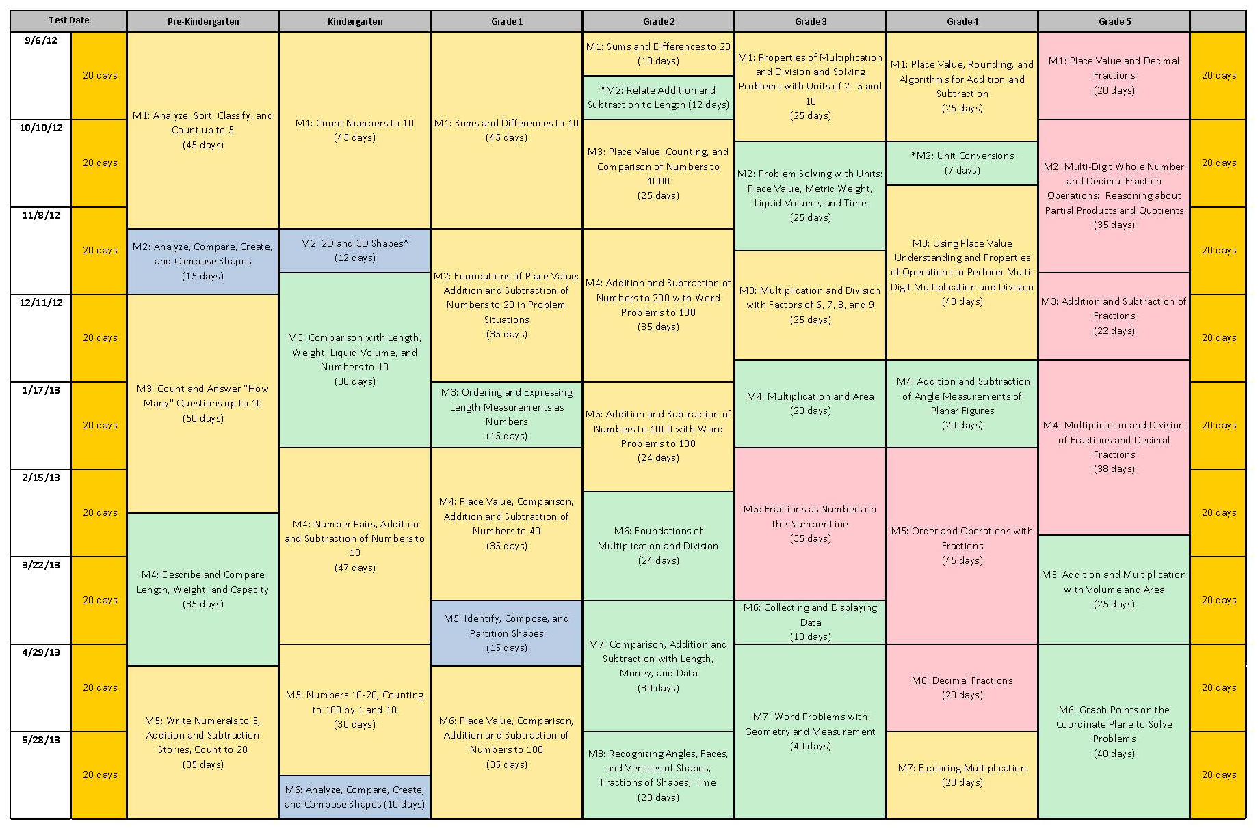
Notes:
This curriculum map is found on page 3 of A Story of Units: A Curriculum Overview for Grades P-5. For those of you who participated in the May NTI, you’ll recall that we deeply examined the first module of Grade 4. In this session, we will continue that deep examination of the next module.
NOTE TO FACILITATOR: Take a moment to share briefly the following information about this module.
What is the title of this module? (Multi-Digit Multiplication and Division – the title has been revised to better reflect the work on the module.)
How many instructional days are allotted for this module? (43)
What modules, prior to this one, might prepare students for success in this module? (G3 M1, 3, and 4)
What modules, beyond this one, might build on the concepts of this module? (G5 M1 & M2, 4 and 5)
TIME ALLOTTED FOR THIS SLIDE:
1 minutes
MATERIALS NEEDED:
Curriculum Map

Slide 3
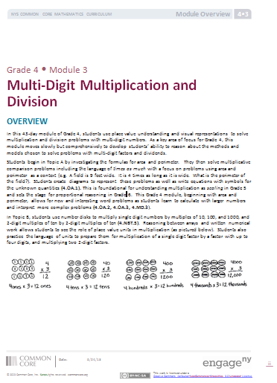
Module 3 Overview
Read the Module Overview independently.
Mark important information that will help the implementation of this module.
Notes:
TIME ALLOTTED FOR THIS SLIDE:
8 minutes
MATERIALS NEEDED:
G4 M3 Module Overview
Each Overview contains multiple components to help educators understand more clearly the focus of the module. These components include:
Descriptive narrative
Distribution of Instructional Minutes
Focus Grade Level Standards, Foundational Standards, and Standards for Mathematical Practices
Overview of Module Topics and Lesson Objectives
Terminology
Suggested Tools and Representations
Scaffolds
Assessment Summary
(CLICK TO ADVANCE FIRST BULLET) Take 8 minutes to read the Module Overview independently.
(CLICK TO ADVANCE SECOND BULLET) As you read, mark important information that will help build understanding of the content in preparation to implement this module. You might do so using a symbol, such as a star, or by highlighting essential portions.

Slide 4
Module 3 Overview
Re-read the Overview to find your table’s assigned Topic
Using the Topic Analysis Handout, complete the focus question for your Topic and list the standards.
Column 1 - Focus questions
Column 2 - Answers
Column 3 - Standards addressed
Notes:
To get a more in depth look at the module, each table has a post-it note with a letter written on it. This letter is your table’s assigned Topic to review.
Using your Topic Analysis Handout, complete the focus questions for your Topic and list the standards that fit into your Topic.
The first column of the handout has the focus questions. Write your responses in the 2nd column. The 3rd column provides a space to record the relevant standards.
Be prepared to share your responses with the group.
TIME ALLOTTED FOR THIS SLIDE:
3 minutes
MATERIALS NEEDED:
G4 M3 Module Overview
Module 3 Topic Analysis Handout

Slide 5
Module 3 Topic A
Multiplicative Comparison Word Problems
What context will students use to explore multiplicative comparisons?
What does Topic A lay the foundation for in upcoming year?
The width of David’s tent is 5 feet. The length is twice the width. David’s rectangular air mattress measures 3 feet by 6 feet. If David puts the air mattress in the tent, how many square feel of floor space will be available for the rest of this things?
Notes:
What context will students use to explore multiplicative comparisons? (Area and perimeter.)
What does Topic A lay the foundation for in upcoming year? (Grade 5 scaling and Grade 6 proportional reasoning.)
Possible answer to word problem: 32 square feet of space will be left.
TIME ALLOTTED FOR THIS SLIDE:
3 minutes
MATERIALS NEEDED:
G4 M3 Module Overview
Module 3 Topic Analysis Handout

Slide 6
Module 3 Topic B
Multiplication by 10, 100, and 1000
Why are students asked to reason between number disks and numerical work?
Topic B lays the foundation for which upcoming Module 3 Topics?
Brianna bought 3 packs of balloons for a party. Each pack had 60 balloons. How many balloons does Brianna have?
Notes:
Why are students asked to reason between number disks and numerical work? (Allows students to see the role of place value units in multiplication and prepares them for the language of multiplying units together.)
Topic B lays the foundation for which upcoming Module 3 Topics? (Topics C, D, and H)
Possible answer to word problem: Brianna has 180 balloons.
TIME ALLOTTED FOR THIS SLIDE:
3 minutes
MATERIALS NEEDED:
G4 M3 Module Overview
Module 3 Topic Analysis Handout

Slide 7
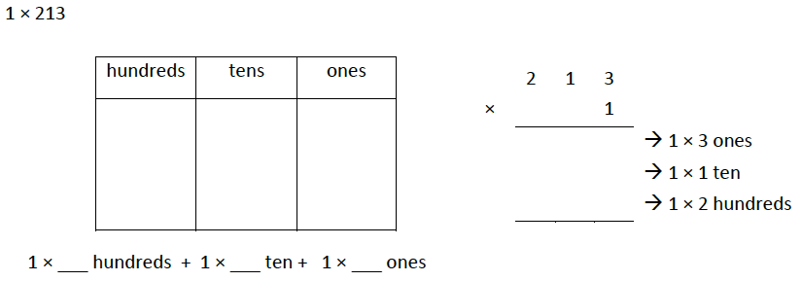
Module 3 Topic C
Multiplication of Up to Four-Digit by Single-Digit Numbers
What methods will students use to record their work in Topic C?
What clarification does the footnote 1 provide for the multiplication algorithm?
Notes:
What methods will students use to record their work in Topic C? (Distributive property, number disks, partial products, standard algorithm, area model.)
What clarification does the footnote 1 provide for the multiplication algorithm? (The standard algorithm for multiplication is not expected to be mastered until Grade 5 – 5.NBT.5. Students are introduced, being supported by place value strategies to prepare them from Grade 5 multiplication.)
Answer to problem:
2×2 hundreds + 2×1 ten + 2×3 ones
4 hundreds + 2 tens + 6 ones
400 + 20 + 6
426
TIME ALLOTTED FOR THIS SLIDE:
3 minutes
MATERIALS NEEDED:
G4 M3 Module Overview
Module 3 Topic Analysis Handout

Slide 8
Module 3 Topic D
Two-Step Multiplication Word Problems
What is the purpose of Topic D?
What operations will students be able to use to solve the problems?
In one month, Charlie read 814 pages. In the same month his mom read 4 times as many pages as Charlie, and that was 143 pages more than Charlie’s dad read. What was the total number of pages read by Charlie and his parents?
Notes:
What is the purpose of Topic D? (Students apply multiplication to solve multi-step word problems and multiplicative comparison problems.)
What operations will students be able to use to solve the problems? (Addition, Subtraction and Multiplication.)
Possible answer to word problem: Charlie and his parents read 7,183 pages in one month.
TIME ALLOTTED FOR THIS SLIDE:
3 minutes
MATERIALS NEEDED:
G4 M3 Module Overview
Module 3 Topic Analysis Handout

Slide 9
Module 3 Topic E
Division of Tens and Ones with Successive Remainders
Which foundational concepts does Topic E build upon?
What clarifications are provided by footnotes 2 and 3?
22 ÷ 5
Solve using an array and an area model.
Notes:
Which foundational concepts does Topic E build upon? (Types of division – groups size unknown/partitive and size of group unknown/measurement.)
What clarifications are provided by footnotes 2 and 3? (#2: remainders must be interpreted correctly. 7÷3 is not equal to 5÷2 since their answer is 2r1. The amount is different. #3: The division algorithm fluency is not expected until Grade 6, but is introduced alongside models to provide adequate practice.)
Answer to problem:
4 with a remainder of 2
*Care must be taken with a remainder. A statement should be given as a response to show the distinction between a quotient and a remainder.
*Only can the ‘r’ form of a remainder (2r1) be shown when using the algorithm.
*An area model breaks down for division when there is a remainder, shown in the image above.
*Use multiplication to check your work. Number bonds can aid as a model.
TIME ALLOTTED FOR THIS SLIDE:
3 minutes
MATERIALS NEEDED:
G4 M3 Module Overview
Module 3 Topic Analysis Handout

Slide 10
Module 3 Topic F
Reasoning with Divisibility
How is Topic F connected to the work of this module?
Topic F provides the foundation for which upcoming Module 3 Topic?
Is the following statement true?
Any number that has 8 as a factor also has 2 and 4 as a factor.
Prove your answer.
Notes:
How is Topic F connected to the work of this module? (Factors and multiples prepare students for division of larger dividends.)
Topic F provides the foundation for which upcoming Module 3 Topic? (Topic G)
Answer to problem:
True. 2 and 4 are factors of 8.
Also:
Numbers with 8 as a factor: 8, 16, 24, 32, 40.
8÷2=4 8÷4=2
16÷2=8 16÷4=4
24÷2=12 24÷4=6
32÷2=16 32÷4=8
40÷2=20 40÷4=10
TIME ALLOTTED FOR THIS SLIDE:
3 minutes
MATERIALS NEEDED:
G4 M3 Module Overview
Module 3 Topic Analysis Handout

Slide 11
Module 3 Topic G
Division of Thousands, Hundreds, Tens and Ones
Topic G builds upon the work of which Topics that came earlier in the Module?
What is the purpose of using number disks in this Topic?
Use number disks to model this problem:
Zach filled 581 one-liter bottles of apple cider.
He distributed the bottles to 4 stores.
How many liter bottles will each store receive?
Will there be any bottles left over?
If so, how many?
Notes:
Topic G builds upon the work of which Topics that came earlier in the Module? (Topic B, E and F.)
What is the purpose of using number disks in this Topic? (Visually supportive for decomposition alongside the the algorithm.)
Answer to problem: Each store will receive 145 liter bottles. One bottle will be left over.
*Tape diagrams model word problems. Division tape diagrams with remainders will need to be redrawn. For this problem, students initially draw 1 bar representing 581 bottles, and divide the bar into 4 parts. But 581 does not divide equally into 4 parts, so we must create a 5th part to the bar. We erase our old lines, and draw new ones after the algorithm or model shows us the remainder. The remainder in the tape diagram is shaded and labeled below, as shown in the model above.
TIME ALLOTTED FOR THIS SLIDE:
3 minutes
MATERIALS NEEDED:
G4 M3 Module Overview
Module 3 Topic Analysis Handout

Slide 12
Module 3 Topic H
Multiplication of Two-Digit by Two-Digit Numbers
Why is the work of Topic H placed last in this Module?
What should students understand about partial products written vertically?
Use the area model to solve
23 × 15.
Notes:
Why is the work of Topic H placed last in this Module? (Most abstract and students have had more time to solidify their understanding of area models. Also, placing 2-by-2 digit multiplication before 1-digit divisors does not allow students to connect 1 digit multipliers and their models.)
What should students understand about partial products written vertically? (They connect explicitly to the distributive property. Partial products can be 4 or 2 numbers.)
Answer to problem: 345
*Shading the lower half of the area model provides a visual support for seeing the new addition to the area model for multiplication. Solving 5 times 23 was address in Topic C. The new complexity is 10 times 23, which is represented in the shaded portion of the area model. Using the distributive property, students can find the answer using the area model, as well as multiplying with partial products or the standard algorithm
TIME ALLOTTED FOR THIS SLIDE:
3 minutes
MATERIALS NEEDED:
G4 M3 Module Overview
Module 3 Topic Analysis Handout

Slide 13
AGENDA
Study of the Progression Document
Examination of Module Overview and Assessments
Exploration of Selected Lessons
Bringing the Module to Life
Notes:
Now that we’ve examined all aspects of the module, let’s consider concerns regarding implementation and differentiation. For this discussion, we ask that you re-group yourselves so that you are sitting with colleagues who share similar roles.
NOTE TO FACILITATOR: Assist the participants in regrouping within the room by professional role.
TIME ALLOTTED FOR THIS SLIDE:
1 minute
MATERIALS NEEDED:

Slide 14
Another Look
Given your role, consider the next steps you would need to take to move forward with this work.
Jot down a mini action plan of 3-5 steps.
Notes:
Give participants 4 minutes to create a mini-action plan independently. Participants might come up with any of the following:
Teacher- time to read through the modules, discuss the lessons with a co-teacher, solve the problems, find/order materials, highlight key questions
School Leader- identify areas that may need the most support, consider how to bridge the gaps in student understanding, identify what teachers need to know to effectively implement the modules, find/order materials
Principal- provide time for teachers to plan, facilitate discussions around modules to encourage team problem solving, consider how the module impacts the way teachers demonstrate lesson planning, consider how this impacts what will been seen during an observation, organize/support the process of gathering/ordering materials
District Leader – provide funding and resources necessary for staff development, curricular materials, and assessment. Consider implications of new curriculum and new tests and prepare stakeholders for change.
BOCES Representative – Identify economies of scale for staff training. Consider implications of new curriculum and new tests and prepare stakeholders for change.
TIME ALLOTTED FOR THIS SLIDE:
5 minutes
MATERIALS NEEDED:

