Slide 1
Tape Diagrams
Sean VanHatten
svanhatten@e2ccb.org
Tracey Simchick
tsimchick@e2ccb.org
Increasing student understanding through visual representation

Slide 2

Morning Session: Progression of Tape Diagrams
  Addition, Subtraction, Multiplication, Division & Fractions
LUNCH: 11:30 AM – 12:30 PM
Afternoon Session: Exploring Tape Diagrams within the Modules
** Norms of Effective Collaboration **

Slide 3

Learning Targets
I understand how mathematical modeling (tape diagrams) builds coherence, perseverance, and reasoning abilities in students
I understand how using tape diagrams shift students to be more independent learners
I can model problems that demonstrates the progression of mathematical modeling throughout the K-5 modules
Notes:
Bullet #2 – RDW – Read, Draw, Write

Slide 4

Opening Exercise …
Directions: Solve the problem below using a tape diagram.
88 children attended swim camp. An equal number of boys and girls attended swim camp. One-third of the boys and three-sevenths of girls wore goggles. If 34 students wore goggles, how many girls wore goggles?
Notes:
We’ll revisit this problem later & give you a solution.
What do you think of it? Complexity? Students? How does it tie into the Shifts and Standards for Math Practice?

Slide 5
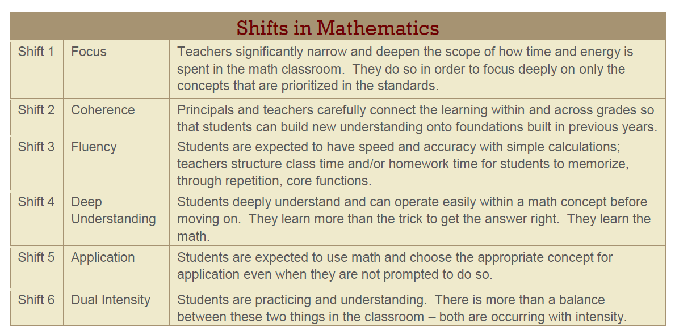
Mathematical Shifts
Fluency + Deep Understanding + Application + Dual Intensity = RIGOR
Notes:
Focus of the Model Method:
-emphasize conceptual understanding
-skills proficiency
-learning of process skills
-metacognition
SHIFTS:
Coherence
Deep Understanding
Application: type of operation, type of model
Dual Intensity: asking themselves the “important questions” “What do I see?” “What do I know?”
STANDARDS for MP:
“Which do you see applying to these problems?”

Slide 6
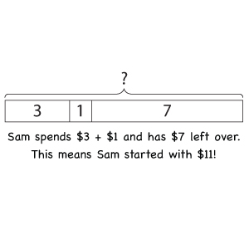
What are tape diagrams?
A “thinking tool” that allows students to visually represent a mathematical problem and transform the words into an appropriate numerical operation
A tool that spans different grade levels

Slide 7
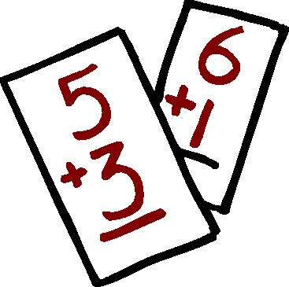
Why use tape diagrams?
Modeling vs. Conventional Methods
A picture (or diagram) is worth a thousand words
Children find equations and abstract calculations difficult to understand. Tape diagrams help to convert the numbers in a problem into pictorial images
Allows students to comprehend and convert problem situations into relevant mathematical expressions (number sentences) and solve them
  Bridges the learning from primary to secondary (arithmetic method to algebraic method)

Slide 8
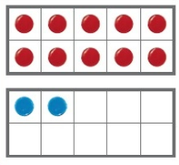
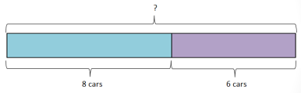

Making the connection …
Concrete
Pictorial
Abstract
9 + 6 = 15

Slide 9
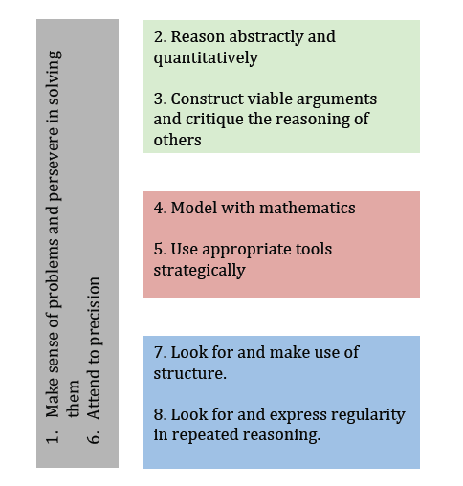
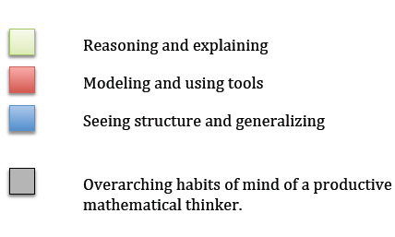
Application
Problem solving requires students
to apply the 8 Mathematical Practices
http://commoncoretools.me/2011/03/10/structuring-the-mathematical-practices/

Slide 10

Background Information
Diagnostic tests on basic mathematics skills were administered to a sample of more than 17,000 Primary 1 – 4 students
These tests revealed:
  that more than 50% of Primary 3 and 4 students performed poorly on items that tested division
  87% of the Primary 2 – 4 students could solve problems when key words (“altogether” or “left”) were given, but only 46% could solve problems without key words
Singapore made revisions in the 1980’s and 1990’s to combat this problem – The Mathematics Framework and the Model Method
The Singapore Model Method, Ministry of Education, Singapore, 2009
Notes:
2nd bullet:
-indicated that primary school students had not been able to master the basic skills of math
-raised concern over low attainment scores and called for a major review/revamping of teaching approaches and instructional materials
What resulted was the Math Framework & Model Method, otherwise known as “Singapore Math”
These instructional techniques are thought of as an innovation in learning and teaching math…this ain’t your mama’s math class, folks
Purpose of the Model Method:
Students learn to solve not only basic word problems, but also open-ended and real-world problems
These problems facilitate both the acquisition and application of basic mathematical skills and concepts as well as the development of mathematical thinking
Distinguishing features of Singapore Math are:
-students draw pictoral representations of math qualities (both known & unknown)
their relationships to one another (part vs whole)
In order to visualize and solve problems for general operations, as well as fractions, ratios, and percents
The framework for drawing diagrams has recently been integrated into algebraic thinking

Slide 11
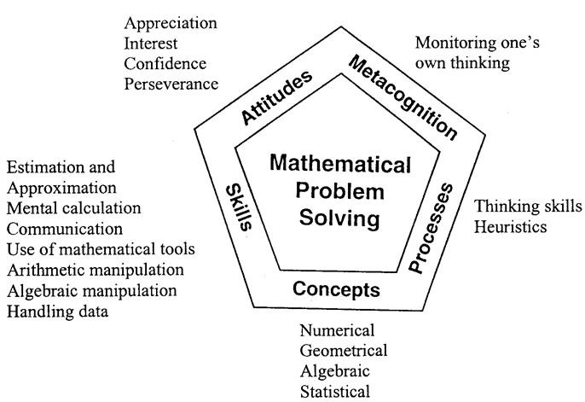
Singapore Math Framework (2000)
Notes:
The development of mathematical problem-solving ability is dependent on five inter-related components: Concepts, Skills, Processes, Attitudes and Metacognition
1) Concepts: cover algebraic, numerical, geometrical, statistical, probabilistic, and analytical concepts
Skills: include procedural skills for numerical calculation, algebraic manipulation, spatial visualization, data analysis, measurement, use of mathematical tools, and estimation
3) Processes: the knowledge (process) skills involved in acquiring and applying mathematical knowledge, including:
reasoning
communication and connections
thinking skills and heuristics
applications and modeling
4) Metacognition: the awareness of, and the ability to control one’s thinking processes, in particular the selection and use of problem-solving strategies
-5) Attitudes: the affective aspects of mathematics learning including:
Beliefs about mathematics and its usefulness
Interest and enjoyment in learning mathematics
Appreciation of the beauty and power of mathematics
Confidence in using mathematics
Perseverance in problem-solving

Slide 12




Progression of Tape Diagrams
Students begin by drawing pictorial models
Evolves into using bars to represent quantities
  Enables students to become more comfortable using letter symbols to represent quantities later at the secondary level (Algebra)
15
7
?

Slide 13
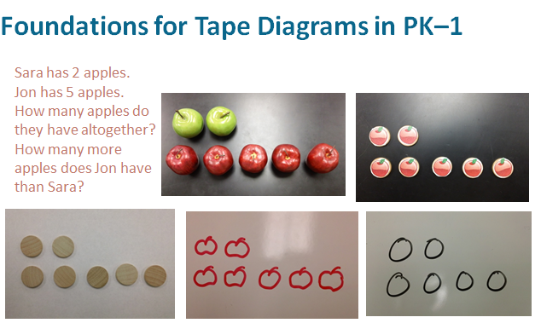
Notes:
Students make use of concrete objects (or picture cut-outs) to make sense of the part-whole and comparison concepts. Then, they progress to drawing rectangular bars as pictorial representations of the models, and use the models to help them solve abstract word problems

Slide 14
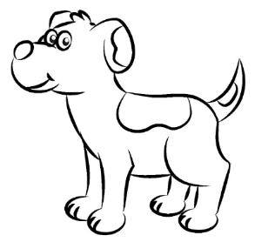

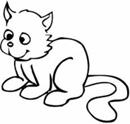
Foundation for tape diagrams:
The Comparison Model – Arrays (K/Grade 1)
Students are asked to match the dogs and cats one to one and compare their numbers.
Example: There are 6 dogs. There are as many dogs as cats. Show how many cats there would be.

Slide 15

The Comparison Model – Grade 1
There are 2 more dogs than cats. If there are 6 dogs, how many cats are there?
There are 6 dogs. There are 2 more dogs than cats. The difference between the two numbers is 2. There are 4 cats.

Slide 16
First Basic Problem Type
Part – Part – Whole
Part + Part = Whole
Whole - Part = Part
8 = 3 + 5
8 = 5 + 3
3 + 5 = 8
5 + 3 = 8
8 – 3 = 5
8 – 5 = 3
5 = 8 – 3
3 = 8 – 5
Number Bond

Slide 17
The Comparison Model – Grade 2
Students may draw a pictorial model to represent the problem situation.
Example:
Notes:
Notice how students are beginning to box in specific portions of their drawings? This leads to the next step, which is a little more abstract.

Slide 18
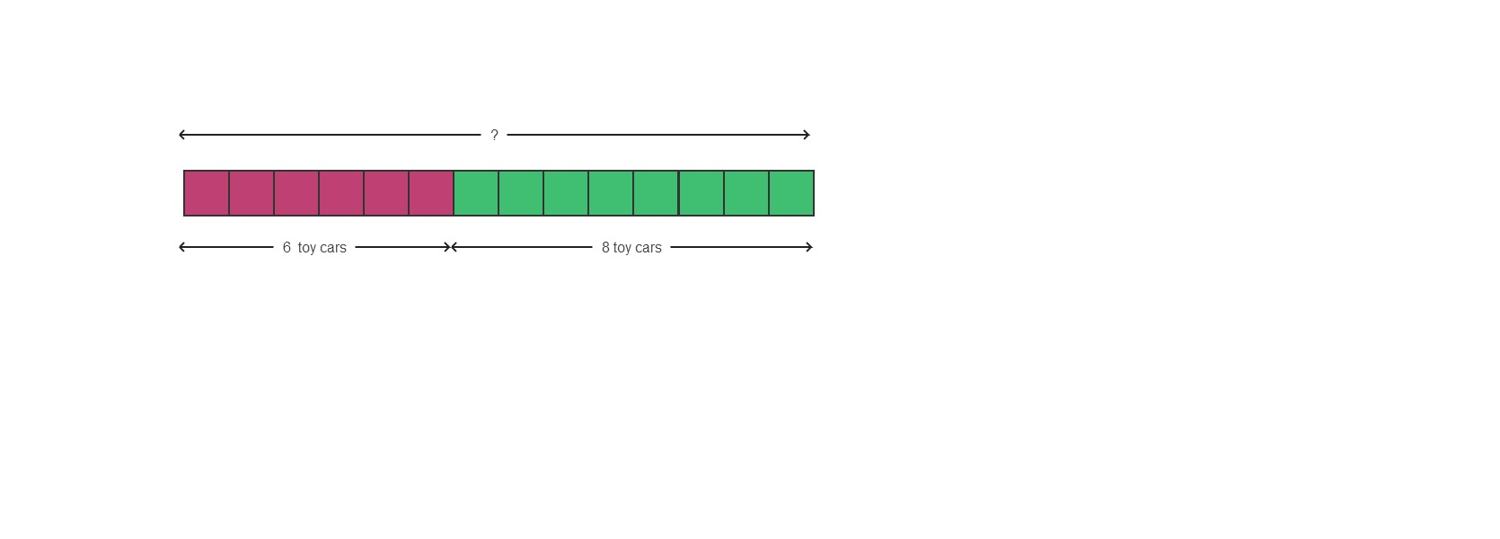
Part-Whole Model – Grade 2
Ben has 6 toy cars. Stacey has 8 toy cars. How many toy cars do they have altogether?
6 + 8 = 14 They have 14 toy cars altogether.
Notes:
Beginning the tape diagram process can sometimes bring rise to student comments of, “But, I can solve this without a diagram.” In general you can convey to students that you are requiring them to explain their work so that you understand their thinking and so that they can share their thinking with their friends and justify their answers. In particular, if you are introducing tape diagrams to a 6th or 7th grade student, you may find it helpful to simply say, “Bear with me – by the end of the week/month/year I promise you will see the value in this process.”

Slide 19
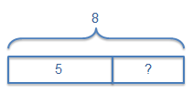
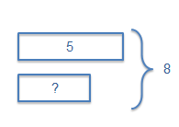
Forms of a Tape Diagram
Part-Whole Model
  Also known as the ‘part-part-whole’ model, shows the various parts which make up a whole
Comparison Model
  Shows the relationship between two quantities when they are compared
Notes:
There are two basic forms of the bar diagram model. The first form is sometimes called the part-whole model; it uses bar segments placed end-to-end. The second form, sometimes called the comparison model, uses two or more bars stacked in rows that are left-justified; in this form the whole is depicted off to the side.
We will reflect on the nuances of the two forms when we have finished this section. For now, you can use whichever works best for you with any given problem.

Slide 20
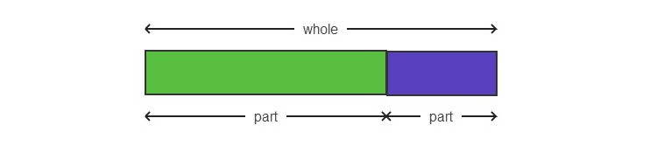
Part-Whole Model
Addition & Subtraction
Part + Part = Whole
Whole – Part = Part

Slide 21
Part-Whole Model
Addition & Subtraction
Variation #1: Given 2 parts, find the whole.
Ben has 6 toy cars. Stacey has 8 toy cars. How many toy cars do they have altogether?
6 + 8 = 14
They have 14 toy cars altogether.

Slide 22
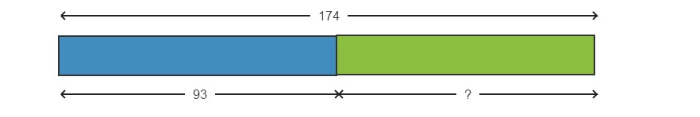
Part-Whole Model
Addition & Subtraction
Variation #2: Given the whole and a part, find the other part.
174 children went to summer camp. If there were 93 boys, how many girls were there?
174 – 93 = 81
There were 81 girls.

Slide 23

Example #1
Shannon has 5 candy bars. Her friend, Meghan, brings her 4 more candy bars. How many candy bars does Shannon have now?
Notes:
(EXAMPLE 1) Let’s consider the first example. (The indented text is to be read as though leading a class of students, thereby modeling for participants how this delivery can be executed in the classroom.)
Read the first sentence with me. “Sara has 5 stamps.”
Let’s draw something. Make your drawing look like mine. (Demonstrate on a flip chart, and then refer to the PPT slide to see completed drawing.)
Read the next sentence with me. “Mark brings her 4 more stamps.”
Let’s draw again. Make your boxes look like mine today.
Read the next sentence with me. “How many stamps does Sara have now?”
Where in my picture can I see how many she has now? (Call on a participant to describe for you where you can see it. Then place the question mark on the diagram.)

Slide 24
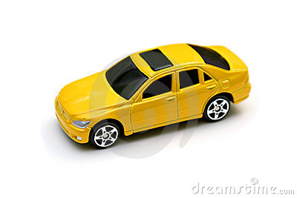
Example #2
Chris has 16 matchbox cars. Mark brings him 4 more matchbox cars. How many matchbox cars does Chris have now?
Notes:
Read the first sentence with me. “Sara has 16 stamps.”
I want to draw something but 16 is a lot of boxes; I’m going to just draw this long rectangle and make a note here that this is 16. Is that okay?
Can you imagine that there are 16 stamps in this row? (Add the label, “Stamps Sara has.”)
Read the next sentence with me. “Mark brings her 4 more stamps.”
If this is 16 stamps, can you imagine how long of a rectangle I should make to show 4 more stamps? Can you see it?
I’m going to start drawing, and you tell me when to stop. (Begin to draw the second bar slowly waiting for participants to say, “stop.” Add the label, “Stamps Mark brings.”)
So this is how we get students to model using the simple, rectangular bar. The approach of imagining the length of the bar, and ‘tell me when to stop’ should be used often until students begin to demonstrate independence in that judgment process.

Slide 25

Example #3
Caleb brought 4 pieces of watermelon to a picnic. After Justin brings him some more pieces of watermelon, he has 9 pieces. How many pieces of watermelon did Justin bring Caleb?
Notes:
A benefit of using rectangular bars without the markings of individual items is that students can now model non-discrete quantities – like measurements of distance or weight – as well as being able to represent unknown quantities.
The next jump in complexity is in moving from a problem where both bar segments represent known quantities and the unknown is the total or the difference, to a problem where the total or difference is known and the bar is representing an unknown.
(EXAMPLE 3)
Go ahead and try depicting this problem. (Allow a moment for participants to work.)
How does your depiction compare to this one? Are we all on the same page?

Slide 26
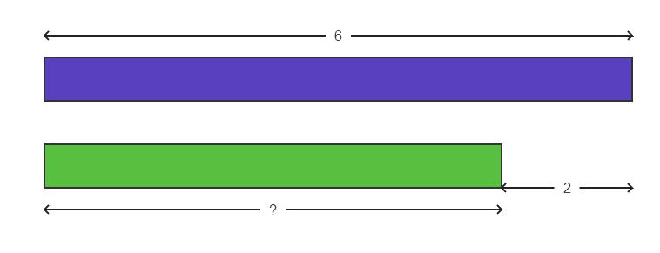
The Comparison Model
There are 6 dogs. There are 2 more dogs than cats. The difference between the two numbers is 2. There are 4 cats.

Slide 27
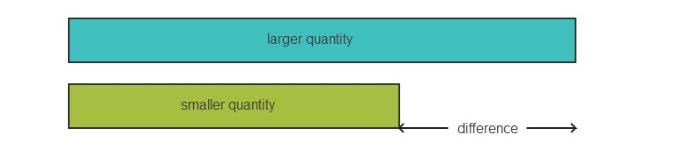
The Comparison Model
Addition & Subtraction
larger quantity – smaller quantity = difference
smaller quantity + difference = larger quantity

Slide 28
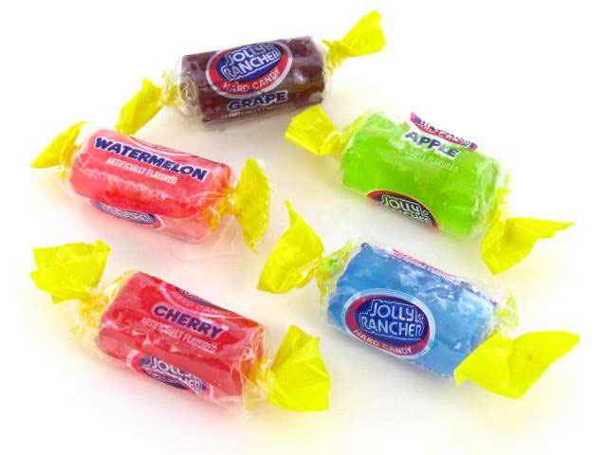
Example #4
Tracy had 328 Jolly Ranchers. She gave 132 Jolly Ranchers to her friend. How many Jolly Ranchers does Tracy have now?
Notes:
Did this problem lend itself to a part-whole model or a comparison model? Did anyone present it this way? Is it wrong to present it this way?
Is this problem more or less complex that the previous problem? (Allow for group response.) So we have removed the two-step complexity, but we’ve added computational complexity of working with 3-digit numbers. What else added complexity to this problem? (Allow participants to comment. Some may have found it difficult to address being given the whole first, and thereby feeling forced into starting with a part-whole model.)
(CLICK TO REVEAL SOLUTION.)
Before we move to the next example, let’s take a poll. The question is, “Was the use of the tape diagram model in Example 5 an example of descriptive modeling or analytic modeling?” Raise your hand if you think it is descriptive? Analytic? Have no idea? (Allow for hand-raising and summarize the result.)
This is subtle, and there is no clear-cut answer, but here is the key: If the student is using the diagram to reveal to them what operation should be applied, then the model is analytic. If they are using the diagram to simply provide more clarity of visualization, then it is purely descriptive.
Let’s move now into some multiplication and division problems. As with addition and subtraction, the ‘compare to’ situations are the ones that benefit most from use of the tape diagram. So, that is where we will begin.

Slide 29

Example #5
Anthony has 5 baseball cards. Jeff has 2 more cards than Anthony. How many baseball cards do Anthony and Jeff have altogether?
Notes:
What complexities are added here, that were not present in Example 3? (Call on a participant to answer.) So this example required two computations in order to answer the question. This is an example of a two-step problem as called for in the standards beginning in Grade 2.

Slide 30
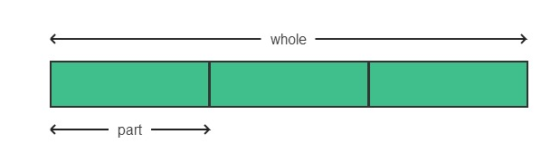
Part-Whole Model
Multiplication & Division
one part x number of parts = whole
whole ÷ number of parts = one part
whole ÷ one part = number of parts

Slide 31
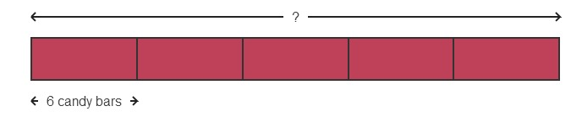
Part-Whole Model
Multiplication & Division
Variation #1: Given the number of parts and one part, find the whole.
5 children shared a bag of candy bars equally. Each child got 6 candy bars. How many candy bars were inside the bag?
5 x 6 = 30
The bag contained 30 candy bars.

Slide 32

Part-Whole Model
Multiplication & Division
Variation #2: Given the whole and the number of parts, find the missing part.
5 children shared a bag of 30 candy bars equally. How many candy bars did each child receive?
30 ÷ 5 = 6
Each child received 6 candy bars.

Slide 33
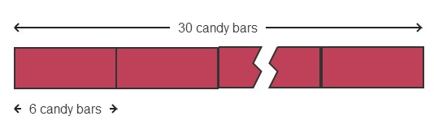
Part-Whole Model
Multiplication & Division
Variation #3: Given the whole and one part, find the missing number of parts.
A group of children shared a bag of 30 candy bars equally. They received 6 candy bars each. How many children were in the group?
30 ÷ 6 = 5
There were 5 children in the group.

Slide 34
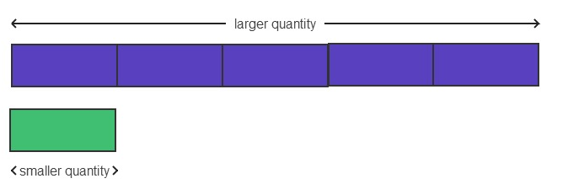
The Comparison Model
Multiplication & Division
larger quantity ÷ smaller quantity = multiple
smaller quantity x multiple = larger quantity
larger quantity ÷ multiple = smaller quantity

Slide 35
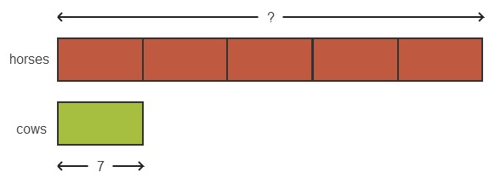
The Comparison Model Multiplication & Division
Variation #1: Given the smaller quantity and the multiple, find
the larger quantity.
A farmer has 7 cows. He has 5 times as many horses as cows. How many horses does the farmer have?
5 x 7 = 35
The farmer has 35 horses.

Slide 36

The Comparison Model Multiplication & Division
Variation #2: Given the larger quantity and the multiple, find the smaller quantity.
A farmer has 35 horses. He has 5 times as many horses as cows. How many cows does he have?
35 ÷ 5 = 7
The farmer has 7 cows.

Slide 37
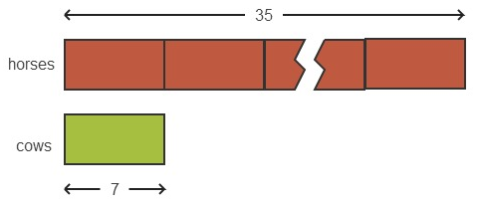
The Comparison Model
Multiplication & Division
Variation #3: Given two quantities, find the multiple.
A farmer has 7 cows and 35 horses. How many times as many horses as cows does he have?
35 ÷ 7 = 5
The farmer has 5 times as many horses as cows.

Slide 38

Example #6
Scott has 4 ties. Frank has twice as many ties as Scott. How many ties does Frank have?
Notes:
With multiplication and division problems, we introduce use of a consistently shaped bar to represent equal parts in the problem. We refer to this quantity as a unit, and then reason through the problem with this language: 1 unit is 4 paper clips, so 2 units would be 8 paper clips. Often times the reasoning applies in a division context. We might see that, “4 units is 28 paperclips, so 1 unit would be 7 paperclips.”

Slide 39

Example #7
Jack has 4 pieces of bubble gum. Michelle has twice as many pieces of bubble gum than Jack. How many pieces of bubble gum do they have altogether?
Notes:
How is this problem more complex than the previous? (Expected response – by asking how many paper clips they have altogether, it becomes a two-step problem, requiring you to first calculate how many Harry has, and then combine it with Jose’s to get the total.)

Slide 40

Example #8
Sean’s weight is 40 kg. He is 4 times as heavy as his younger cousin Louis. What is Louis’ weight in kilograms?
Notes:
What mistake are students most likely to make when solving this problem? (Allow someone to share – we are looking for them to say that students might take the information ‘4 times as heavy’ and interpret that as Sean is 4 times as heavy as William, leading to an answer of 160 kg.)
This reason right here is a case in point of why teachers want students to internalize a specific habit from the RDW process. Whenever a second quantity is introduced in any of the comparison styles, ask the students, ‘who has more’ or, in this case, “Who weighs more, William or Sean?” That simple reflection should be a standard part of reading a word problem with a comparison.
Once internalized, students will be much less likely to make these mistakes of misrepresenting the relationship stated. They will instead have a habit of reflecting on who has more, and when asked directly they are much more likely to make a thoughtful reply, double checking the wording if they are unsure.

Slide 41

Example #9
Tiffany has 8 more pencils than Edward. They have 20 pencils altogether. How many pencils does Edward have?
Notes:
. Read the first sentence with me. “Jamal has 8 more marbles that Thomas.” Do I know how many marbles Jamal has? Do I know how many marbles Thomas has? What do I know? So who has more marbles Jamal or Thomas? Can I draw something to show this? Who can describe for me what I can draw? (Call on a participant to answer.) OK, so I can draw a bar for each boy. And whose bar will be longer? I’m going to draw Jamal’s bar first. (Demonstrate on a flip chart.) Now, I’m going to draw Thomas’ bar. Can you tell me when to stop? (Stop when participants say to stop.) Is this right? Does this show that Jamal has more than Thomas? Can I label anything yet? So I can label that this piece of Jamal’s bar represents 8 marble. Is there anything else I can label? Do you notice anything else?
Do my last two questions seem inappropriate – why would I ask them when there is nothing else that I really need the students to label or notice yet? (Call for a participant to share, add or summarize with the following - ) I don’t want the students developing a dependency on the teacher to suggest what to do next, instead I want them internalizing the habit of pausing after each reading or drawing to ask if there is anything more to see or note.
Let’s read the next sentence together. “They have 20 marbles altogether.” How can I include this new information in my diagram? Where does it go? What else do I see in my diagram? Is there anything else I can label? Raise your hand if you see something else in your diagram. (Allow participants to contribute and document their findings. If there are none, move on to reading the next sentence.) Let’s go ahead and read the final sentence in the problem. “How many marbles does Thomas have?” What are we being asked to find? Can you see Thomas’s marbles in the diagram? So where can we place the ? in this problem.
(If participants have not already noticed the solution method, scaffold with the following questions.) Is this piece (the part that is separated from the 8) of Jamal’s bar longer or shorter than Thomas’ bar? Or is it the same? Do we know how many marbles is represented by this piece of the bar? What do we know? Could it be a number as big as 20? Could it be as big as 10? (Participants can reason than it could not be 10 because that would lead to a total more than 20 for the entire diagram.) If this is 8 and there are 20 marbles altogether, how many marbles are in these two bars combined? So if two of these bars represent 12 marbles, then one of these bars would represent how many marbles?
This problem illustrates a more subtle use of the consistently sized rectangular strip representing a unit within the problem.

Slide 42


Example #10
The total weight of a soccer ball and 10 golf balls is 1 kg. If the weight of each golf ball is 60 grams, find the weight of the soccer ball.
Notes:
Let’s work example 10 together.
Let’s read the first sentence together. “The total weight of a football and 10 tennis balls is 1 kg.” Can we draw something? What can we draw? Can we draw a bar to represent the football? Does my bar represent how many footballs? What does the length of the bar represent? (Weight of the football.) So making it longer would imply it weighed more and making it shorter would imply it weighed less?
So now I need to represent the tennis balls. What should I draw to represent the tennis balls? (Allow participants time to think and make suggestions. Guide participants with questions like these - ) Should I have 10 bars or 1 bar for the tennis balls? (note that either approach is reasonable)
Will the bar(s) represent how many tennis balls I have, or how much they weigh? (how much they weigh)
Should the bar(s) be longer or shorter than the bar I drew for the football? We don’t know, right, perhaps we need to make an assumption. What would you like to assume? We can adjust our drawing when we have more information.
Would it be okay if we drew the bar lengths as the same size as each other? (No, this is too likely to lead us to a false assumption.)
OK, so we’ve drawn something and we made an assumption in the drawing, realizing that we may need to adjust the drawing when we have more information. Is there anything I can see from my drawing?
Let’s read the next sentence. “If the weight of each tennis ball is 60 g, find the weight of the football.”
What can I draw or label now? (Label the total weight as 1 kg and the weight of each tennis ball as 60 g and/or label the 10 balls as totaling 600 g.)
Is there anything that you notice? What can you see? (Notice the presence of both kg and g in the units of the problem.) Shall we do a conversion? (Convert 1 kg into 1000 g).
Is there anything else see in the drawing? Is there something else we can label? (See that the weight of the football is 400 g and label it.) Do I need to adjust the size of my bars to match what I know now? (If so, make the adjustment.)
From here we, of course, answer in a complete sentence using the context of the problem.
(CLICK TO REVEAL SOLUTION.) In the solution of this last example shown on the slide, notice that there are 10 bar segment representing the tennis balls and that they are not the same width as the bar segment representing the football. Is it feasible that a problem will need two types of bar units? What if this problem had read 2 footballs and 10 tennis balls? Can you imagine how the diagram would change?
What complexities were present in this last example? (Allow participants to contribute.) Changing units. Also, the bar length did not represent how many footballs, rather we drew 10 bars for 10 tennis balls because the bar length was representing the weight of the balls.
Of course, not every problem should be led by the teacher, once students have been led through 1 – 4 or more examples of a given type of problem, they should begin to work problems with increasing levels of independence. To challenge high-performing students, or even typical students, it can be appropriate to add a new level of complexity to their seatwork without leading them through an example. Just be prepared to step in and ask them the scaffolding questions if they are not able to reason through it on their own.

Slide 43


Example #11
Two bananas and a mango cost $2.00. Two bananas and three mangoes cost $4.50. Find the cost of a mango.
Notes:
In the spirit of that thought, try Example 10 on your own. (Allow participants 1-3 minutes to work the problem.)
Compare your model with a partner at your table. (Allow participants 1 minute to compare their work.)
Who has answer? (Allow for 1 or more people to answer.) Is he/she right? Did anyone get something different? (If there is any difference of opinion, allow 2 participants with different answers to draw their solutions on flip charts. Allow each participant a chance to explain their reasoning.)
(CLICK TO REVEAL SOLUTION.)
Notice that again in this situation, length of the bar did not represent the quantity of pears or pineapples, but rather their cost. We used multiple bars of the same length to show when we had 2 pears and to show we had 1 or 3 pineapples.
The use of the length to represent something other that quantity of items is another form of complexity. Would you agree that this added complexity is a fairly significant one relative to the others?
Let’s move now into word problems involving using the tape diagram as a visual fraction model.

Slide 44
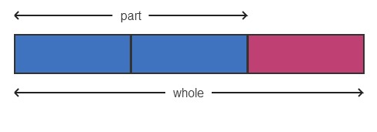

Part-Whole Model
Fractions
To show a part as a fraction of a whole:
Here, the part is $\frac{2}{3}$ of the whole.

Slide 45
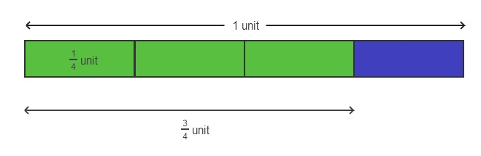

Part-Whole Model
Fractions
$\frac{3}{4}$ means $\frac{1}{4}$ + $\frac{1}{4}$ + $\frac{1}{4}$ , or 3 x $\frac{1}{4}$

Slide 46


Part-Whole Model
Fractions
4 units = 12
1 unit = $\frac{12}{4}$ = 3
3 units = 3 x 3 = 9
There are 9 objects in $\frac{3}{4}$ of the whole.

Slide 47


Part-Whole Model
Fractions
3 units = 9
1 unit = $\frac{9}{3}$ = 3
4 units = 4 x 3 = 12
There are 12 objects in the whole set.

Slide 48
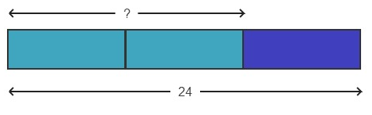
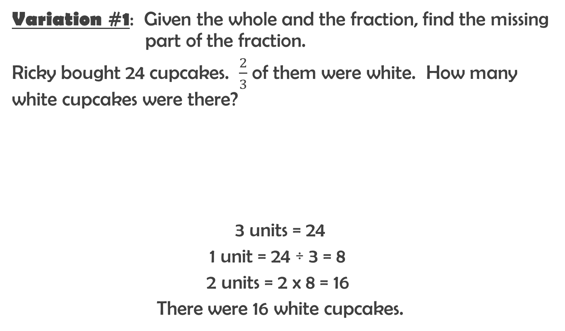
Part-Whole Model
Fractions
Variation #1: Given the whole and the fraction, find the missing part of the fraction.
Ricky bought 24 cupcakes. $\frac{2}{3}$ of them were white. How many white cupcakes were there?
3 units = 24
1 unit = 24 ÷ 3 = 8
2 units = 2 x 8 = 16
There were 16 white cupcakes.

Slide 49
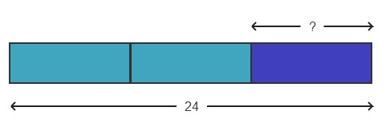
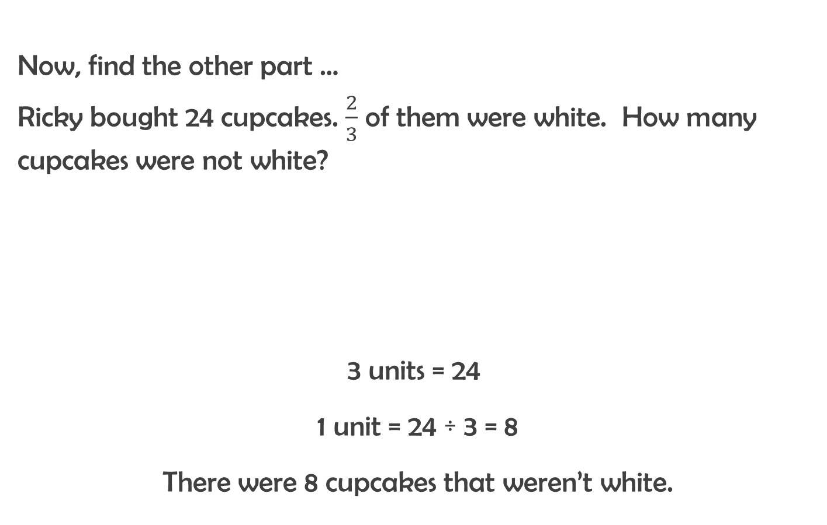
Part-Whole Model
Fractions
Now, find the other part …
Ricky bought 24 cupcakes. $\frac{2}{3}$ of them were white. How many cupcakes were not white?
3 units = 24
1 unit = 24 ÷ 3 = 8
There were 8 cupcakes that weren’t white.

Slide 50

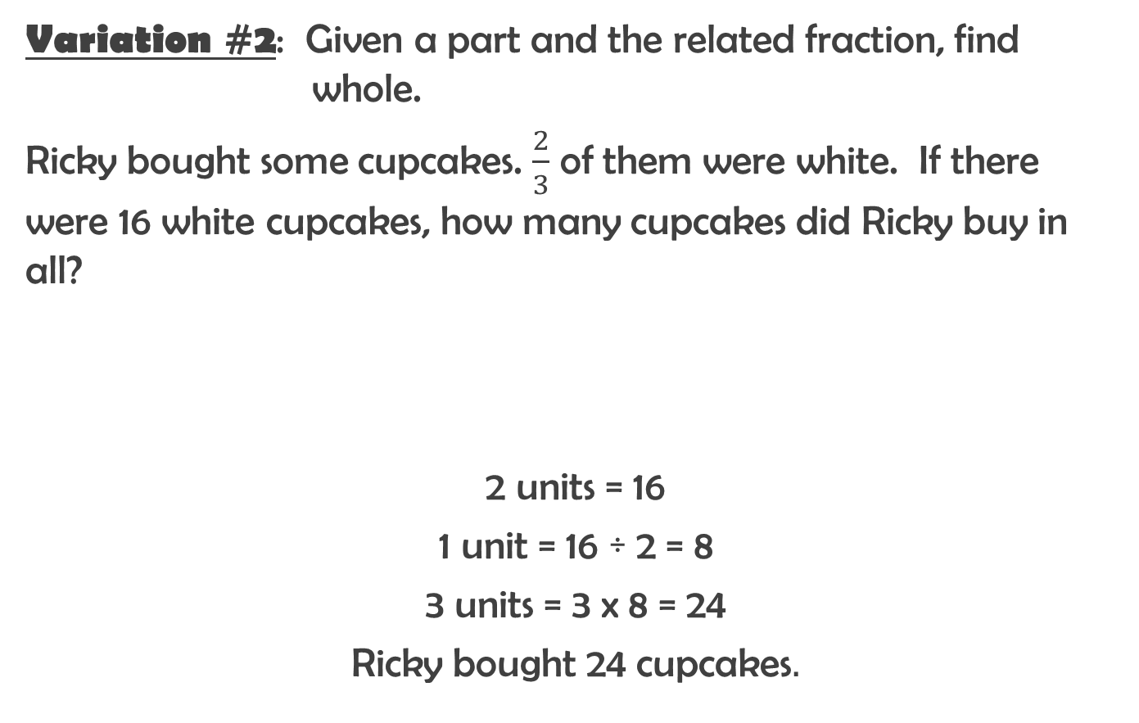
Part-Whole Model
Fractions
Variation #2: Given a part and the related fraction, find whole.
Ricky bought some cupcakes. $\frac{2}{3}$ of them were white. If there were 16 white cupcakes, how many cupcakes did Ricky buy in all?
2 units = 16
1 unit = 16 ÷ 2 = 8
3 units = 3 x 8 = 24
Ricky bought 24 cupcakes.

Slide 51
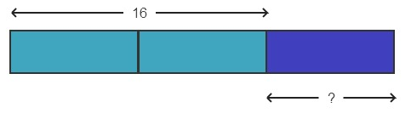
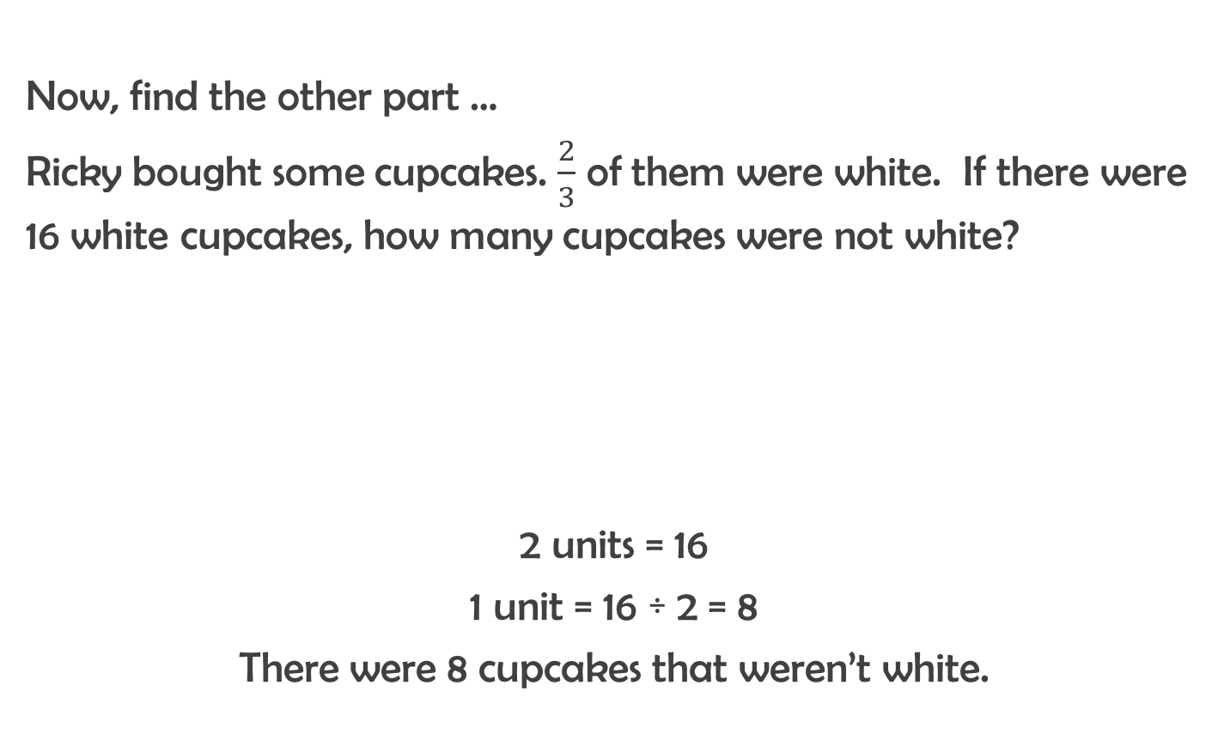
Part-Whole Model
Fractions
Now, find the other part …
Ricky bought some cupcakes. $\frac{2}{3}$ of them were white. If there were 16 white cupcakes, how many cupcakes were not white?
2 units = 16
1 unit = 16 ÷ 2 = 8
There were 8 cupcakes that weren’t white.

Slide 52
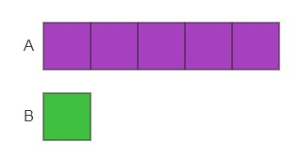
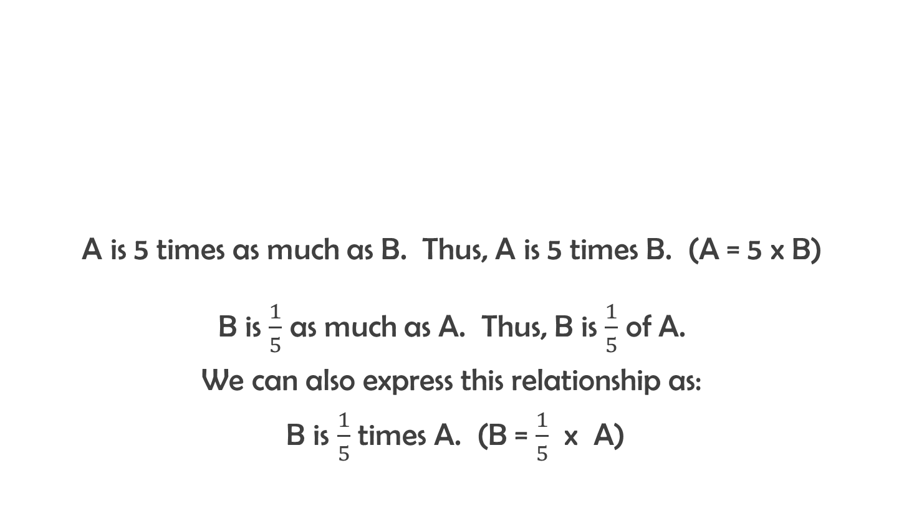
The Comparison Model
Fractions
A is 5 times as much as B. Thus, A is 5 times B. (A = 5 x B)
B is $\frac{1}{5}$ as much as A. Thus, B is $\frac{1}{5}$ of A.
We can also express this relationship as:
B is $\frac{1}{5}$ times A. (B = $\frac{1}{5}$ x A)

Slide 53
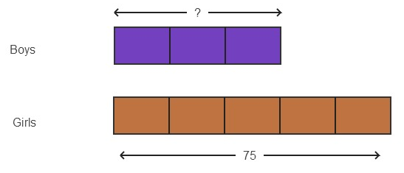

The Comparison Model
Fractions
There are $\frac{3}{5}$ as many boys as girls. If there are 75 girls, how many boys are there?
5 units = 75
1 unit = 75 ÷ 5 = 15
3 units = 3 x 15 = 45
There are 45 boys.

Slide 54
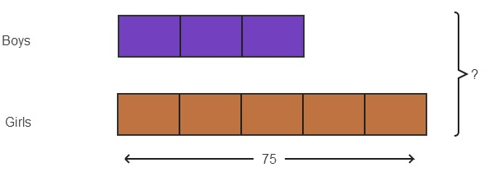
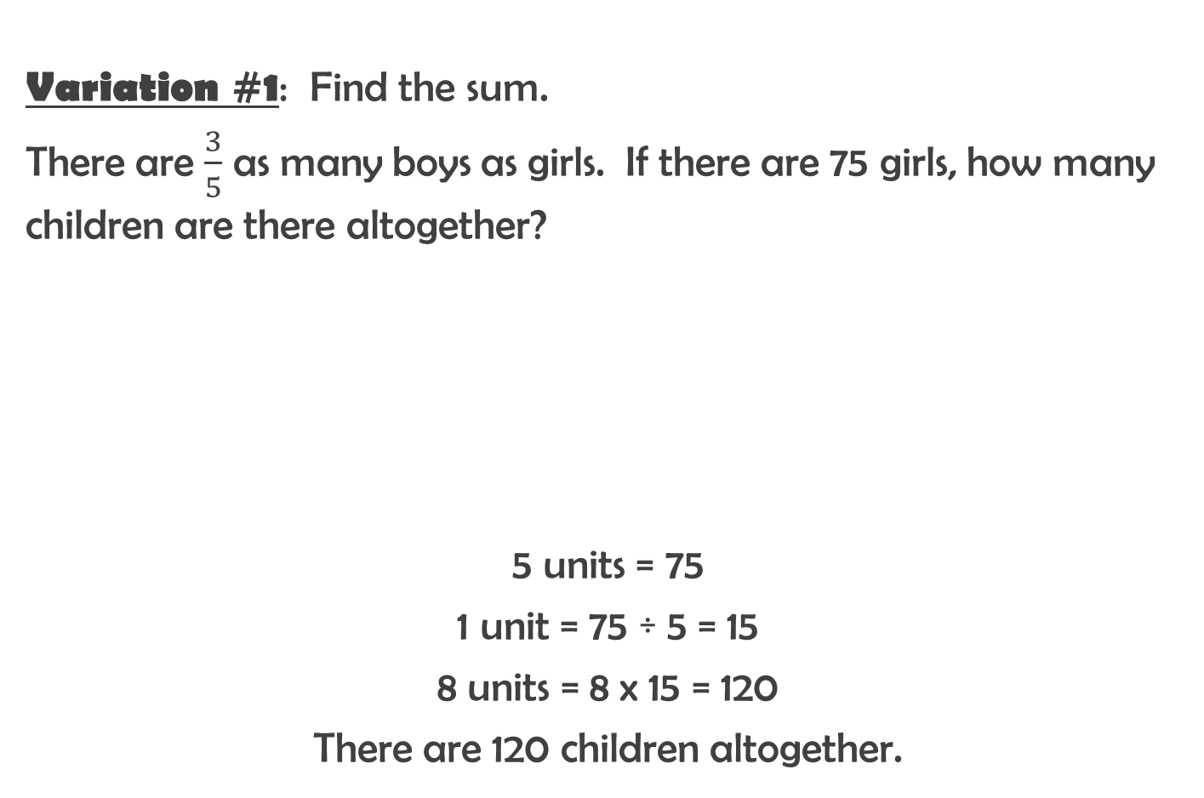
The Comparison Model
Fractions
Variation #1: Find the sum.
There are $\frac{3}{5}$ as many boys as girls. If there are 75 girls, how many children are there altogether?
5 units = 75
1 unit = 75 ÷ 5 = 15
8 units = 8 x 15 = 120
There are 120 children altogether.

Slide 55

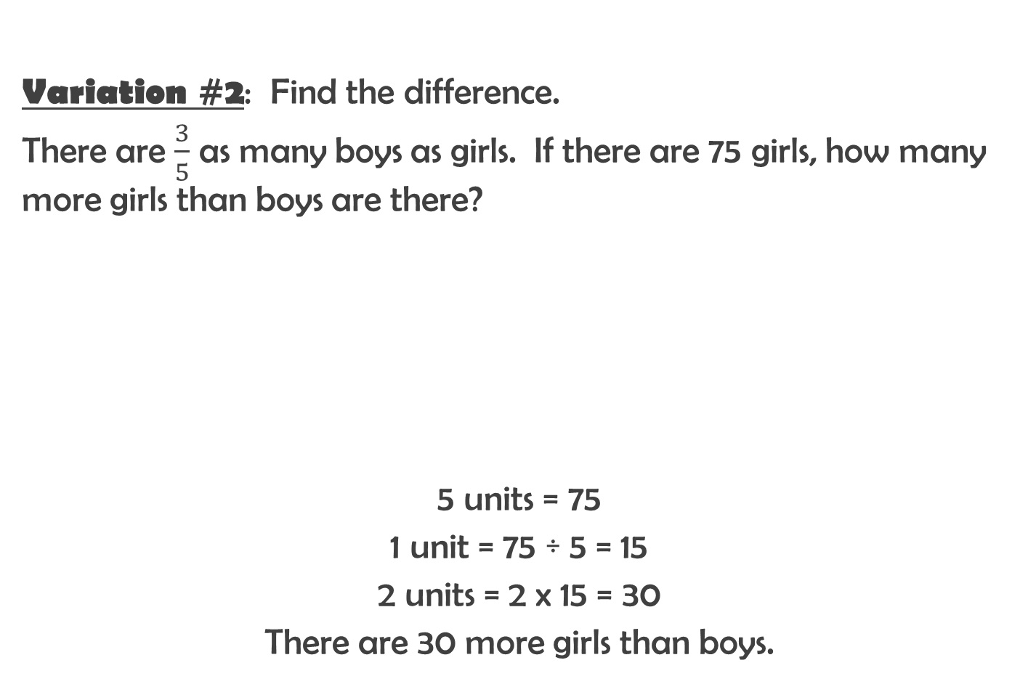
The Comparison Model
Fractions
Variation #2: Find the difference.
There are $\frac{3}{5}$ as many boys as girls. If there are 75 girls, how many more girls than boys are there?
5 units = 75
1 unit = 75 ÷ 5 = 15
2 units = 2 x 15 = 30
There are 30 more girls than boys.

Slide 56

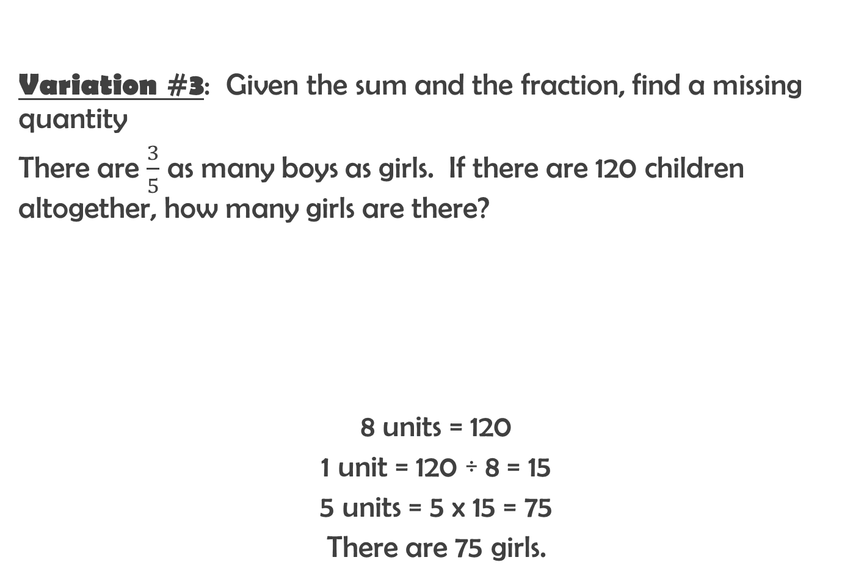
The Comparison Model
Fractions
Variation #3: Given the sum and the fraction, find a missing quantity
There are $\frac{3}{5}$ as many boys as girls. If there are 120 children altogether, how many girls are there?
8 units = 120
1 unit = 120 ÷ 8 = 15
5 units = 5 x 15 = 75
There are 75 girls.

Slide 57


Example #12
Markel spent $\frac{2}{5}$ of his money on a remote control car. The remote control car cost $20. How much did he have at first?
Notes:
Let’s read the first sentence together, “David spent 2/5 of his money on a storybook.” Who is the story about? (David.) What do we know so far? (That he spent 2/5 of his money on a book.) Can we draw something?
What will our bar represent? (David’s money) (Draw one bar that is long enough to be partitioned into five equal parts.) What does two fifths of David’s money look like? Can you imagine it here? Go ahead and show me on the diagram. (Partition it into five equal parts.)
What can we label on our diagram?
Use’s whale’s tale’s to show 2/5 and label it book. Write David’s money to the left of the bar.
Is there anything else we can draw, or label? What do we see?
Let’s read the next sentence. “The storybook cost $20.” Can we revise or add a label to our diagram to include this new information?
What else do we see? (That each fifth represents $10.) Can we label something else?
What else does our diagram tell us? (That the whole is representing $50.) Where can we add that information?

Slide 58

Example #13
Dana bought some chairs. One third of them were red and one fourth of them were blue. The remaining chairs were yellow. What fraction of the chairs were yellow?
Notes:
Let’s read the first sentence. “Alex bought some chairs.” Do we know how many chairs he had? Can we draw something? We can start with one bar and see if we need to adjust the drawing later. And we can label it Alex’s Chairs. Let’s read the next sentence. “One third of them were red and one fourth of them were blue.” So now we have some new information. Do we know how many chairs we have? What do we know? We know that some are red and some are blue. Do we know how many are red or how many are blue? No. We just know that a fraction of them were red and a fraction of them were blue. Can we draw something? Do we need to adjust our drawing? Are we happy with one bar or do we need two bars?
Take a minute to try working with what you have or try something new if you’d like, and see if you can create a drawing to show that one third of Alex’s chairs were red and one fourth of them were blue.”
(Allow 1-2 minutes for participants to work quietly.) Show your work to your partner and see if you and your partner can agree on a good representation. If both of you are unsatisfied, see if anyone at your table thinks they have a good way to show this.
Is there anything we can label? When we look at our drawing is there anything else that we see? Anything else we can label?
Let’s read the next sentence. “The remaining chairs were yellow” How can we add this information to our drawing? Is there anything else I can see from this?
Let’s read the next sentence. “What fraction of the chairs were yellow?” Why did I ‘lead you down the wrong path’ by saying ‘are we happy with one bar or do we need two bars?’ Students will have to make these decisions on their own. We won’t be there for them in real life or on an exam telling them, ‘in this problem you’re going to be better off with two bars.’ The value in working these problems is in developing their own habit to think each decision through on their own and make a judgment, hey this isn’t working out to be helpful… let me try it with one bar again.
Notice what happened after we read “The remaining chairs were yellow.” We labeled them yellow, that was the obvious thing to do with that information. But what did I say next. Did I say, “ok we’ve done that, we’re done with it, let’s move on to the next sentence?” No, we said, what else can we see in our diagram. Let’s go ahead and fill that in, we want to internalize in the students the habit of asking and reflecting, is there anything more I can reveal from my model before they move on to the next piece of information?
What should happen, is that by the time they read the question, the answer is already spelled out, because, unless there is additional information embedded in the sentence containing the question, by the time we read the question, we have hypothetically been given all the information needed.
So we encourage students to begin to analyze the model, using it to garner new information right away. It is a great exercise in fact to leave the question off and have students come up with all the different questions that could be asked. And then say, what questions could we ask if we had even more information?

Slide 59


Example #14
Jason had 360 toy action figures. He sold $\frac{1}{3}$ of them on Monday and $\frac{1}{4}$ of the remainder on Tuesday. How many action figures did Jason sell on Tuesday?
Notes:
Let’s read the first sentence of the problem. “Jim had 360 stamps.”
Can we draw something? What can we draw? Can we add a label to our drawing? Is there anything else that we can draw or label?
Let me read you the next sentence. “He sold a fraction of them on Monday and a fraction of the remainder on Tuesday.” What fraction did he sell on Monday?
Can we draw something to show what he sold on Monday? How should I label this?
What fraction did he sell on Tuesday? One fourth of the remainder. Where is the remainder shown in this diagram? Can you imagine what one fourth of the remainder looks like? How can I show one fourth of the e remainder.
If I mark this like so. Is the whole of the stamps still partitioned into equal parts? What can I do to make sure I am partitioning my whole into equal parts? Does anybody know? (Allow for contributions).
Oh, ___ is suggesting that I partition the whole into sixths. (Demonstrate partitioning the whole into sixths.) Can I still see one third. Is this still one third? Can I see one fourth of the remainder?
Is there anything else I can label or draw? What can I see when I look at my diagram?
Let’s read the final sentence. “How many stamps did he sell on Tuesday?” Where can I see this on the diagram?
There are two ways to model this for students, one way is within the existing bar, another way is to redraw ‘the remainder’ just below and then partition only the remainder.

Slide 60


Example #15
Tina spent $\frac{3}{5}$ of her money in a one shop and $\frac{1}{4}$ of the remainder in another shop. What fraction of her money was left? If he had $90 left, how much did he have at first?

Slide 61


Example #16
Jacob bought 280 blue and red paper cups. He used $\frac{1}{3}$ of the blue ones and $\frac{1}{2}$ of the red ones at a party. If he had an equal number of blue cups and red cups left over, how many cups did he use altogether?
Notes:
These last 3 examples clearly demonstrate how the model serves as an analytic tool. Without the model the operations and solution is not apparent, but with the model, you can see what computations need to be made to solve the problems.
Read the first sentence with me. “Henry bought 280 cups.” Can we draw something? Can we label something? Looking at my diagram can I draw or label something else?
Let’s read the next sentence. “Some of the cups were red and some were blue.” Do we know how many were red? Do we know how many were blue? Is there something I can draw or adjust in my drawing? (If no one else suggests it, provide - )
Now that I know that some are red and some are blue, maybe it would be helpful to draw two separate bars instead of just 1. It is up to you. Do what you think will help you the most.
Is there anything else we can draw? What do we see here? Can we add any labels?
Right now, this process of questioning may seem overly repetitive. When you have worked with a class for the better part of a year, you will not need to repeat every question every time. It would suffice to ask one question that suggests the students should look deeper, like “What else could we add to the diagram?”
Let’s read the next sentence. He used one third of the blue ones and half of the red ones at a party. Can you show this on your diagram? What else can you see in your diagram?
Let’s read the last sentence. “If he had an equal number of blue cups and red cups left, how many cups did he use altogether?” How does this new information change what we have drawn? Can we adjust our drawing to reflect an equal number of blue cups and red cups left?

Slide 62

Opening Question Revisited …
94
Children at swim camp
Boys Girls
34
54
Did not wear goggles
Wore goggles
Wore goggles
20
14
34

Slide 63

Key Points
When building proficiency in tape diagraming skills, start with simple accessible situations and add complexities one at a time
Develop habits of mind in students to reflect on the size of bars relative to one another
Part-whole models are more helpful when modeling situations where __________________________________________
Compare to models are best when _________________________
Notes:
When building proficiency in tape diagraming skills start with simple accessible situations and add complexities one at a time.
Develop habits of mind in students to continue to ask, ‘is there anything else I can see in my model’ before moving on to the next sentence in the problem.
Develop habits of mind in students to reflect on the size of bars relative to one another, by asking, ‘who has more’ type questions.
Part-whole models are more helpful when modeling situations where you are given information relative to a whole.
Compare to models are best when comparing quantities.

Slide 64

Exploring Module 1
Activities

Slide 65

Next Steps …
What’s your next critical move?
How do you build capacity within your district to ensure the successful implementation of tape diagram?
Drawing your own Tape Diagram:
http://ultimath.com/whiteboard.php

Slide 66
Name: _______________________________
Date: Thursday, August 8th
Using Tape Diagrams: K - 5
Example Booklet
Sean VanHatten – IES, Staff Development Specialist (Mathematics)
svanhatten@e2ccb.org
Tracey Simchick – IES, Staff Development Specialist (Mathematics & Science)
tsimchick@e2ccb.org

