Slide 1
Mathematics Common Core Implementation
Phase 1
2012- 2013
Notes:
This year is a full implementation of the common core standards. Each year we will be able to expand our understanding of the standards. The following slides outline some key steps to take this year to make meaningful progress as we implement the math standards.

Slide 2
Moving Forward
These Standards are not intended to be new names for old ways of doing business. They are a call to take the next step. … It is time to recognize that standards are not just promises to our children, but promises we intend to keep.
–CCSSM, p. 5
Notes:
The standards were built upon progressions of key mathematical concepts. These progressions start and stop where appropriate. Each year provides the foundation for the next. Each year is designed to “take new ground” in mathematical learning. It is important to ask, “What have the students learned? What are they able to do?” not just, “What have they been exposed to through their lessons?”

Slide 3
Putting the Shifts into Action
Focus: focus strongly where the standards focus
Coherence: think across grades, and link to major
topics in each grade
Rigor: in major topics, pursue with equal intensity
    conceptual understanding
    procedural skill and fluency
    applications
http://corestandards.org/assets/Math_Publishers_Criteria_K-8_Summer%202012_FINAL.pdf
Notes:
Publisher’s Criteria- http://corestandards.org/assets/Math_Publishers_Criteria_K-8_Summer%202012_FINAL.pdf
This document outlines the expectations for materials that are truly aligned to the common core.
Read the page in the powerpoint handouts that aligns to this slide. The whole document will be useful to you as you align your materials to the common core or examine materials that claim to be aligned to the common core.
Focus creates the conditions for us to be able to teach the mathematics well – we need the time and we need to remove concepts that distract us from accomplishing the major work of our grade level.
Coherence will tap into the power of transfer. When mathematics is taught with coherence, students are able to see and make the connections among topics within a grade level and across the grades. This will be an area of ongoing growth. The we pay attention to making connections among the topics, the more connections we will see.

Slide 4
The Six Shifts
Focus
Coherence
Fluency
Deep Understanding
Application
Equal Importance!
http://ime.math.arizona.edu/progressions/
Notes:
Fluency, Deep Understanding, and Application are pursued with equal intensity, simultaneously. That’s what the sixth shift that isn’t listed on this slide “Dual Intensity” is all about.

Slide 5
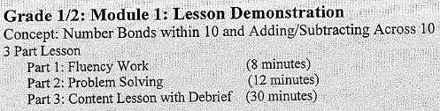
Connection to the Modules
Fluency
What is included in a lesson
and the sequence of the parts
depends upon the concept
being taught.
Deep Understanding
of Concepts
Application
Notes:
The structure of the demonstration lessons acknowledge the importance of addressing fluency, application, and deep understanding of concepts. But ultimately the content drives our lesson structure. It may make sense to change the order or just have a couple parts in a lesson. But when we look at the math instruction across several lessons we should see that fluency, application, and deep understanding of concepts all play a starring role.

Slide 6
Focus
Less topic coverage can be associated with higher scores on those topics covered because students have more time to master the content that is taught.
–Ginsburg et al., 2005, Reassessing U.S. International Mathematics Performance: New Findings from the 2003 TIMSS and PISA

Slide 7
Finding the Focus
Read the introduction to your grade levels standards- the paragraphs outline the critical areas
The Content Priorities- highlight the focus, additional, and supporting cluster titles in your standards using 3 different colors.
(70, 20, 10)
Notes:
If you have not already done this please take the time to understand the focus of your grade level.
Highlighting the cluster headings in your standards helps you see the information from the 70, 20 10 chart every time you look at your standards. Recognize that the Content Priorities chart only shows the cluster headings. Do not use it as a substitute for your standards. The actual standards contain detail that the Content Priorities chart is lacking.

Slide 8
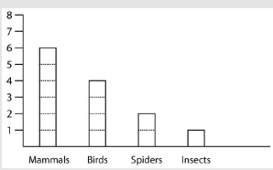
Strengthening the Focus
Connections at a single grade level can be used to improve focus, by tightly linking secondary topics to the major work of the grade.
Pictures in a Science Magazine
Notes:
Tightly link secondary topics to the major work of your grade to strengthen the focus.
How does the number of mammal pictures compare to the number of spider pictures?
There are four more pictures of mammals. There are 4 fewer pictures of spiders (before 3rd)
There are three times as many mammal pictures compared to spider pictures. (3rd or after)

Slide 9
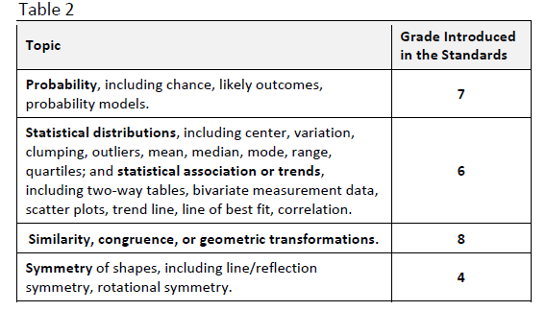
What’s Missing?
Materials do not assess any of the following topics before the grade level indicated.
This was intentional. Please remove these topics from your curriculum.
http://corestandards.org/assets/Math_Publishers_Criteria_K-8_Summer%202012_FINAL.pdf
Notes:
This chart is from the Publisher’s Criteria. It highlights some of the areas that have been removed from the elementary standards in the common core.

Slide 10
Why is it Missing
Time for mathematics instruction is a limited resource.
Invest in the topics that are the most valuable in building mathematical success.
(Topics Leading to Algebra)
Notes:
Please the refer to the second page in the powerpoint handouts that has the arrow. It shows the clusters within the standards that provide the foundation for success in Algebra.

Slide 11
Fluency
Grade | Standard | Fluency
K | K.OA.5 | Add/subtract within 5
1 | 1.OA.6 | Add/subtract within 10
2 | 2.OA.2 | Add/subtract within 20
 | 2.NBT.5 | Add/subtract within 100
3 | 3.OA.7 | Multiply/divide within 100
 | 3.NBT.2 | Add/subtract within 1,000
4 | 4.NBT.4 | Add/subtract within 1,000,000
5 | 5.NBT.5 | Multi-digit multiplication
6 | 6.NS.2,3 | Multi-digit division Multi-digit decimal operations
Notes:
These are the fluency targets outlined in the standards. Fluency is more than fact practice.

Slide 12
Fluency is More Than Rote Facts
Sustained fluency leads to concept mastery which support the learning of new concepts
Notes:
Fluency leads to concept mastery. We want students to be flexible and automatic so that they can be better problem solvers. Students should be taught a concept. Fluency work helps to polish up and solidify a skill. It can also help students access a strategy that you are going to need to apply in the lesson. If I’m going to have a student do problems where I want them to make a 10 to solve 16 + 8. Fluency practice that involves the earlier skill of partners to 10 can help prepare the students for the lesson.
See the sample sprints posted on the K-2 Implementation page. A sample fluency activity for 1/2 is shown in the powerpoint handouts.

Slide 13
Counting Fluency
PK- K | 1-2 | 3 | 4-5
1-3 1-5 1-10 Up to 100 “math way” 1 ten 2, 1 ten 3, Whisper/ speak Roller coaster | 1’s (pennies) 5’s (nickels) 10’s (dimes) 23, 33, 43, etc. Up to 120 Whisper odd, speak evens Repeated + or subtraction | Multiples of whole numbers Unit fractions (beyond 1- keep as improper fractions) | Multiples of unit fractions/ whole numbers Decimals
Notes:
Simple routines like pointing up to signify count up, pointing down to signify count down, and holding your hand flat to show stay at the number can be applied across the grade levels with increasing complexity.
Simple exercises can also be done in conjunction with the counting fluency practice to help the students stretch and refocus.
These routines can be used for just a few minutes during the transition from one task to another.

Slide 14

Sprints
Bill Davidson http://www.youtube.com/watch?v=G_y9gGnd68M
Notes:
Bill Davidson learned how to do Sprints from Dr. Yoram Sagher (http://ramosgroup.squarespace.com/sprints/) The content of the sprint has already been taught. He structures them so that the first quadrant is easy enough for all students to get 11 questions in the minute. If a students finishes part of the task before everyone, they are directed to see how many multiples of a given number they can write. This is why you will see some of the students stand up to show they are finished, but they continue to write.

Slide 15
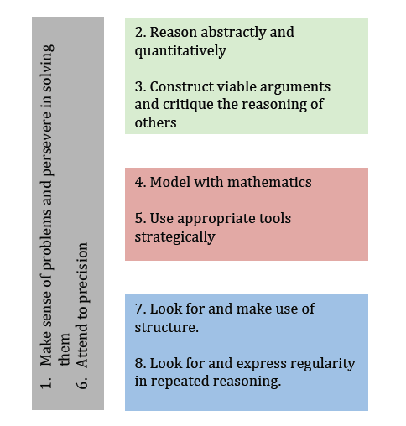
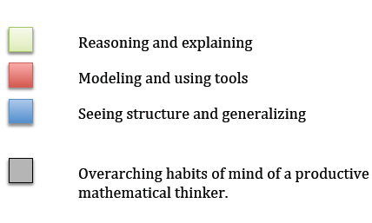
Application
Problem solving requires students
to apply the 8 Mathematical Practices
Bill McCallum – “Structuring the Mathematical Practices” http://commoncoretools.me
Notes:
When students simply match a key word to an operation, they are not developing their mathematical thinking. Be sure students can picture what is happening in the problem and what this means in terms of the math. Students will need to learn how to efficiently model their thinking when solving word problems. You will notice in the student work shown on slides 17-18 that the students have learned some ways to demonstrate their mathematical thinking.
Mathematical practice number 5 isn’t the “calculator” or “ruler” practice. Using appropriate tools strategically can be knowing which model or strategy make sense for a given type of problem. If I have a comparison problem, my work will look differently compared to what I would do to set up a part-part- whole problem.

Slide 16
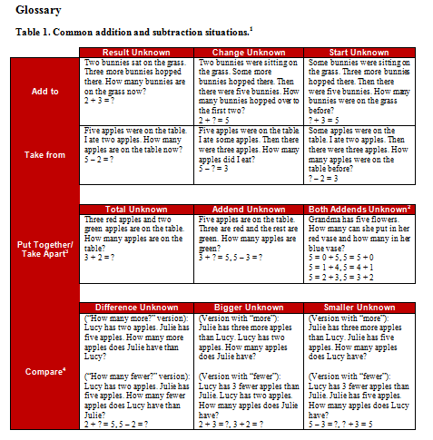
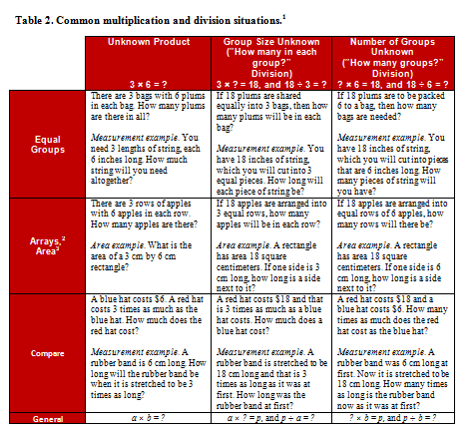
Table I and 2
Notes:
These two tables at the back of the standards outline the different types of problems that students in 1st and 2nd grade (Table 1) and 3rd and up (Table 2) should be able to do. You can use these sample questions to help you generate more questions or identify questions that fit the different categories.

Slide 17
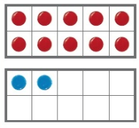
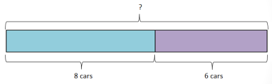

Making the Connection
Concrete
Pictorial
Abstract
9 + 6 = 15
Notes:
As students work on solving problems, it important to make an intentional connection from the concrete, to the pictorial, to the abstract. Students need concrete models when building number sense, but as they develop their understanding it is important that they transition to more efficient modeling tools.

Slide 18
Multipurpose Models
Number path
Number stairs
Number bond
Place Value Models
  Ten frames, bundles, base ten blocks, money, number disks
Bar Model
Area Model
Number line
Array
  Rekenrek- physical model of an array
Notes:
Above are listed some models that Common Core Inc., the creators of the modules, noted were particularly useful. These models will likely show up when we see the modules. If you see models here that you currently use, consider how the model will help you meet your standards.

Slide 19
Second Grade
8 children are swimming in the pool. 5 more children jump in. How many children are in the pool now?
?
● | ● | ● | ● | ● | ● | ● | ●
● | ● | ● | ● | ●
8 children
5 more
8 + 5 = 13 13 children are in the pool.
Notes:
This example shows how you could model this problem. Please see the sample RDW (read draw write) in the powerpoint materials to see the lesson that accompanied this problem. This example is very teacher directed. This would shift towards partner/independent work as the students become comfortable with this method of modeling.
This sample is laying the foundation for the bar model that would just use the rectangles and the labels- no dots.

Slide 20
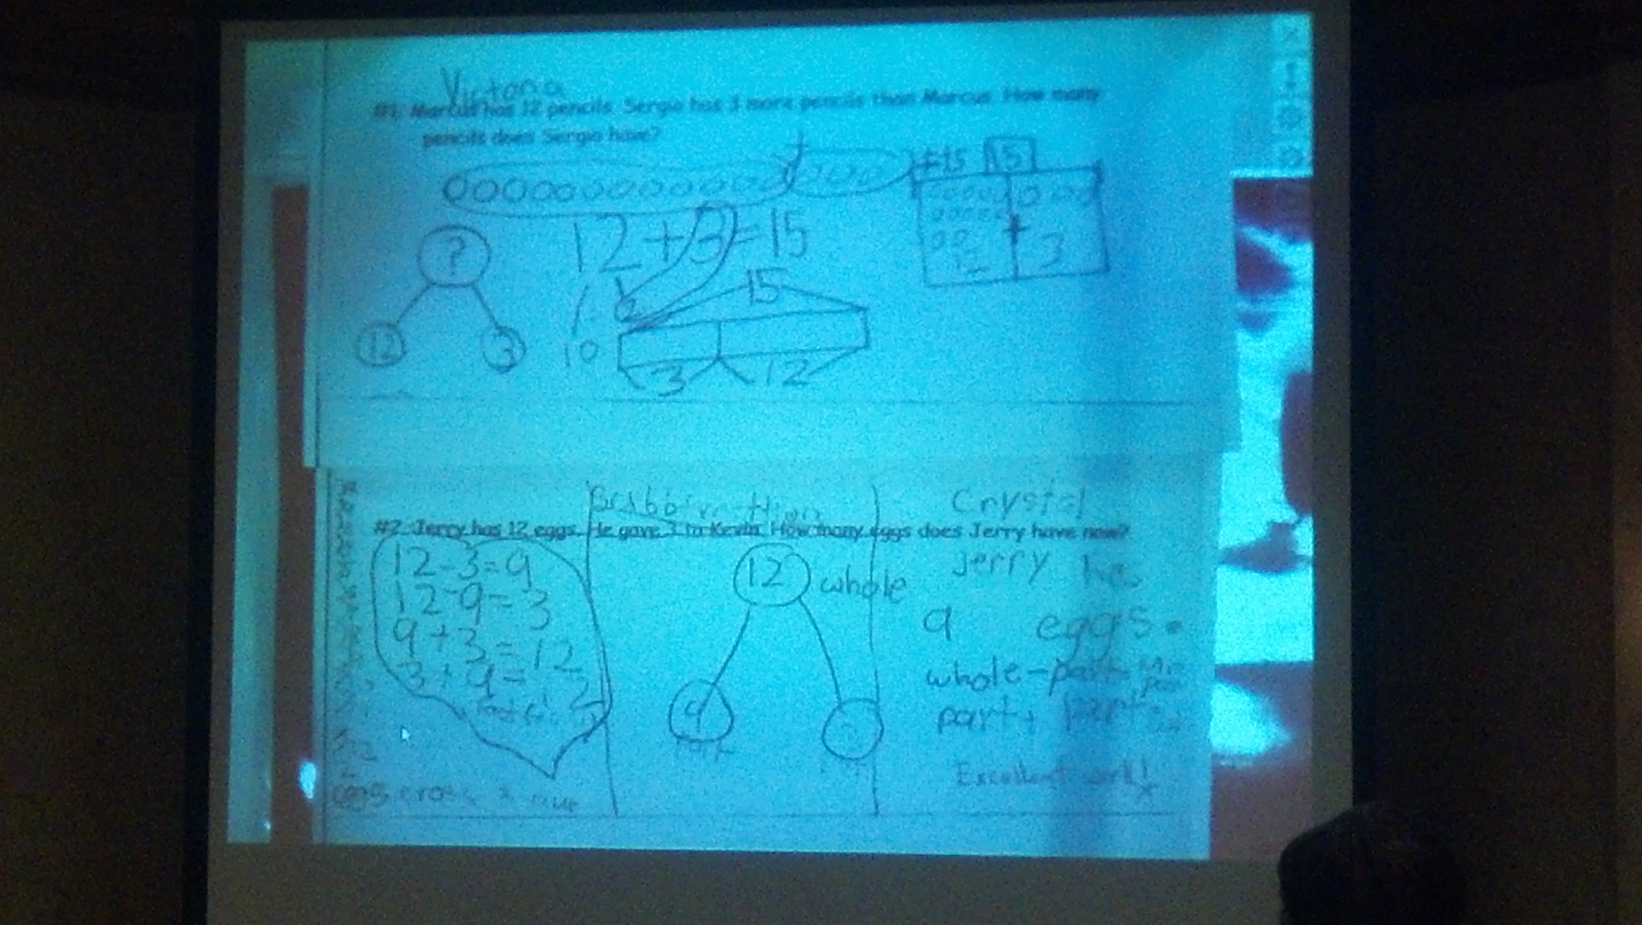
Marcus has 12 pencils. Sergio has 3 more pencils than Marcus. How many pencils does Sergio have?
Notes:
This student drew a number bond to show that the parts of Sergio’s number were given and the whole is what was missing. In the number sentence you can see that 12 was broken into 10 and 2. The student combined 2 and 3 to get 5. So 10 + 5 = 15. The student also showed the line of circles combine which is an early stage of the bar model. She also showed a chart with 12 and 3. You can easily see the 10 within the 12 because she arranged her circles like a 10-frame.

Slide 21
Jerry has 12 eggs. He gave 3 to Kevin. How many eggs does Jerry have now?
Notes:
On the left the student is showing subtraction by crossing out 3 numbers. The next portion shows a heart around the fact family associating 12, 3, and 9. Then the student drew a number bond and recognized that the whole was given and a part was given. Then she noted that whole – part = part and part +part = whole.
Her answer was that Jerry has 9 eggs.

Slide 22
Putting the Shifts into Action
Focus: focus strongly where the standards focus
Coherence: think across grades, and link to major
topics in each grade
Rigor: in major topics, pursue with equal intensity
    conceptual understanding
    procedural skill and fluency
    applications
http://corestandards.org/assets/Math_Publishers_Criteria_K-8_Summer%202012_FINAL.pdf
Notes:
Publisher’s Criteria- http://corestandards.org/assets/Math_Publishers_Criteria_K-8_Summer%202012_FINAL.pdf
In summary- Examine this slide.
Ask yourself, “Have we weeded out unnecessary topics from our curriculum?” If not, start weeding.
“Do a have a clear understanding of what the major work of my grade level is?” If not, revisit slide 7 and do the tasks listed there. I like the “domain progression” charts from Maine. They are missing the little bit that NY added, but they are nice because they line up the grade levels according to domain. You can see how the work from one grade builds the foundation for the next. http://www.maine.gov/education/lres/math/standards.html#ccss-math
“Can I sharpen my students’ conceptual understanding?” Making intentional connections and showing the students how their new learning is building off of what they know can be helpful.
“What procedural skills and fluencies do I need to strengthen for my students to have a better understanding of the math?” Be intentional about fluency practice and helping students see that they are improving.
“How can I my students increase their ability to apply mathematical thinking to problem solving tasks?” Consider how you word questions. Structure problems to prevent a dependence on key words. Provide students with models that they can use in a variety of situations across multiple grades.

