Slide 1
Video 10: Guide Papers for 4th Grade
Three Point Question
New York State 2013 Grades 3-8 Common Core Mathematics Rubric and Scoring Turnkey Training
Notes:
Ensure participants have a copy of the Grade 4 Extended-response (3-point) Sample Guide/Practice Set packet.
The general purpose of this video:
Now that you have seen the descriptions of the levels of performance on the three point rubric we will use the guide papers to define what types of work demonstrate the understanding required for each level of the three point rubric
Time estimate:
4 minutes

Slide 2
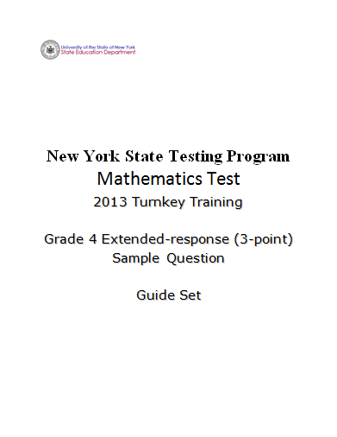
Notes:
We will now look at student responses to the grade 4 3-point question.
Refer participants to the Grade 4 Extended-response (3-point) Sample Question Guide/Practice Set.
You will also need your 3 Point Holistic Rubric and the Scoring Policies as you work through this section.

Slide 3
Grade 4 Extended-response Question
2
Candy wants to buy herself a new bicycle that cost $240. Candy has already saved $32, but she needs to make a plan so she can save the rest of the money she needs. She decides to save the same amount of money, x dollars, each month for the next four months.
Write an equation that helps Candy determine the amount of money she must save each month.
Equation ___________________________________________________
Solve the equation to find the amount of money she must save each month to meet her goal of buying a bicycle.
Show your work.
Answer $_________________________________________________
3
Notes:
This is a sample of a grade 3 point question that is aligned with Common Core learning standard 4.OA.3

Slide 4
Grade 4 Extended-response Common Core Learning Standard Assessed
CCLS 4.OA.3
Solve multistep word problems posed with whole numbers and having whole-number answers using the four operations, including problems in which remainders must be interpreted. Represent these problems using equations with a letter standing for the unknown quantity. Assess the reasonableness of answers using mental computation and estimation strategies including rounding.
Notes:
CCLS 4.OA.3
Requires that students solve multistep word problems posed with whole numbers and having whole-number answers using the four operations, including problems in which remainders must be interpreted. Represent these problems using equations with a letter standing for the unknown quantity. Assess the reasonableness of answers using mental computation and estimation strategies including rounding.

Slide 5
Grade 4 Extended-response Question
2
Candy wants to buy herself a new bicycle that cost $240. Candy has already saved $32, but she needs to make a plan so she can save the rest of the money she needs. She decides to save the same amount of money, x dollars, each month for the next four months.
Write an equation that helps Candy determine the amount of money she must save each month.
Equation ___________________________________________________
Solve the equation to find the amount of money she must save each month to meet her goal of buying a bicycle.
Show your work.
Answer $_________________________________________________
How would you answer this question?
5
Notes:
Take a couple minutes to think about how you would answer the question. (Allow participants 3 – 4 minutes to answer the question and reflect.)
Pause the video and solve this problem
Before we look at the guide papers-
Ask yourself what a typical a student response might look like at each of the levels of the three point rubric.
Pause the video to discuss or jot down your thoughts.

Slide 6
Grade 4 Extended-response Exemplar
2
Candy wants to buy herself a new bicycle that cost $240. Candy has already saved $32, but she needs to make a plan so she can save the rest of the money she needs. She decides to save the same amount of money, x dollars, each month for the next four months.
Write an equation that helps Candy determine the amount of money she must save each month.
Equation ___________________________________________________
Solve the equation to find the amount of money she must save each month to meet her goal of buying a bicycle.
Show your work.
Answer $_________________________________________________
6
Notes:
Talk through the response:
So here is an example of how a student could earn a 3 on this question
The equation written on the line is correct, (240 – 32)/4 = x. The equation is then correctly solved and the answer is correct.
This is what we would expect as a common, but not the only, 3-point response.
Guide the discussion by asking a few teachers for other ways this question may be answered correctly or what we might expect as common 2-point, 1-point and 0-point responses.

Slide 7
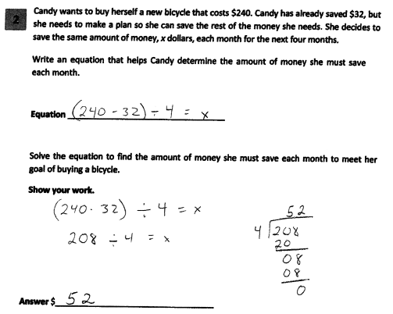
Grade 4 Extended-response Guide Paper 1
Score Point 3
7
Notes:
Refer participants to Guide Paper 1 in the Grade 4 Extended-response (3-point) Sample Guide Set packet.
Guide paper 1 is our first example of a 3 point response.
This response answers the question correctly and demonstrates a thorough understanding of the mathematical concepts. The written equation is correct, the mathematical procedure used to solve the equation is appropriate with all necessary work shown, and the final answer is correct.

Slide 8
Grade 4 Extended-response Guide Paper 1 Annotation
Score Point 3
This response answers the question correctly and demonstrates a thorough understanding of the mathematical concepts. The written equation is correct, the mathematical procedure used to solve the equation is appropriate with all necessary work shown, and the final answer is correct.
8
Notes:
Direct the participants to read the annotation; ask if there are any questions. A second training option is to read or paraphrase the annotation for participants while viewing the response slide.

Slide 9
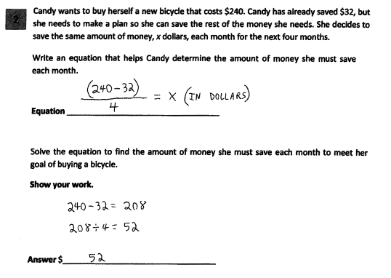
Grade 4 Extended-response Guide Paper 2
Score Point 3
9
Notes:
Refer participants to Guide Paper 2 in the Grade 4 Extended-response (3-point) Sample Guide Set packet.
Here is another example of a score point of 3.
This response answers the question correctly and indicates that the student has completed the task correctly, using mathematically sound procedures. The written equation is correct, the mathematical procedure used to solve the equation is appropriate with all necessary work shown, and the final answer is correct.

Slide 10
Grade 4 Extended-response Guide Paper 2 Annotation
Score Point 3
This response answers the question correctly and indicates that the student has completed the task correctly, using mathematically sound procedures. The written equation is correct, the mathematical procedure used to solve the equation is appropriate with all necessary work shown, and the final answer is correct.
10
Notes:
Direct the participants to read the annotation; ask if there are any questions. A second training option is to read or paraphrase the annotation for participants while viewing the response slide.

Slide 11
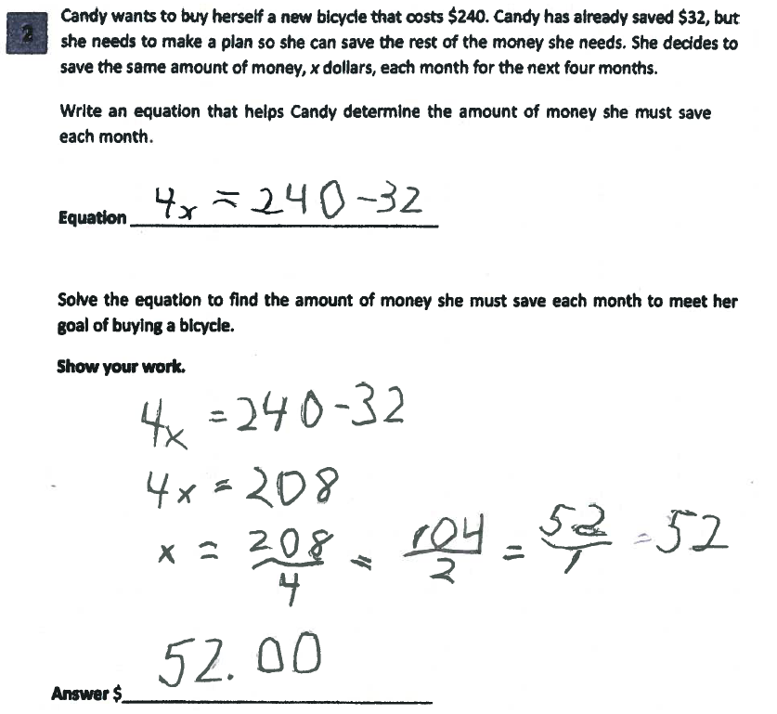
Grade 4 Extended-response Guide Paper 3
Score Point 3
11
Notes:
Refer participants to Guide Paper 3 in the Grade 4 Extended-response (3-point) Sample Guide Set packet.
Guide Paper 3 is also a three point response. The student wrote an equation to show that 4 times the amount she needed to save each month would equal what she needed minus what she already had.
This response answers the question correctly and demonstrates a thorough understanding of the mathematical concepts. The written equation is correct, the mathematical procedure used to solve the equation is appropriate with all necessary work shown, and the final answer is correct.

Slide 12
Grade 4 Extended-response Guide Paper 3 Annotation
Score Point 3
This response answers the question correctly and demonstrates a thorough understanding of the mathematical concepts. The written equation is correct, the mathematical procedure used to solve the equation is appropriate with all necessary work shown, and the final answer is correct.
12
Notes:
Direct the participants to read the annotation; ask if there are any questions. A second training option is to read or paraphrase the annotation for participants while viewing the response slide.

Slide 13
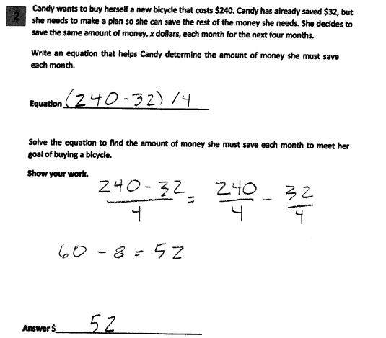
Grade 4 Extended-response Guide Paper 4
Score Point 2
13
Notes:
Refer participants to Guide Paper 4 in the Grade 4 Extended-response (3-point) Sample Guide Set packet.
Guide Paper 4 is our first example of a 2 point paper
This response answers the question correctly and demonstrates a thorough understanding of the mathematical concepts. The written equation is not correct because an expression was written on the line, the mathematical procedure used to determine the amount saved each month is appropriate with all necessary work shown, and the final answer is correct.

Slide 14
Grade 4 Extended-response Guide Paper 4 Annotation
Score Point 2
This response is partially correct and addresses most aspects of the task, using mathematically sound procedures. An expression rather than an equation is written and it does not include a variable. However, the expression has been simplified correctly and the final answer is correct.
14
Notes:
Direct the participants to read the annotation; ask if there are any questions. A second training option is to read or paraphrase the annotation for participants while viewing the response slide.

Slide 15
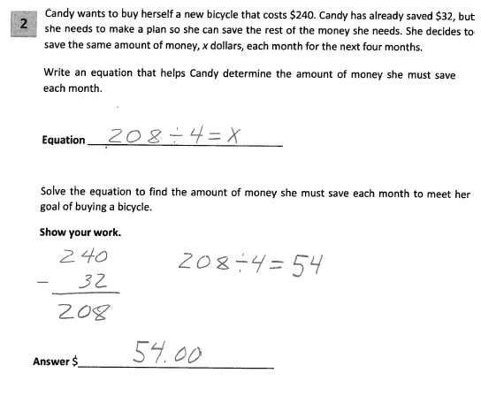
Grade 4 Extended-response Guide Paper 5
Score Point 2
15
Notes:
Refer participants to Guide Paper 5 in the Grade 4 Extended-response (3-point) Sample Guide Set packet.
Guide Paper 5 is also an example of a 2 point paper. This response demonstrates partial understanding and addresses most aspects of the task, using mathematically sound procedures. The equation is partially correct; it does not account for the 208. The mathematical procedure used to determine the amount of money to be saved each month is mathematically sound; however, the division error results in an incorrect answer.

Slide 16
Grade 4 Extended-response Guide Paper 5 Annotation
Score Point 2
This response demonstrates partial understanding and addresses most aspects of the task, using mathematically sound procedures. The equation is partially correct; it does not account for the 208. The mathematical procedure used to determine the amount of money to be saved each month is mathematically sound; however, the division error results in an incorrect answer.
16
Notes:
Direct the participants to read the annotation; ask if there are any questions. A second training option is to read or paraphrase the annotation for participants while viewing the response slide.

Slide 17
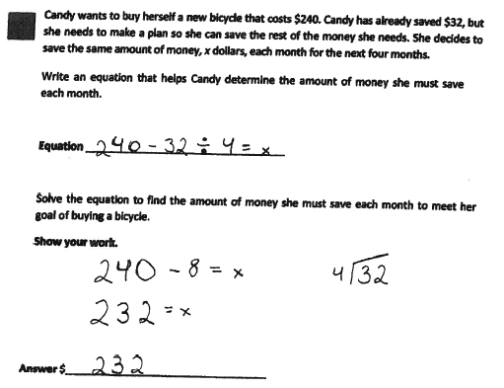
Grade 4 Extended-response Guide Paper 6
Score Point 2
17
Notes:
Refer participants to Guide Paper 6 in the Grade 4 Extended-response (3-point) Sample Guide Set packet.
Guide Paper 6 is our last example of a two point paper. This response demonstrates partial understanding. The equation is missing the parentheses around 240 - 32. However, the correct order of operations is followed to solve the incorrect equation.

Slide 18
Grade 4 Extended-response Guide Paper 6 Annotation
Score Point 2
This response demonstrates partial understanding. The equation is missing the parentheses around 240 - 32. However, the correct order of operations is followed to solve the incorrect equation.
18
Notes:
Direct the participants to read the annotation; ask if there are any questions. A second training option is to read or paraphrase the annotation for participants while viewing the response slide.

Slide 19
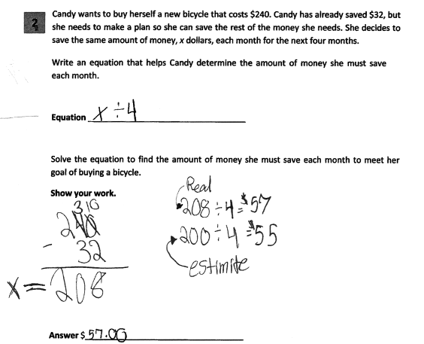
Grade 4 Extended-response Guide Paper 7
Score Point 1
19
Notes:
Refer participants to Guide Paper 7 in the Grade 4 Extended-response (3-point) Sample Guide Set packet.
Guide Paper 7 is our first example of a 1 point paper. This response exhibits many flaws and demonstrates only a limited understanding of the question. There is no equation given and the expression (x ÷ 4) does not show any understanding. The procedure used to solve the equation is appropriate; however, there are two division errors – both for the estimate (200 ÷ 4 = $55) and for the equation identified as “real” (208 ÷ 4 = $57). The final answer (57.00) is incorrect.

Slide 20
Grade 4 Extended-response Guide Paper 7 Annotation
Score Point 1
This response exhibits many flaws and demonstrates only a limited understanding of the question. There is no equation given and the expression (x ÷ 4) does not show any understanding. The procedure used to solve the equation is appropriate; however, there are two division errors – both for the estimate (200 ÷ 4 = $55) and for the equation identified as “real” (208 ÷ 4 = $57). The final answer (57.00) is incorrect.
20
Notes:
Direct the participants to read the annotation; ask if there are any questions. A second training option is to read or paraphrase the annotation for participants while viewing the response slide.

Slide 21
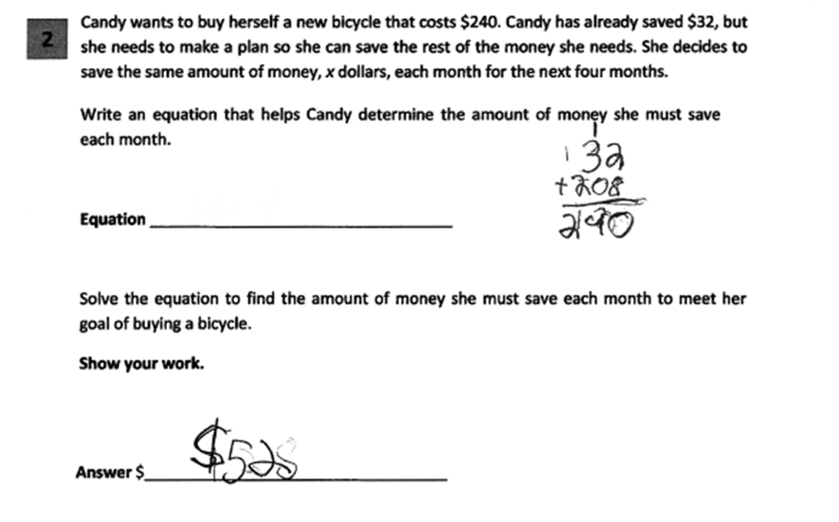
Grade 4 Extended-response Guide Paper 8
Score Point 1
21
Notes:
Refer participants to Guide Paper 8 in the Grade 4 Extended-response (3-point) Sample Guide Set packet.
Guide Paper 8 is scored as a 1. This response demonstrates only a limited understanding of the mathematical concepts. The equation is not provided and while the answer is correct, not all of the required work is provided.

Slide 22
Grade 4 Extended-response Guide Paper 8 Annotation
Score Point 1
This response demonstrates only a limited understanding of the mathematical concepts. The equation is not provided and while the answer is correct, not all of the required work is provided.
22
Notes:
Direct the participants to read the annotation; ask if there are any questions. A second training option is to read or paraphrase the annotation for participants while viewing the response slide.

Slide 23
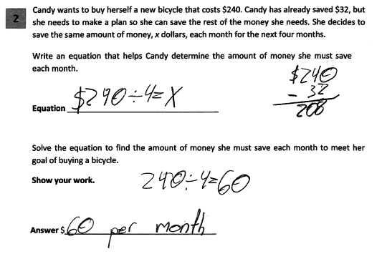
Grade 4 Extended-response Guide Paper 9
Score Point 1
23
Notes:
Refer participants to Guide Paper 9 in the Grade 4 Extended-response (3-point) Sample Guide Set packet.
Guide Paper 9 is also an example of a 1 point paper.
This response demonstrates only a limited understanding. While some aspects of the task are addressed correctly, faulty reasoning results in an inadequate solution. The equation is incorrect and does not take into account the $32 already saved. This reflects a lack of essential understanding of the underlying mathematical concept. However, that incorrect equation is solved correctly.

Slide 24
Grade 4 Extended-response Guide Paper 9 Annotation
Score Point 1
This response demonstrates only a limited understanding. While some aspects of the task are addressed correctly, faulty reasoning results in an inadequate solution. The equation is incorrect and does not take into account the $32 already saved. This reflects a lack of essential understanding of the underlying mathematical concept. However, that incorrect equation is solved correctly.
24
Notes:
Direct the participants to read the annotation; ask if there are any questions. A second training option is to read or paraphrase the annotation for participants while viewing the response slide.

Slide 25
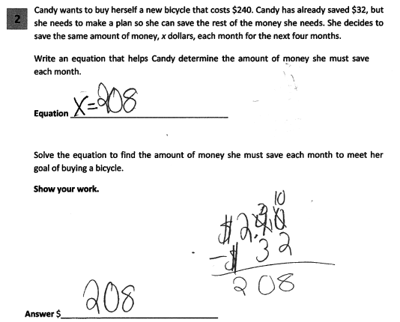
Grade 4 Extended-response Guide Paper 10
Score Point 0
25
Notes:
Refer participants to Guide Paper 10 in the Grade 4 Extended-response (3-point) Sample Guide Set packet.
Guide Paper 10 is our first example of a 0 point paper. This response is incorrect. The initial equation is not correct and only the very first step of the process is completed. This results in an incorrect answer. Holistically, this is not sufficient to demonstrate even a limited understanding of the mathematical concepts embodied in the task.

Slide 26
Grade 4 Extended-response Guide Paper 10 Annotation
Score Point 0
This response is incorrect. The initial equation is not correct and only the very first step of the process is completed. This results in an incorrect answer. Holistically, this is not sufficient to demonstrate even a limited understanding of the mathematical concepts embodied in the task.
Notes:
Direct the participants to read the annotation; ask if there are any questions. A second training option is to read or paraphrase the annotation for participants while viewing the response slide.

Slide 27
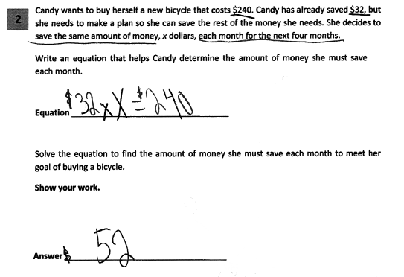
Grade 4 Extended-response Guide Paper 11
Score Point 0
27
Notes:
Refer participants to Guide Paper 11 in the Grade 4 Extended-response (3-point) Sample Guide Set packet.
This response is incorrect. The equation given is incorrect and while the final answer is correct, no correct work or mathematically appropriate process is shown that would lead to that answer. So Guide Paper 11 is an example of a 0 point paper.

Slide 28
Grade 4 Extended-response Guide Paper 11 Annotation
Score Point 0
This response is incorrect. The equation given is incorrect and while the final answer is correct, no correct work or mathematically appropriate process is shown that would lead to that answer.
28
Notes:
Direct the participants to read the annotation; ask if there are any questions. A second training option is to read or paraphrase the annotation for participants while viewing the response slide.

Slide 29
Grades 3-8 Mathematics Assessment Scoring Training
Video 1: Instructional Shifts
Video 2: Holistic Scoring
Video 3: Scoring Policies & the Test Development Process
Video 4: Two Point Holistic Rubric
Videos 5-8: Guide Papers and Practice Sets- 2 Point Rubric
Video 9: Three Point Holistic Rubric
Videos 10-13: Guide Papers and Practice Sets- 3 Point Rubric
Notes:
This concludes the guide paper analysis for the 4th grade 3 point question.
The next section in the Grade 4 Extended-response (3-point) Sample packet contains the practice papers for this question.
Using the 3 point holistic rubric, the scoring policies and these guide papers determine the scores for the practice papers.

Slide 30
Resources
For questions related to assessment:
Email your question to: emscassessinfo@mail.nysed.gov
Check for additional information at the following website http://www.p12.nysed.gov/assessment/ei/eigen.html
For questions related to APPR
Email your question to: educatoreval@mail.nysed.gov
Additional information regarding the common core shifts can be found at the following website:
http://engageny.org/resource/common-core-shifts/
30

