Slide 1
Video 11: Practice Papers for 4th Grade
Three Point Question
New York State 2013 Grades 3-8 Common Core Mathematics Rubric and Scoring Turnkey Training
Notes:
Ensure participants have a copy of the Grade 4 Extended-response (3-point) Sample Guide/Practice Set packet.
The general purpose of this video:
Now that you have the descriptions of the levels of performance on the three point rubric and have the seen how the guide papers to define what types of work demonstrate the understanding required for each level, we will use this information to score the 5 practice papers. If you find that your scores are not accurate, it is important to consider why. Once you are able to identify how the practice papers connect to the guide papers, your accuracy will improve.
Time estimate:
4 minutes

Slide 2
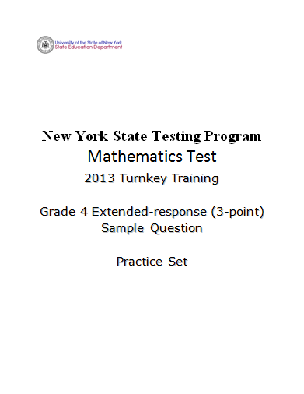
2
Notes:
Refer participants to Grade 4 Extended-response (3-point) Sample Practice Set packet.
If you have not yet had the opportunity to score the practice papers, please stop and score them before reviewing information.

Slide 3
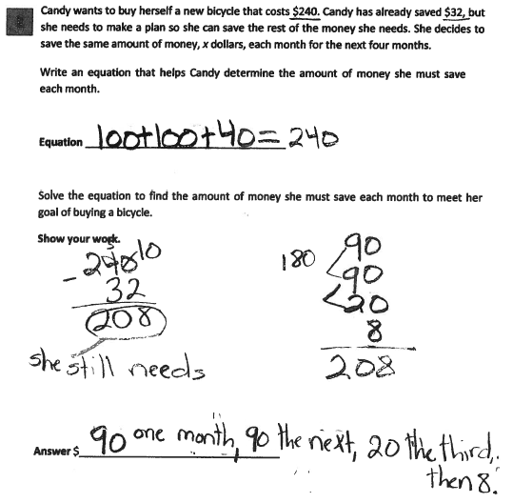
Grade 4 Extended-response Practice Paper 1
3
Notes:
Refer participants to Practice Paper 1 in the Grade 4 Extended-response (3-point) Sample Practice Set packet.
This response is incorrect. The equation does not contain a variable and is irrelevant. While the initial step in the solution is correct (240 – 32 = 208), the question’s direction specifying that the same amount of money is saved every month is disregarded, resulting in incorrect work and an incorrect answer. While some parts contain correct mathematical procedures, holistically, they are not sufficient to demonstrate even a limited understanding of the mathematical concepts embodied in the task.

Slide 4
Grade 4 Extended-response Practice Paper 1 Annotation
Score Point 0
This response is incorrect. The equation does not contain a variable and is irrelevant. While the initial step in the solution is correct (240 – 32 = 208), the question’s direction specifying that the same amount of money is saved every month is disregarded, resulting in incorrect work and an incorrect answer. While some parts contain correct mathematical procedures, holistically, they are not sufficient to demonstrate even a limited understanding of the mathematical concepts embodied in the task.
4
Notes:
Direct the participants to read the annotation; ask if there are any questions. A second training option is to read or paraphrase the annotation for participants while viewing the response slide.

Slide 5
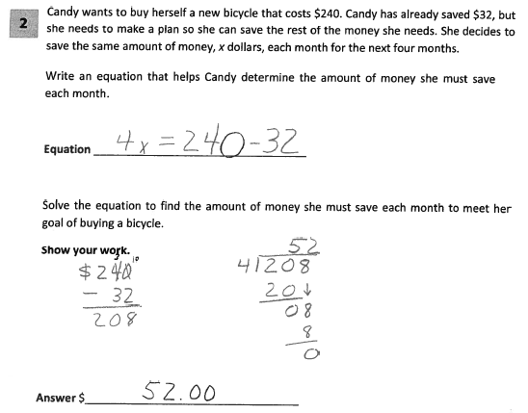
Grade 4 Extended-response Practice Paper 2
5
Notes:
Refer participants to Practice Paper 2 in the Grade 4 Extended-response (3-point) Sample Practice Set packet.
This response answers the question correctly and indicates that the student has completed the task correctly, using mathematically sound procedures. The equation given is correct. The mathematical procedure used to solve the equation is appropriate with all necessary work shown, and the final answer is correct.

Slide 6
Grade 4 Extended-response Practice Paper 2 Annotation
Score Point 3
This response answers the question correctly and indicates that the student has completed the task correctly, using mathematically sound procedures. The equation given is correct. The mathematical procedure used to solve the equation is appropriate with all necessary work shown, and the final answer is correct.
6
Notes:
Direct the participants to read the annotation; ask if there are any questions. A second training option is to read or paraphrase the annotation for participants while viewing the response slide.

Slide 7
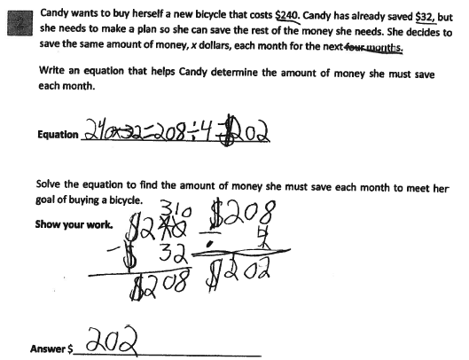
Grade 4 Extended-response Practice Paper 3
7
Notes:
Refer participants to Practice Paper 3 in the Grade 4 Extended-response (3-point) Sample Practice Set packet.
This response is incorrect. The equation is incorrect. Though some correct operations are indicated in the work, subtraction followed by division, only the subtraction is correctly completed. Holistically, this is not sufficient to demonstrate even a limited understanding of the mathematical concepts embodied in the task.

Slide 8
Grade 4 Extended-response Practice Paper 3 Annotation
Score Point 0
This response is incorrect. The equation is incorrect. Though some correct operations are indicated in the work, subtraction followed by division, only the subtraction is correctly completed. Holistically, this is not sufficient to demonstrate even a limited understanding of the mathematical concepts embodied in the task.
8
Notes:
Direct the participants to read the annotation; ask if there are any questions. A second training option is to read or paraphrase the annotation for participants while viewing the response slide.

Slide 9
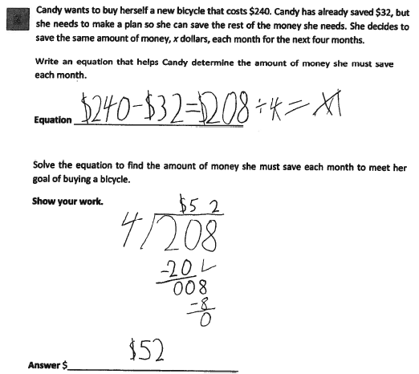
Grade 4 Extended-response Practice Paper 4
9
Notes:
Refer participants to Practice Paper 4 in the Grade 4 Extended-response (3-point) Sample Practice Set packet.
This response demonstrates partial understanding and addresses most aspects of the task using mathematically sound procedures. The equation is not correct. However, the mathematical procedure used and the answer are correct.

Slide 10
Grade 4 Extended-response Practice Paper 4 Annotation
Score Point 2
This response demonstrates partial understanding and addresses most aspects of the task using mathematically sound procedures. The equation is not correct. However, the mathematical procedure used and the answer are correct.
10
Notes:
Direct the participants to read the annotation; ask if there are any questions. A second training option is to read or paraphrase the annotation for participants while viewing the response slide.

Slide 11
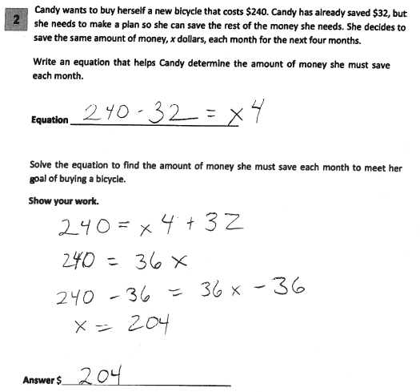
Grade 4 Extended-response Practice Paper 5
11
Notes:
Refer participants to Practice Paper 5 in the Grade 4 Extended-response (3-point) Sample Practice Set packet.
This response exhibits many flaws but is not completely incorrect. The written equation is an acceptable equation; however, the mathematical procedure used to solve the equation and the answer are flawed and incorrect.

Slide 12
Grade 4 Extended-response Practice Paper 5 Annotation
Score Point 1
This response exhibits many flaws but is not completely incorrect. The written equation is an acceptable equation; however, the mathematical procedure used to solve the equation and the answer are flawed and incorrect.
12
Notes:
Direct the participants to read the annotation; ask if there are any questions.

Slide 13
Grades 3-8 Mathematics Assessment Scoring Training
Video 1: Instructional Shifts
Video 2: Holistic Scoring
Video 3: Scoring Policies & the Test Development Process
Video 4: Two Point Holistic Rubric
Videos 5-8: Guide Papers and Practice Sets- 2 Point Rubric
Video 9: Three Point Holistic Rubric
Videos 10-13: Guide Papers and Practice Sets- 3 Point Rubric

Slide 14
Resources
For questions related to assessment:
Email your question to: emscassessinfo@mail.nysed.gov
Check for additional information at the following website http://www.p12.nysed.gov/apda/
For questions related to APPR
Email your question to: educatoreval@mail.nysed.gov
Additional information regarding the common core shifts can be found at the following website:
http://engageny.org/resource/common-core-shifts/
14
Notes:
Point out the available resources.
Cover any “parking lot” issues/questions that were tabled during the presentation.
A video of this training has been created and will be available, along with the handouts, on EngageNY.
Thank the participants for being engaged in the training, which covered a lot of material.

