Slide 1
Video 12: Guide Papers for 6th Grade
Three Point Question
New York State 2013 Grades 3-8 Common Core Mathematics Rubric and Scoring Turnkey Training
Notes:
Ensure participants have a copy of the Grade 6 Extended-response (3-point) Sample Guide/Practice Set packet.
The general purpose of this video:
Now that you have seen the descriptions of the levels of performance on the three point rubric we will use the guide papers to define what types of work demonstrate the understanding required for each level of the three point rubric
Time estimate:
4 minutes

Slide 2
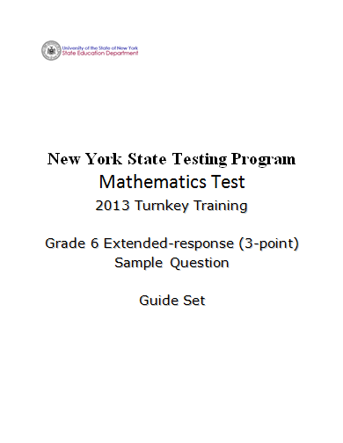
Notes:
Refer participants to the Grade 6 Extended-response (3-Point) Sample Question Guide Set packet.
You will also need your 3 Point Holistic Rubric and the Scoring Policies as you work through this section.
The first page after the cover sheet is the question.
The second page is the Common Core Learning Standard that this question assesses.

Slide 3
Grade 6 Extended-response Question
2
A closed box in the shape of a rectangular prism has a length of 13 cm, a width of 5.3 cm, and a height of 7.1 cm.
Draw a net of the box and find its surface area in square centimeters.
Show your work.
Answer .
3
Notes:
This is a sample of a grade 6 3 point question that is aligned with Common Core learning standard 6.G.4 .

Slide 4
Grade 6 Extended-response Common Core Learning Standard Assessed
CCLS 6.G.4
Represent three-dimensional figures using nets made up of rectangles and triangles, and use the nets to find the surface area of these figures. Apply these techniques in the context of solving real-world and mathematical problems.
Notes:
CCLS 6.G.4
Requires that students represent three-dimensional figures using nets made up of rectangles and triangles, and use the nets to find the surface area of these figures. Apply these techniques in the context of solving real-world and mathematical problems

Slide 5
Grade 6 Extended-response Question
2
A closed box in the shape of a rectangular prism has a length of 13 cm, a width of 5.3 cm, and a height of 7.1 cm.
Draw a net of the box and find its surface area in square centimeters.
Show your work.
Answer .
How would you answer this question?
5
Notes:
Take a couple minutes to think about how you would answer the question. (Allow participants 3 – 4 minutes to answer the question and reflect.)
Note: Calculators are permitted for all constructed-response questions in grades 6, 7 and 8.
Pause the video and solve this problem
Before we look at the guide papers consider-
Ask yourself what a typical a student response might look like at each of the levels of the three point rubric.
Pause the video to discuss or jot down your thoughts.

Slide 6
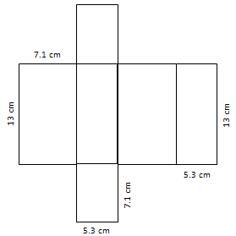
Grade 6 Extended-response Exemplar
2
A closed box in the shape of a rectangular prism has a length of 13 cm, a width of 5.3 cm, and a height of 7.1 cm.
Draw a net of the box and find its surface area in square centimeters.
Show your work.
Answer .
$$2×\left(13×7.1\right)=2×92.3=184.6$$
$$2×\left(5.3×7.1\right)=2×37.63=75.26$$
$$2×\left(5.3×13\right)=137.8$$
$$184.6+75.26+137.8=397.66$$
397.66 sq. cm.
6
Notes:
Talk through the response:
The net is correctly drawn and appropriately labeled. The work is shown for calculating the surface area. The total surface area is correct.
This is what we would expect as a common, but not the only, 3-point response.
Guide the discussion by asking a few teachers for other ways this question may be answered correctly or what we might expect as common 2-point, 1-point and 0-point responses.

Slide 7
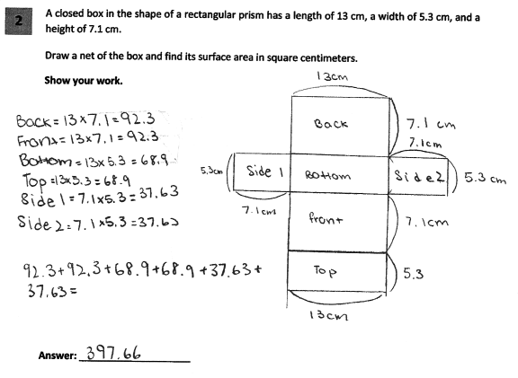
Grade 6 Extended-response Guide Paper 1
Score Point 3
7
Notes:
Refer participants to Guide Paper 1 in the Grade 6 Extended-response (3-Point) Sample Question Guide Set packet.
Guide Paper 1 is our first example of a 3 point paper.
This response answers the question correctly and demonstrates a thorough understanding of the mathematical concepts. A complete net is drawn and accurately labeled, and all calculations for each of the rectangles are shown. The final answer, the sum of the area of all six rectangles, is correct.

Slide 8
Grade 6 Extended-response Guide Paper 1 Annotation
Score Point 3
This response answers the question correctly and demonstrates a thorough understanding of the mathematical concepts. A complete net is drawn and accurately labeled, and all calculations for each of the rectangles are shown. The final answer, the sum of the area of all six rectangles, is correct.
Notes:
Direct the participants to read the annotation; ask if there are any questions. A second training option is to read or paraphrase the annotation for participants while viewing the response slide.

Slide 9
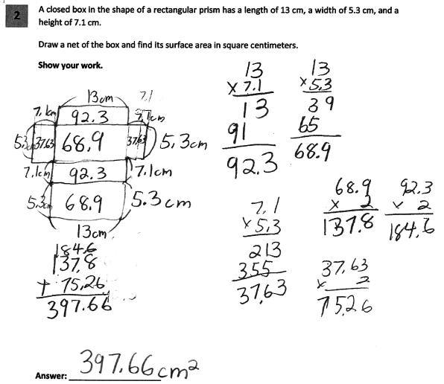
Grade 6 Extended-response Guide Paper 2
Score Point 3
9
Notes:
Refer participants to Guide Paper 2 in the Grade 6 Extended-response (3-Point) Sample Question Guide Set packet.
Guide Paper 2 is the next example of a 3 point paper.
This response answers the question correctly and indicates that the student has completed the task correctly, using mathematically sound procedures. A complete net is drawn and accurately labeled.
The calculations for each of the three sizes of rectangles are shown, multiplied by two, and then added.
The final answer is correct.

Slide 10
Grade 6 Extended-response Guide Paper 2 Annotation
Score Point 3
This response answers the question correctly and indicates that the student has completed the task correctly, using mathematically sound procedures. A complete net is drawn and accurately labeled. The calculations for each of the three sizes of rectangles are shown, multiplied by two, and then added. The final answer is correct.
Notes:
Direct the participants to read the annotation; ask if there are any questions. A second training option is to read or paraphrase the annotation for participants while viewing the response slide.

Slide 11
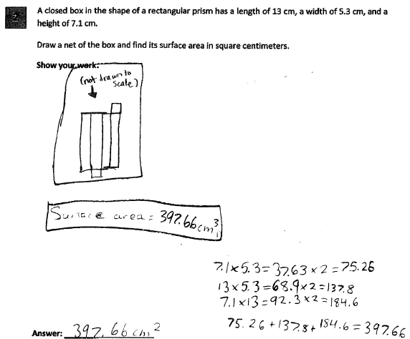
Grade 6 Extended-response Guide Paper 3
Score Point 3
11
Notes:
Refer participants to Guide Paper 3 in the Grade 6 Extended-response (3-Point) Sample Question Guide Set packet.
Guide Paper 3 is also an example of a 3 point paper.
This response answers the question correctly and demonstrates a thorough understanding of the mathematical concepts. A complete net is drawn.
The calculations for each of the three sizes of rectangles are shown, multiplied by two, and then added.
The final answer is correct.
Labeling the dimensions of the net is not required for demonstration of a thorough understanding of the problem.
The run-on number sentences and the cm³ label do not detract from the demonstration of a thorough understanding of the concepts.

Slide 12
Grade 6 Extended-response Guide Paper 3 Annotation
Score Point 3
This response answers the question correctly and demonstrates a thorough understanding of the mathematical concepts. A complete net is drawn. The calculations for each of the three sizes of rectangles are shown, multiplied by two, and then added. The final answer is correct. Labeling the dimensions of the net is not required for demonstration of a thorough understanding of the problem. The run-on equations and the cm³ label do not detract from the demonstration of a thorough understanding of the mathematical concepts.
Notes:
Direct the participants to read the annotation; ask if there are any questions. A second training option is to read or paraphrase the annotation for participants while viewing the response slide.

Slide 13
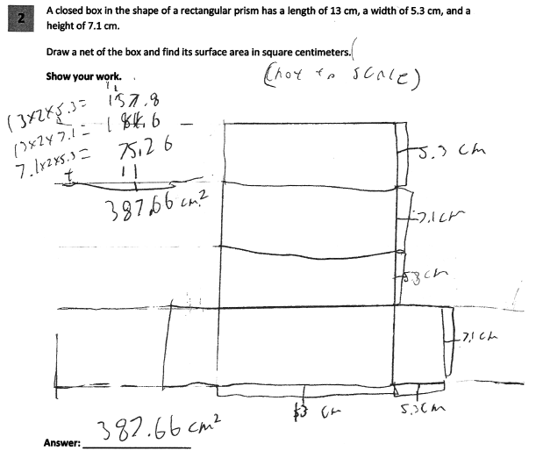
Grade 6 Extended-response Guide Paper 4
Score Point 2
13
Notes:
Refer participants to Guide Paper 4 in the Grade 6 Extended-response (3-Point) Sample Question Guide Set packet.
Guide Paper 4 is our first example of a 2 point paper.
This response is partially correct and addresses most aspects of the task, using mathematically sound procedures.
A complete net is drawn and accurately labeled, and the correct procedure for the area calculations for each of the rectangles is used.
However, a multiplication error is made while calculating one of the areas (13 × 2 × 5.3 = 157.8) and an addition error is made when determining the total area (157.8 + 184.6 + 75.26 = 387.66).
The training materials identify the lines that appear to be extra flaps on the net are indicators of the lengths of the sides, but I suspect that the student has seen a net where those extra flaps help you glue together your net after you have cut it out and folded it.

Slide 14
Grade 6 Extended-response Guide Paper 4 Annotation
Score Point 2
This response is partially correct and addresses most aspects of the task, using mathematically sound procedures. A complete net is drawn and accurately labeled, and the correct procedure for the area calculations for each of the rectangles is used. However, a multiplication error is made while calculating one of the areas (13 × 2 × 5.3 = 157.8) and an addition error is made when determining the total area (157.8 + 184.6 + 75.26 = 387.66). The lines that appear to be extra flaps on the net are indicators of the lengths of the sides.
Notes:
Direct the participants to read the annotation; ask if there are any questions. A second training option is to read or paraphrase the annotation for participants while viewing the response slide.

Slide 15
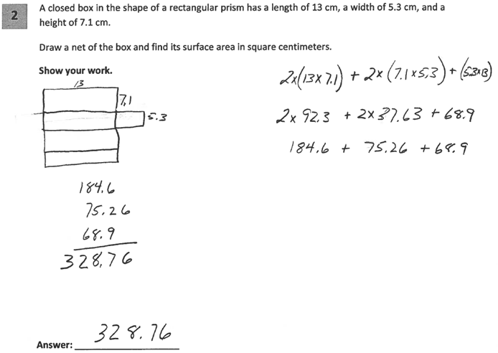
Grade 6 Extended-response Guide Paper 5
Score Point 2
15
Notes:
Refer participants to Guide Paper 5 in the Grade 6 Extended-response (3-Point) Sample Question Guide Set packet.
Guide Paper 5 is also an example of a 2 point paper.
This response demonstrates partial understanding of the mathematical procedures embodied in the task. The net, missing the rectangle that represents one side (5.3 by 7.1) of the box, is only partially correct. The surface area calculated is for an open, rather than a closed, box; the area representing the top of the box is not included.

Slide 16
Grade 6 Extended-response Guide Paper 5 Annotation
Score Point 2
This response demonstrates partial understanding of the mathematical procedures embodied in the task. The net, missing the rectangle that represents one side (5.3 by 7.1) of the box, is only partially correct. The surface area calculated is for an open, rather than a closed, box; the area representing the top of the box is not included.
Notes:
Direct the participants to read the annotation; ask if there are any questions. A second training option is to read or paraphrase the annotation for participants while viewing the response slide.

Slide 17
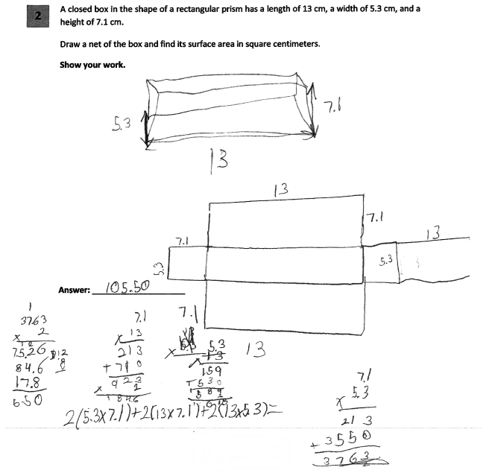
Grade 6 Extended-response Guide Paper 6
Score Point 2
17
Notes:
Refer participants to Guide Paper 6 in the Grade 6 Extended-response (3-Point) Sample Question Guide Set packet.
Guide Paper 6 is our last example of a 2 point paper.
This response is partially correct and addresses most aspects of the task, using mathematically sound procedures. A complete net is drawn and accurately labeled, and the correct procedure for the total area calculation is shown in the work. However, minor calculation errors result in an incorrect answer. It looks like the student set up the correct process here, but it’s unclear what they had as an answer and quite possibly they couldn’t read what they had written here either which led to the computation error.

Slide 18
Grade 6 Extended-response Guide Paper 6 Annotation
Score Point 2
This response is partially correct and addresses most aspects of the task, using mathematically sound procedures. A complete net is drawn and accurately labeled, and the correct procedure for the total area calculation is shown in the work. However, minor calculation errors result in an incorrect answer.
Notes:
Direct the participants to read the annotation; ask if there are any questions. A second training option is to read or paraphrase the annotation for participants while viewing the response slide.

Slide 19
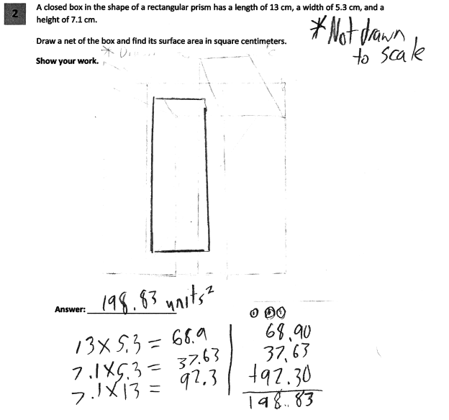
Grade 6 Extended-response Guide Paper 7
Score Point 1
19
Notes:
Refer participants to Guide Paper 7 in the Grade 6 Extended-response (3-Point) Sample Question Guide Set packet.
Guide Paper 7 is our first example of a 1 point paper.
This response is incomplete and exhibits many flaws but is not completely incorrect; it addresses some elements of the task correctly but reaches an inadequate solution and provides reasoning that is incomplete.
No net is shown- they have only drawn one rectangle.
The area calculations for each size rectangle are shown and are correctly added together. However, the determined value is not multiplied by 2 to determine the total surface area.

Slide 20
Grade 6 Extended-response Guide Paper 7 Annotation
Score Point 1
This response is incomplete and exhibits many flaws but is not completely incorrect; it addresses some elements of the task correctly but reaches an inadequate solution and provides reasoning that is incomplete. No net is shown. The area calculations for each size rectangle are shown and are correctly added together. However, the determined value is not multiplied by two to determine the total surface area.
Notes:
Direct the participants to read the annotation; ask if there are any questions. A second training option is to read or paraphrase the annotation for participants while viewing the response slide.

Slide 21
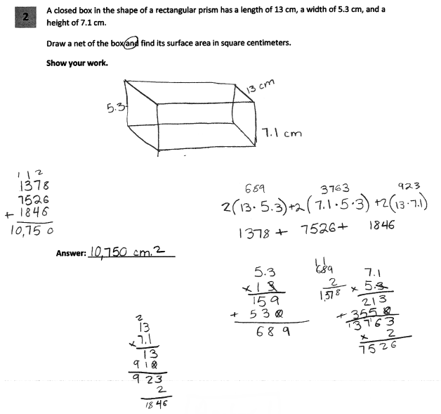
Grade 6 Extended-response Guide Paper 8
Score Point 1
21
Notes:
Refer participants to Guide Paper 8 in the Grade 6 Extended-response (3-Point) Sample Question Guide Set packet.
Guide Paper 8 is another 1 point example.
This response exhibits many flaws but is not completely incorrect and demonstrates only a limited understanding of the mathematical procedures embodied in the task.
They drew a sketch of the rectangular prism but no net is shown.
While the work shows the correct procedures for the calculation of the total surface area, multiplication errors for all three sizes of rectangles result in an incorrect answer. The student dropped the decimal points so this leads to an incorrect sum when the quantities are added.

Slide 22
Grade 6 Extended-response Guide Paper 8 Annotation
Score Point 1
This response exhibits many flaws but is not completely incorrect and demonstrates only a limited understanding of the mathematical procedures embodied in the task. No net is shown. While the work shows the correct procedures for the calculation of the total surface area, multiplication errors for all three sizes of rectangles result in an incorrect answer.
Notes:
Direct the participants to read the annotation; ask if there are any questions. A second training option is to read or paraphrase the annotation for participants while viewing the response slide.

Slide 23
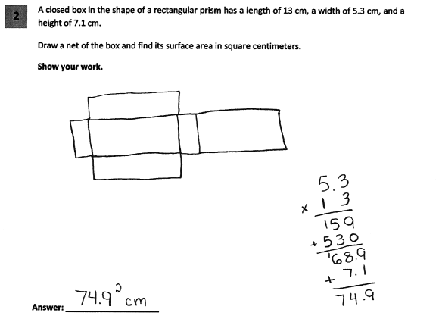
Grade 6 Extended-response Guide Paper 9
Score Point 1
23
Notes:
Refer participants to Guide Paper 9 in the Grade 6 Extended-response (3-Point) Sample Question Guide Set packet.
Guide Paper 9 is our last example of a 1 point paper.
This response exhibits many flaws but is not completely incorrect and reflects a lack of essential understanding of the underlying mathematical concepts. An appropriate net is shown. However, an inappropriate mathematical process is used to determine the surface area and the answer is incorrect. So drawing the correct net was deemed to be sufficient for demonstrating a limited understanding of this task.

Slide 24
Grade 6 Extended-response Guide Paper 9 Annotation
Score Point 1
This response exhibits many flaws but is not completely incorrect and reflects a lack of essential understanding of the underlying mathematical concepts. An appropriate net is shown. However, an inappropriate mathematical process is used to determine the surface area and the answer is incorrect.
24
Notes:
Direct the participants to read the annotation; ask if there are any questions. A second training option is to read or paraphrase the annotation for participants while viewing the response slide.

Slide 25
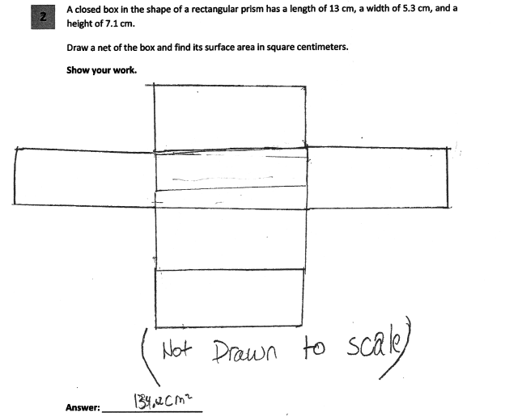
Grade 6 Extended-response Guide Paper 10
Score Point 0
25
Notes:
Refer participants to Guide Paper 10 in the Grade 6 Extended-response (3-Point) Sample Question Guide Set packet.
Guide Paper 10 is our first example of a 0 point paper.
This response is incorrect. A net is shown; however, but this differs from Guide Paper 9 because the size of all 6 rectangles is approximately the same. This net is not an appropriate representation of the original three-dimensional figure. No other work is shown and the answer given is incorrect.

Slide 26
Grade 6 Extended-response Guide Paper 10 Annotation
Score Point 0
This response is incorrect. A net is shown; however, the size of all six rectangles is approximately the same. This net is not an appropriate representation of the original three-dimensional figure. No other work is shown and the answer given is incorrect.
26
Notes:
Direct the participants to read the annotation; ask if there are any questions. A second training option is to read or paraphrase the annotation for participants while viewing the response slide.

Slide 27
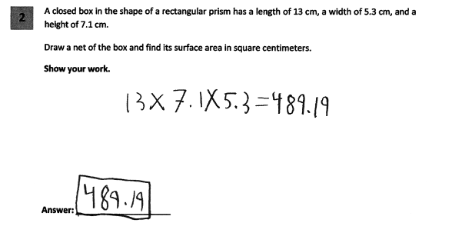
Grade 6 Extended-response Guide Paper 11
Score Point 0
27
Notes:
Refer participants to Guide Paper 11 in the Grade 6 Extended-response (3-Point) Sample Question Guide Set packet.
Guide Paper 11 is a 0 point paper because this response is irrelevant. No net is shown and the volume is calculated, rather than the surface area.

Slide 28
Grade 6 Extended-response Guide Paper 11 Annotation
Score Point 0
This response is irrelevant. No net is shown and the volume is calculated, rather than the surface area.
28
Notes:
Direct the participants to read the annotation; ask if there are any questions. A second training option is to read or paraphrase the annotation for participants while viewing the response slide.

Slide 29
Grades 3-8 Mathematics Assessment Scoring Training
Video 1: Instructional Shifts
Video 2: Holistic Scoring
Video 3: Scoring Policies & the Test Development Process
Video 4: Two Point Holistic Rubric
Videos 5-8: Guide Papers and Practice Sets- 2 Point Rubric
Video 9: Three Point Holistic Rubric
Videos 10-13: Guide Papers and Practice Sets- 3 Point Rubric
Notes:
This concludes the guide paper analysis for the 6th grade 3 point question.
The next section in the Grade 6 Extended-response (3-point) Sample packet contains the practice papers for this question.
Using the 3 point holistic rubric, the scoring policies and these guide papers determine the scores for the practice papers.
Video 12 will review the practice problems and explain the scores assigned to those papers.

Slide 30
Resources
For questions related to assessment:
Email your question to: emscassessinfo@mail.nysed.gov
Check for additional information at the following website http://www.p12.nysed.gov/assessment/ei/eigen.html
For questions related to APPR
Email your question to: educatoreval@mail.nysed.gov
Additional information regarding the common core shifts can be found at the following website:
http://engageny.org/resource/common-core-shifts/
30

