Slide 1
Video 13: Guide Papers for 6th Grade
Three Point Question
New York State 2013 Grades 3-8 Common Core Mathematics Rubric and Scoring Turnkey Training
Notes:
Ensure participants have a copy of the Grade 6 Extended-response (3-point) Sample Guide/Practice Set packet.
The general purpose of this video:
Now that you have the descriptions of the levels of performance on the three point rubric and have the seen how the guide papers to define what types of work demonstrate the understanding required for each level, we will use this information to score the 5 practice papers. If you find that your scores are not accurate, it is important to consider why. Once you are able to identify how the practice papers connect to the guide papers, your accuracy will improve.
Time estimate:
4 minutes

Slide 2
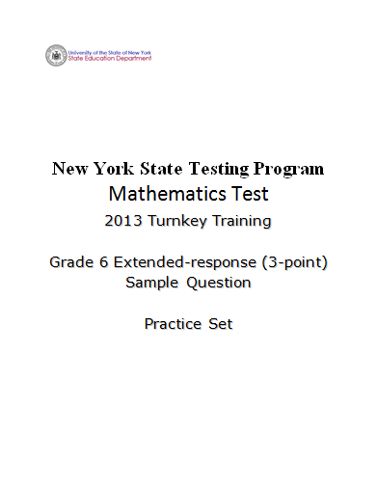
Notes:
Refer participants to the Grade 6 Extended-response (3-Point) Sample Question Practice Set packet.
If you have not already scored the practice set, please pause the video so you can read and score the entire practice set prior to reviewing the responses in the set.

Slide 3
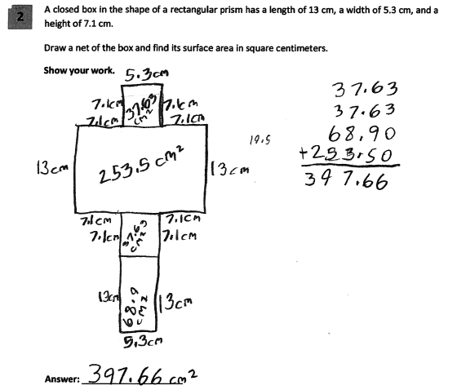
Grade 6 Extended-response Practice Paper 1
3
Notes:
Refer participants to Practice Paper 1 in the Grade 6 Extended-response (3-Point) Sample Question Practice Set packet.
This response is partially correct and demonstrates partial understanding of the mathematical procedures embodied in the task. A net is drawn and the dimensions are correctly labeled; however, there are two missing lines which result in four rectangles instead of six. The area of each labeled rectangle is correct. The areas of the four rectangles shown on the incorrect net are added correctly and the final answer is correct.

Slide 4
Grade 6 Extended-response Practice Paper 1 Annotation
Score Point 2
This response is partially correct and demonstrates partial understanding of the mathematical procedures embodied in the task. A net is drawn and the dimensions are correctly labeled; however, there are two missing lines which result in four rectangles instead of six. The area of each labeled rectangle is correct. The areas of the four rectangles shown on the incorrect net are added correctly and the final answer is correct.
4
Notes:
Direct the participants to read the annotation; ask if there are any questions. A second training option is to read or paraphrase the annotation for participants while viewing the response slide.

Slide 5
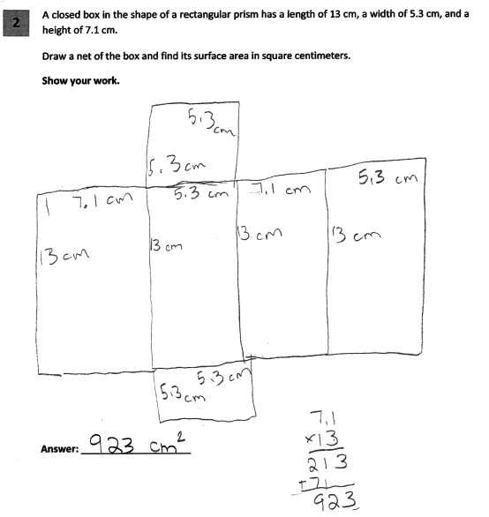
Grade 6 Extended-response Practice Paper 2
5
Notes:
Refer participants to Practice Paper 2 in the Grade 6 Extended-response (3-Point) Sample Question Practice Set packet.
This response exhibits many flaws but is not completely incorrect and reflects a lack of essential understanding of the underlying mathematical concepts. Although not all of the labels are accurate, an appropriate net is shown. However, an inappropriate mathematical process is used to determine the surface area and the answer is incorrect.

Slide 6
Grade 6 Extended-response Practice Paper 2 Annotation
Score Point 1
This response exhibits many flaws but is not completely incorrect and reflects a lack of essential understanding of the underlying mathematical concepts. Although not all of the labels are accurate, an appropriate net is shown. However, an inappropriate mathematical process is used to determine the surface area and the answer is incorrect.
6
Notes:
Direct the participants to read the annotation; ask if there are any questions. A second training option is to read or paraphrase the annotation for participants while viewing the response slide.

Slide 7
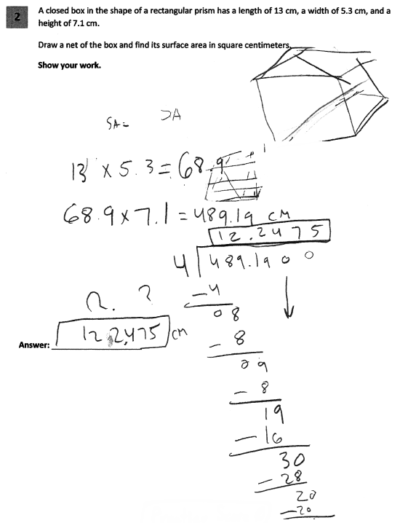
Grade 6 Extended-response Practice Paper 3
7
Notes:
Refer participants to Practice Paper 3 in the Grade 6 Extended-response (3-Point) Sample Question Practice Set packet.
This response is irrelevant. No net is shown and the volume is calculated and then divided by 4. The surface area is not determined.

Slide 8
Grade 6 Extended-response Practice Paper 3 Annotation
Score Point 0
This response is irrelevant. No net is shown and the volume is calculated and then divided by four. The surface area is not determined.
8
Notes:
Direct the participants to read the annotation; ask if there are any questions. A second training option is to read or paraphrase the annotation for participants while viewing the response slide.

Slide 9
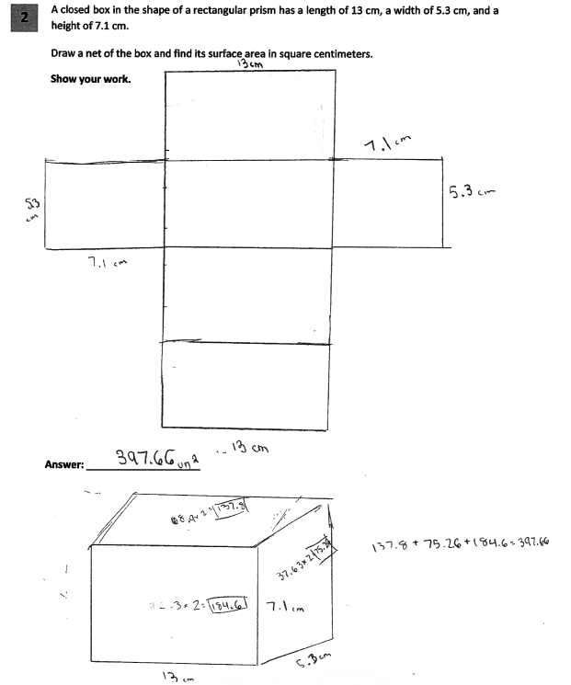
Grade 6 Extended-response Practice Paper 4
9
Notes:
Refer participants to Practice Paper 4 in the Grade 6 Extended-response (3-Point) Sample Question Practice Set packet.
This response answers the question correctly and demonstrates a thorough understanding of the mathematical concepts. A complete net is drawn and accurately labeled. The areas are shown on a three-dimensional box with labeled sides, indicating the values used to determine the areas. These areas are multiplied by two and then added, resulting in the correct answer.

Slide 10
Grade 6 Extended-response Practice Paper 4 Annotation
Score Point 3
This response answers the question correctly and demonstrates a thorough understanding of the mathematical concepts. A complete net is drawn and accurately labeled. The areas are shown on a three-dimensional box with labeled sides, indicating the values used to determine the areas. These areas are multiplied by two and then added, resulting in the correct answer.
10
Notes:
Direct the participants to read the annotation; ask if there are any questions. A second training option is to read or paraphrase the annotation for participants while viewing the response slide.

Slide 11
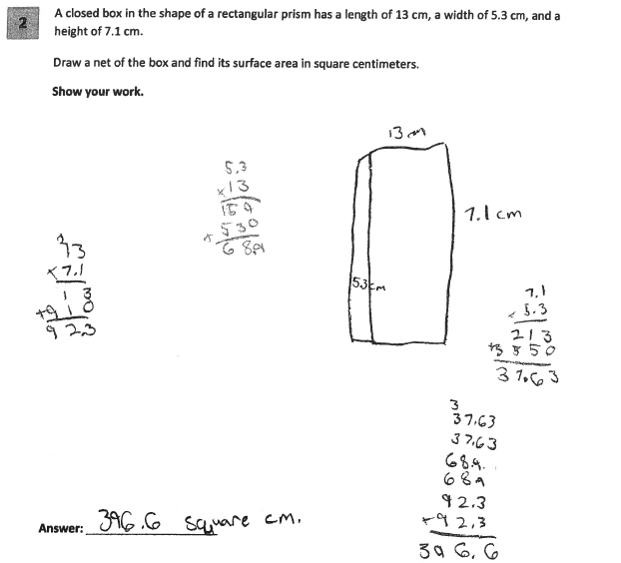
Grade 6 Extended-response Practice Paper 5
11
Notes:
This response exhibits many flaws but is not completely incorrect and demonstrates only a limited understanding of the mathematical procedures embodied in the task. No net is shown. While the areas of the rectangles are all calculated correctly, an addition error and an inappropriate truncation result in an incorrect answer (396.6).

Slide 12
Grade 6 Extended-response Practice Paper 5 Annotation
Score Point 1
This response exhibits many flaws but is not completely incorrect and demonstrates only a limited understanding of the mathematical procedures embodied in the task. No net is shown. While the areas of the rectangles are all calculated correctly, an addition error and an inappropriate truncation result in an incorrect answer (396.6).
12
Notes:
Direct the participants to read the annotation; ask if there are any questions. A second training option is to read or paraphrase the annotation for participants while viewing the response slide.

Slide 13
Grades 3-8 Mathematics Assessment Scoring Training
Video 1: Instructional Shifts
Video 2: Holistic Scoring
Video 3: Scoring Policies & the Test Development Process
Video 4: Two Point Holistic Rubric
Videos 5-8: Guide Papers and Practice Sets- 2 Point Rubric
Video 9: Three Point Holistic Rubric
Videos 10-13: Guide Papers and Practice Sets- 3 Point Rubric

Slide 14
Resources
For questions related to assessment:
Email your question to: emscassessinfo@mail.nysed.gov
Check for additional information at the following website http://www.p12.nysed.gov/apda/
For questions related to APPR
Email your question to: educatoreval@mail.nysed.gov
Additional information regarding the common core shifts can be found at the following website:
http://engageny.org/resource/common-core-shifts/
14
Notes:
Point out the available resources.
Cover any “parking lot” issues/questions that were tabled during the presentation.
A video of this training has been created and will be available, along with the handouts, on EngageNY.
Thank the participants for being engaged in the training, which covered a lot of material.

