Slide 1
Video 3: Scoring Policies and
Test Development Process
New York State 2013 Grades 3-8 Common Core Mathematics Rubric and Scoring Turnkey Training
Notes:
Ensure participants have a copy of the “New York State Testing Program Mathematics Test 2013 Turnkey Training : Rubrics, Scoring Policies and Practice Score Sheet” materials
The general purpose of this video: To examine the changes in the scoring policies and to understand the test development process.
Time estimate:
4 minutes

Slide 2
Scoring Policies
Notes:
We will next discuss the Scoring Policies that go along with the 2- and 3-point holistic rubrics
Time estimate:
20 minutes

Slide 3
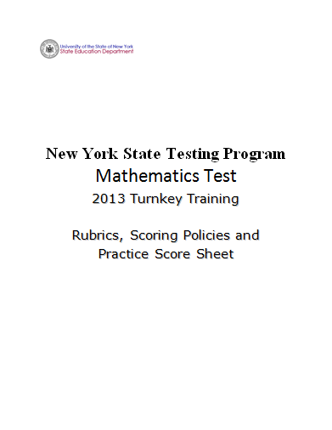
Notes:
Refer participants to the Rubrics, Scoring Policies and Practice Score Sheet packet.

Slide 4
2- and 3-point Mathematics Scoring Policies (pg. 2)
Below are the policies to be followed while scoring the mathematics tests for all grades:
If a student does the work in other than a designated “Show your work” area, that work should still be scored. (Additional paper is an allowable accommodation for a student with disabilities if indicated on the student’s Individualized Education Program or Section 504 Accommodation Plan.)
If the question requires students to show their work, and the student shows appropriate work and clearly identifies a correct answer but fails to write that answer in the answer blank, the student should still receive full credit.
If the question requires students to show their work, and the student shows appropriate work and arrives at the correct answer but writes an incorrect answer in the answer blank, the student should not receive full credit.
In questions that provide ruled lines for students to write an explanation of their work, mathematical work shown elsewhere on the page should be considered and scored.
If the student provides one legible response (and one response only), teachers should score the response, even if it has been crossed out.
Notes:
Below are the policies to be followed while scoring the mathematics tests for all grades:
The pre-Common Core Scoring Polices and Scoring Clarifications have been reduced from 23 to 12 policy statements for the Common Core based test. Make special note that only the policies in this document may be used when scoring student responses based on the Common Core Standards. The old scoring policies do not apply to this year’s exams.
Read through the scoring policies. (Policy 1 and 2 are the same as they were last year)
Policy 3 What the student writes on the line is what they are indicating they saw the answer to be. (also the same as last year)
Policy 4 is modified from the previous policy, where work outside the ruled lines could not be considered unless the student directed the scorer to that work with an arrow or a note to “see my work.”
Policy 5 also applies to situations where a student has one erased answer but you can see what the answer was. This answer should be scored.

Slide 5
2- and 3-point Mathematics Scoring Policies (Continued)
If the student has written more than one response but has crossed some out, teachers should score only the response that has not been crossed out.
Trial-and-error responses are not subject to Scoring Policy #6 above, since crossing out is part of the trial-and-error process.
If a response shows repeated occurrences of the same conceptual error within a question, the student should not be penalized more than once.
In questions that require students to provide bar graphs:
In Grades 3 and 4 only, touching bars are acceptable.
In Grades 3 and 4 only, space between bars does not need to be uniform.
In all grades, widths of the bars must be consistent.
In all grades, bars must be aligned with their labels.
In all grades, scales must begin at zero (0), but the 0 does not need to be written.
Notes:
Policy 6- No change
Policy 7- Students used to have to have 3 trials… this isn’t expressly required in this policy.
Policy 8- This goes along with the concept of holistic scoring – it is essentially just one error. (same as last year)

Slide 6
2- and 3-point Mathematics Scoring Policies (Continued)
In questions requiring number sentences, the number sentences must be written horizontally.
In pictographs, the student is permitted to use a symbol other than the one in the key, provided that the symbol is used consistently in the pictograph; the student does not need to change the symbol in the key. The student may not, however, use multiple symbols within the chart, nor may the student change the value of the symbol in the key.
If students are not directed to show work, any work shown will not be scored. This applies to items that do not ask for any work and items that ask for work for one part and do not ask for work in another part.
Notes:
Policy 10- This also applies to questions where students are asked to write an inequality or an equation

Slide 7
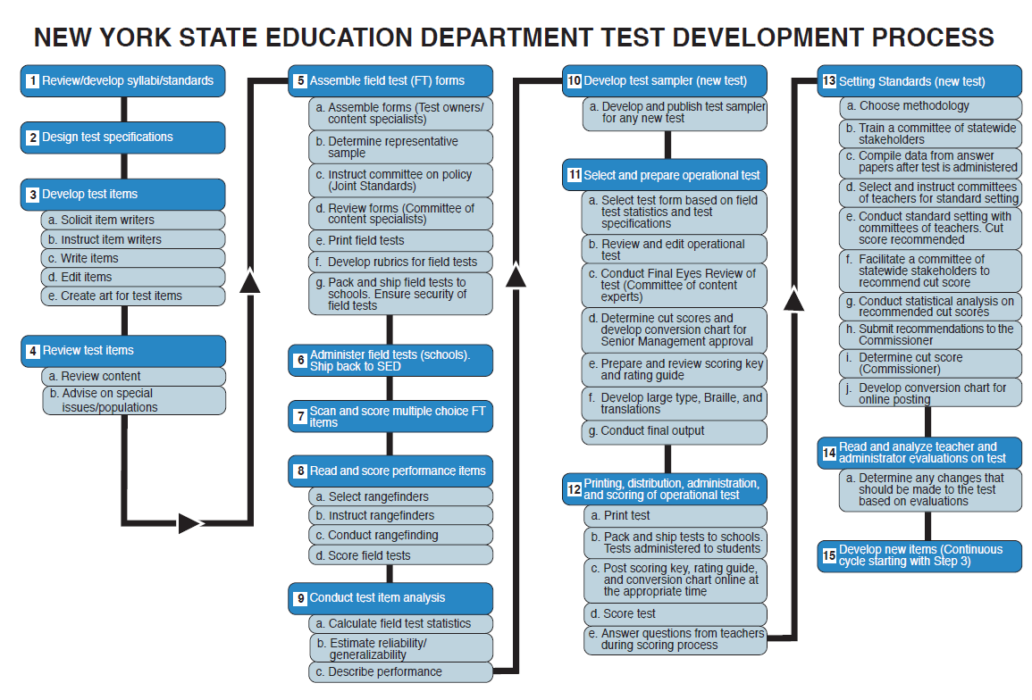
Notes:
As I had mentioned before, the number of scoring policies have been reduced and this provides greater flexibility to define the appropriate scores for a question through the guide papers.
This is a good time to stop and address the question of how an item gets on the test and how are the guide papers used to score the questions are selected.
For a question to end up on a state exam it is a year and half to two year process. Questions are currently being written for 2014 test.
Part of the review process involves a committee of teachers getting together and looking at the questions. Does the question assess the standard? Is it written appropriately for that grade level? They provide their knowledge as classroom teachers to the editing process so that the questions are vetted and then are signed off on by the state education department.
Then the questions appear on a field test where we are testing the question. The student responses are gathered together and are assembled into a range of responses that are shown to a committee of teachers. During that range finding process if we have a committee of 6 teachers and they have a set of papers. Each response is scored separately by those 6 teachers and then they talk about why they scored the paper the way they did and eventually they come to a consensus as to what the score for each paper should be. So on this committee of 6 one person may have scored the paper 0, someone else scored the paper 1, 2, and 2, 0 and 1. As a committee they need to come to a consensus on the score for each paper. Choose 8 papers for the 2 point score papers and 11 papers for 3 point score papers those become the guide papers. And then those guides papers are reviewed by the state education department and then if approved by those become the guide papers used in scoring. Once those decisions have been made and have been reviewed and signed off by the state education department those decisions are set in stone. We may disagree with the decisions that the committee has made, but they made the decision and that’s where it stands. This is the process that materials that we will be using this year to score the state test have gone through. There may be some responses in those scoring materials that you personally feel should have a different score but for consistent scoring across the state we need to set those opinions aside so that all the students that respond in the same way get the same score.

Slide 8
Grades 3-8 Mathematics Assessment Scoring Training
Video 1: Instructional Shifts
Video 2: Holistic Scoring
Video 3: Scoring Policies & the Test Development Process
Video 4: Two Point Holistic Rubric
Videos 5-8: Guide Papers and Practice Sets- 2 Point Rubric
Video 9: Three Point Holistic Rubric
Videos 10-13: Guide Papers and Practice Sets- 3 Point Rubric

Slide 9
Resources
For questions related to assessment:
Email your question to: emscassessinfo@mail.nysed.gov
Check for additional information at the following website http://www.p12.nysed.gov/assessment/ei/eigen.html
For questions related to APPR
Email your question to: educatoreval@mail.nysed.gov
Additional information regarding the common core shifts can be found at the following website:
http://engageny.org/resource/common-core-shifts/
9

