Slide 1
Video 4: 2-Point Holistic Rubric
New York State 2013 Grades 3-8 Common Core Mathematics Rubric and Scoring Turnkey Training
Notes:
Ensure participants have a copy of the “New York State Testing Program Mathematics Test 2013 Turnkey Training : Rubrics, Scoring Policies and Practice Score Sheet” materials
The general purpose of this video: To examine the changes in the two-point holistic rubric
Time estimate:
4 minutes

Slide 2
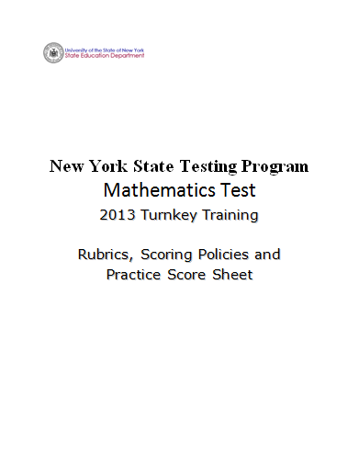
Notes:
Refer participants to the Rubrics, Scoring Policies and Practice Score Sheet packet.

Slide 3
Mathematics 2-point Holistic Rubric (pg. 1)
Score Point | Description
2 Points | A two-point response answers the question correctly. This response demonstrates a thorough understanding of the mathematical concepts but may contain errors that do not detract from the demonstration of understanding indicates that the student has completed the task correctly, using mathematically sound procedures
1 Point | A one-point response is only partially correct. This response indicates that the student has demonstrated only a partial understanding of the mathematical concepts and/or procedures in the task correctly addresses some elements of the task may contain an incorrect solution but applies a mathematically appropriate process may contain correct numerical answer(s) but required work is not provided
0 Points | A zero-point response is incorrect, irrelevant, incoherent, or contains a correct response arrived using an obviously incorrect procedure. Although some parts may contain correct mathematical procedures, holistically they are not sufficient to demonstrate even a limited understanding of the mathematical concepts embodied in the task.
Notes:
Refer participants to the 2-point Holistic Rubric in their packet.
The 2-point rubric applies to all grade 3 – 8 short-response questions. Responses that demonstrate each level of understanding are further defined by the approved guide papers. It is important to understand the differences in the language at each score point on the rubric. The Guide papers will show how the student responses are held to the criteria in the rubric.

Slide 4
Mathematics 2-point Holistic Rubric (Continued)
Score Point | Description
2 Points | A two-point response answers the question correctly. This response demonstrates a thorough understanding of the mathematical concepts but may contain errors that do not detract from the demonstration of understanding indicates that the student has completed the task correctly, using mathematically sound procedures
Notes:
Read through the rubric. Read all text from score point 2 first and then move down the score scale.
A two-point response answers the question correctly.
This response
demonstrates a thorough understanding of the mathematical concepts but may contain errors that do not detract from the demonstration of understanding
indicates that the student has completed the task correctly, using mathematically sound procedures

Slide 5
Mathematics 2-point Holistic Rubric (Continued)
Score Point | Description
2 Points | A two-point response answers the question correctly. This response demonstrates a thorough understanding of the mathematical concepts but may contain errors that do not detract from the demonstration of understanding indicates that the student has completed the task correctly, using mathematically sound procedures
Notes:
Note the 2-point description is changed from “…complete and correct” in the old rubric to “…answers the question correctly” in the Common Core based rubric. A 2-point response will still have the correct answer, but does not have to be flawless if a thorough understanding is clearly demonstrated.

Slide 6
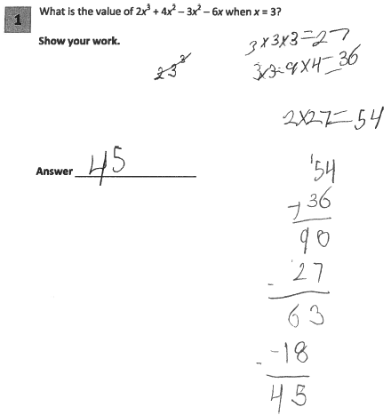
Grade 6 Short-response Practice Paper 5
Score Point 2
Notes:
Refer participants to Practice Paper 5 in the Grade 6 Short-response (2-point) Sample Practice Set packet.
Practice Paper 5 receives a score of 2. It has the correct answer of 45. The step showing that 3x3=9x4=36 is a false mathematical statement but is wasn’t deemed to detract from the level of understanding demonstrated in the response

Slide 7
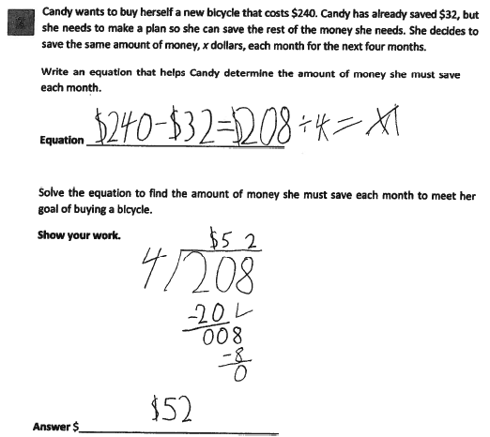
Grade 4 Extended-response Practice Paper 4
7
Notes:
Refer participants to Practice Paper 4 in the Grade 4 Extended-response (3-point) Sample Practice Set packet.
The equation is not correct. However, the mathematical procedure used and the answer are correct.

Slide 8
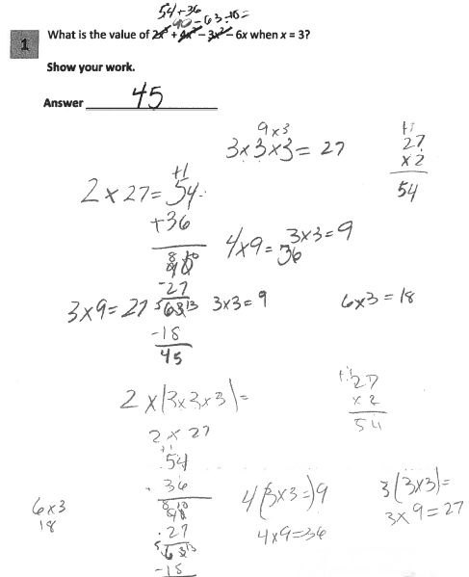
Grade 6 Short-response Guide Paper 3
Notes:
Note that one calculation shown is incorrect (4(3 × 3 =) 9), but the following line shows the correct calculation and this inaccurate statement within the work does not detract from the demonstration of a thorough understanding.
This work is an example of a level 2 response that contains a correct answer arrived at using a correct procedure with a minor inaccuracy that doesn’t detract from a demonstration of understanding.

Slide 9
Mathematics 2-point Holistic Rubric (Continued)
Score Point | Description
1 Point | A one-point response is only partially correct. This response indicates that the student has demonstrated only a partial understanding of the mathematical concepts and/or procedures in the task correctly addresses some elements of the task may contain an incorrect solution but applies a mathematically appropriate process may contain correct numerical answer(s) but required work is not provided
Notes:
Read the description of a score of a 1
Note the differences in language between score 2 point and the 1 point level of the rubric.

Slide 10
Mathematics 2-point Holistic Rubric (Continued)
Score Point | Description
0 Points | A zero-point response is incorrect, irrelevant, incoherent, or contains a correct response arrived using an obviously incorrect procedure. Although some parts may contain correct mathematical procedures, holistically they are not sufficient to demonstrate even a limited understanding of the mathematical concepts embodied in the task.
Notes:
Read and explain the 0 point score point.
What is considered a limited understanding- guide papers define the boundary between a score of 1 and a score of 0 for a particular question.

Slide 11
Grades 3-8 Mathematics Assessment Scoring Training
Video 1: Instructional Shifts
Video 2: Holistic Scoring
Video 3: Scoring Policies & the Test Development Process
Video 4: Two Point Holistic Rubric
Videos 5-8: Guide Papers and Practice Sets- 2 Point Rubric
Video 9: Three Point Holistic Rubric
Videos 10-13: Guide Papers and Practice Sets- 3 Point Rubric
Notes:
This concludes video 4 on the two point holistic rubric.
The rubrics define the levels of performance but it’s the guide papers that really show us what student work looks like at each level.
Move onto the next videos to extend your understanding of the two point rubric by working with the sample problems for the 2 point rubric. Or you may continue with the general overview by going to Video 9: The Three Point Rubric

Slide 12
Resources
For questions related to assessment:
Email your question to: emscassessinfo@mail.nysed.gov
Check for additional information at the following website http://www.p12.nysed.gov/assessment/ei/eigen.html
For questions related to APPR
Email your question to: educatoreval@mail.nysed.gov
Additional information regarding the common core shifts can be found at the following website:
http://engageny.org/resource/common-core-shifts/
12

