Slide 1
Video 5: Guide Papers for
6th Grade Two Point Question
New York State 2013 Grades 3-8 Common Core Mathematics Rubric and Scoring Turnkey Training
Notes:
Ensure participants have a copy of the Grade 6 Short-response (2-point) Sample Guide Set packet.
The general purpose of this video:
Now that you have seen the descriptions of the levels of performance on the two point rubric we will use the guide papers to define what types of work demonstrate the understanding required for each level of the two point rubric
Time estimate:
4 minutes

Slide 2
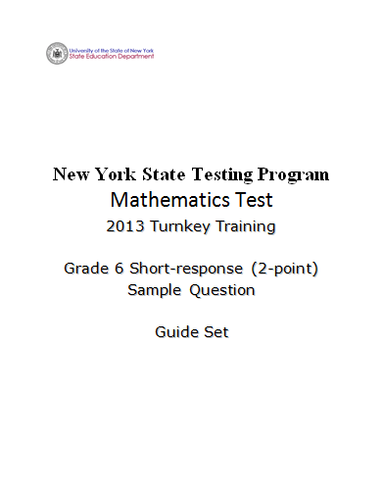
Notes:
Refer participants to the Grade 6 Short-response (2-point) Sample Guide Set packet.
The first page after the cover sheet is the question. The second page is the Common Core Learning Standard the question assesses. (Show the next slide.)

Slide 3
Grade 6 Short-response Question
What is the value of 2x³ + 4x² – 3x² – 6x when x = 3?
Show your work.
Answer ____________________
1
Notes:
Refer participants to the question in the Grade 6 Short-response (2-point) Sample Guide Set packet.
This is a sample of a grade 6 0 – 2-point question that is aligned with Common Core learning standard 6.EE.2c

Slide 4
Grade 6 Short-response Common Core Learning Standard Assessed
CCLS 6.EE.2c
Evaluate expressions at specific values of their variables. Include expressions that arise from formulas used in real-world problems. Perform arithmetic operations, including those involving whole-number exponents, in the conventional order when there are no parentheses to specify a particular order (Order of Operations). For example, use the formulas V = s³ and A = 6s² to find the volume and surface area of a cube with sides of length s = ½.
Notes:
So here is the standard the question is designed to measure-
Evaluate expressions at specific values of their variables. Include expressions that arise from formulas used in real-world problems. Perform arithmetic operations, including those involving whole-number exponents, in the conventional order when there are no parentheses to specify a particular order

Slide 5
Grade 6 Short-response Question
What is the value of 2x³ + 4x² – 3x² – 6x when x = 3?
Show your work.
Answer ____________________
1
How would you answer this question?
Notes:
Take a couple minutes to think about how you would answer the question. (Allow participants 3 – 4 minutes to answer the question and reflect.)
Note: Calculators are permitted for all constructed-response questions in grades 6, 7 and 8.
Pause the video and solve this problem
Before we look at the guide papers consider-
Ask yourself what a typical a 2-point student response might look like.
Also consider what a typical 1-point or a common 0-point student response might possibly look like.
Pause the video to discuss or jot down your thoughts.

Slide 6
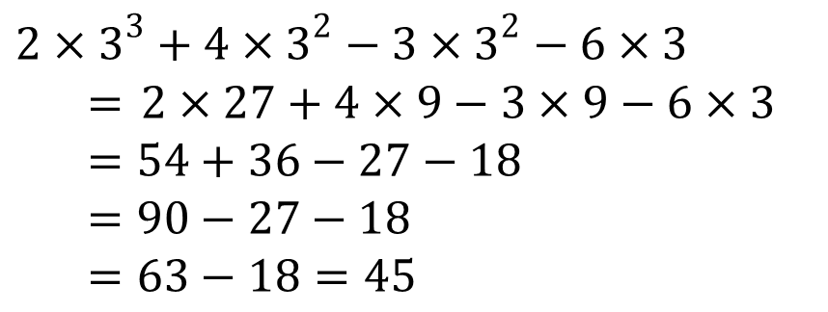
Grade 6 Short-response Exemplar
What is the value of 2x³ + 4x² – 3x² – 6x when x = 3?
Show your work.
Answer ____________________
1
45
Notes:
Talk through the response:
Three is correctly substituted into the expression. The exponential terms are simplified; the multiplication operations are completed; 54 and 36 are added; 27 is subtracted from 90; 18 is subtracted from 63; the answer is 45.
This is what we would expect as a common, but not the only, 2-point response.

Slide 7
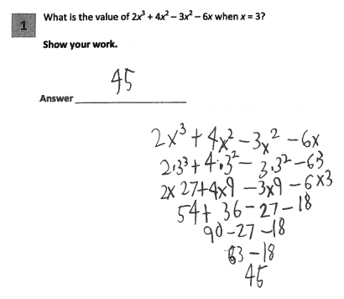
Grade 6 Short-response Guide Paper 1
Score Point 2
Notes:
Refer participants to Guide Paper 1 in the Grade 6 Short-response (2-point) Sample Guide Set packet.
This is a 2-pt response; 3 is correctly substituted, the order of operations is followed and the calculations are correct.
So let’s just stop to remember that the role of the guide papers is to interpret the rubrics and define the NYS scoring criteria for the question. We are looking at them to determine how to score and not whether or not we agree with how they have scored the student work.

Slide 8
Grade 6 Short-response Guide Paper 1 Annotation
Score Point 2
This response answers the question correctly and demonstrates a thorough understanding of the mathematical concepts. Three is correctly substituted into the expression, the order of operations is correctly followed, all calculations and the final answer are correct.
Notes:
On the next page you will see the annotation for guide paper 1. The annotation provides the rationale of the committee that determined that this student’s work was a level 2 response. There will be an annotation in your book for each guide paper. I may not specifically reference it, but it is there to help you understand the thinking of the range finding committee.

Slide 9
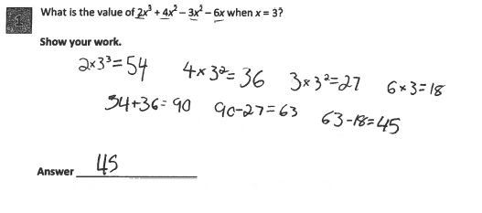
Grade 6 Short-response Guide Paper 2
Score Point 2
Notes:
We note the student doesn’t show the value of 3 squared but does show that 3 x 3 squared equals 27. All the individual operations are calculated separately; however, they are all done correctly and in the proper order, resulting in the correct answer. So this paper is another example of how a student could demonstrate a level 2 understanding of this task.

Slide 10
Grade 6 Short-response Guide Paper 2 Annotation
Score Point 2
This response answers the question correctly and indicates that the student has completed the task correctly, using mathematically sound procedures. The individual operations are calculated separately; however, they are all done correctly and in the proper order, resulting in the correct answer.
Notes:
Direct the participants to read the annotation; ask if there are any questions. A second training option is to read or paraphrase the annotation for participants while viewing the response slide.

Slide 11
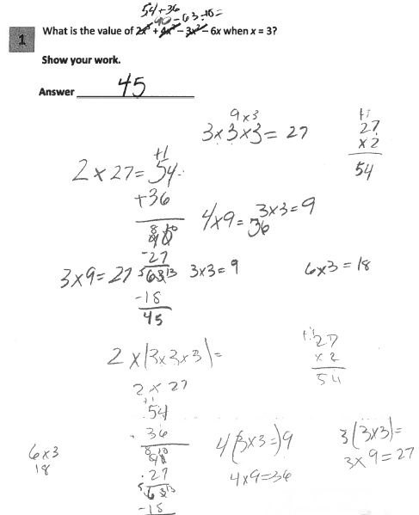
Grade 6 Short-response Guide Paper 3
Score Point 2
Notes:
In the center of this paper we see the flow of the student’s work. This is an example of a paper that you have to put a bit more effort into following the student’s thinking and figuring out what was done because the work isn’t as organized as the other two guide papers we have examined so far. Off to the sides we see how the student calculated the values of the expressions. Then they did 54 + 36 to get 90 then subtracted 27 and then subtracted 18 to get 45 as their answer.
Note that one calculation shown is incorrect (4(3 × 3 =) 9), but the following line shows the correct calculation and this inaccurate statement within the work does not detract from the demonstration of a thorough understanding.
So this work is an example of a level 2 response that contains a correct answer arrived at using a correct procedure with a minor inaccuracy that doesn’t detract from a demonstration of understanding.

Slide 12
Grade 6 Short-response Guide Paper 3 Annotation
Score Point 2
This response answers the question correctly and demonstrates a thorough understanding of the mathematical concepts. The individual operations are calculated separately; however, they are done correctly and in the proper order, resulting in the correct answer. One calculation shown is incorrect (4(3 × 3 =) 9), but the following line shows the correct calculation and this inaccurate statement within the work does not detract from the demonstration of a thorough understanding.
Notes:
Direct the participants to read the annotation; ask if there are any questions. A second training option is to read or paraphrase the annotation for participants while viewing the response slide.

Slide 13
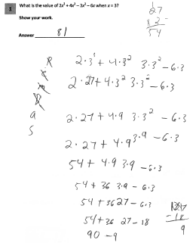
Grade 6 Short-response Guide Paper 4
Score Point 1
Notes:
Refer participants to Guide Paper 4 in the Grade 6 Short-response (2-point) Sample Guide Set packet.
This is our first example of a 1-point paper.
Three is correctly substituted into the expression; the operations on the exponents are performed first followed by the multiplication operations; 54 and 36 are correctly added. However, instead of subtracting 27 from 90 or subtracting 18 from -27, 18 is subtracted from 27. The absence of the first subtraction symbol does not detract from the partial understanding of the problem. However, this error is likely the reason the student made a miscalculation in the last steps of the problem. Precision is very important because sloppy work can cause students to make mistakes that lead to inaccurate answers.

Slide 14
Grade 6 Short-response Guide Paper 4 Annotation
Score Point 1
This response is only partially correct. Three is correctly substituted into the expression; the operations on the exponents are performed first, followed by the multiplication operations. The numbers 54 and 36 are correctly added. However, instead of subtracting 27 from 90 or subtracting 18 from -27, 18 is subtracted from 27, resulting in an incorrect answer. The absence of the first subtraction symbol does not detract from the partial understanding of the problem.
Notes:
Direct the participants to read the annotation; ask if there are any questions. A second training option is to read or paraphrase the annotation for participants while viewing the response slide.

Slide 15
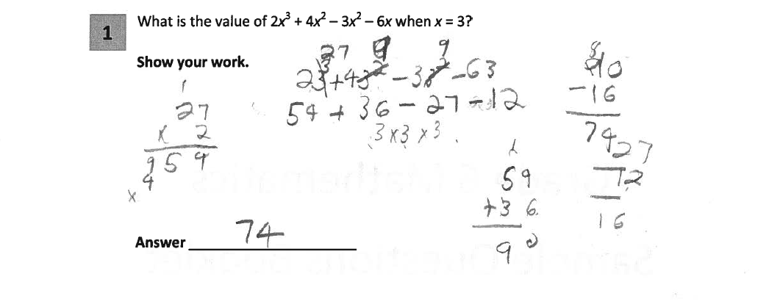
Grade 6 Short-response Guide Paper 5
Score Point 1
Notes:
Refer participants to Guide Paper 5 in the Grade 6 Short-response (2-point) Sample Guide Set packet.
This response demonstrates only a partial understanding. So it is also assigned a score point of 1. Three is correctly substituted into the expression; the exponents are simplified first then the multiplication operations are completed. However, the multiplication error 6x3=12 and the subtraction error 27-12 =16 (should be -27-12) result in an incorrect answer. The absence of the multiplication symbols does not detract from the demonstrated level of understanding.

Slide 16
Grade 6 Short-response Guide Paper 5 Annotation
Score Point 1
This response is only partially correct. Three is correctly substituted into the expression, the exponents are simplified first and then the multiplication operations are completed. However, the multiplication error 6x3=12 and the subtraction error 27-12 =16 and the change of -27 to 27 result in an incorrect answer. The absence of the multiplication symbols does not detract from the demonstrated level of understanding.
Notes:
Direct the participants to read the annotation; ask if there are any questions. A second training option is to read or paraphrase the annotation for participants while viewing the response slide.

Slide 17
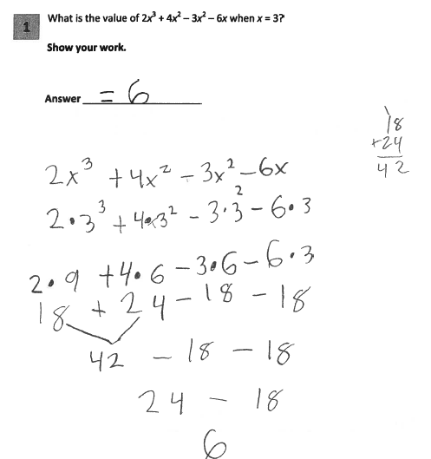
Grade 6 Short-response Guide Paper 6
Score Point 1
Notes:
Refer participants to Guide Paper 6 in the Grade 6 Short-response (2-point) Sample Guide Set packet.
Guide paper 6 is another 1-point paper.
This response is only partially correct. Three is correctly substituted into the expression and the order of operations is correct. However, the simplification of the exponential terms is incorrect; the base is multiplied by the exponent. The answer is also incorrect.

Slide 18
Grade 6 Short-response Guide Paper 6 Annotation
Score Point 1
This response is only partially correct and indicates that the student has demonstrated only a partial understanding of the mathematical concepts in the task. Three is correctly substituted into the expression and the order of operations is correct. However, the simplification of the exponential terms is incorrect; the base is multiplied by the exponent. The resultant answer is also incorrect.
Notes:
Direct the participants to read the annotation; ask if there are any questions. A second training option is to read or paraphrase the annotation for participants while viewing the response slide.

Slide 19
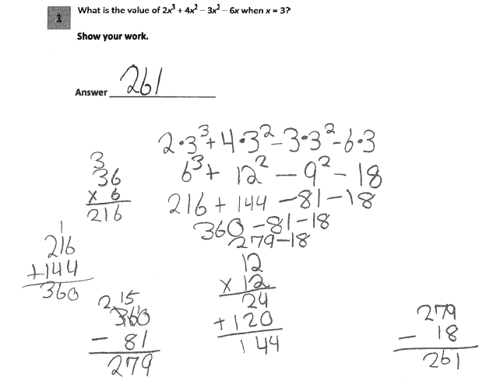
Grade 6 Short-response Guide Paper 7
Score Point 0
Notes:
Refer participants to Guide Paper 7 in the Grade 6 Short-response (2-point) Sample Guide Set packet.
Guide paper 7 is our first example of a 0 point paper. This response is incorrect. The order of operations is incorrect; the multiplication operations are completed prior to the exponent calculations.

Slide 20
Grade 6 Short-response Guide Paper 7 Annotation
Score Point 0
This response is incorrect. The order of operations is incorrect; the multiplication operations are completed prior to the exponent calculations.
Notes:
Direct the participants to read the annotation; ask if there are any questions. A second training option is to read or paraphrase the annotation for participants while viewing the response slide.

Slide 21
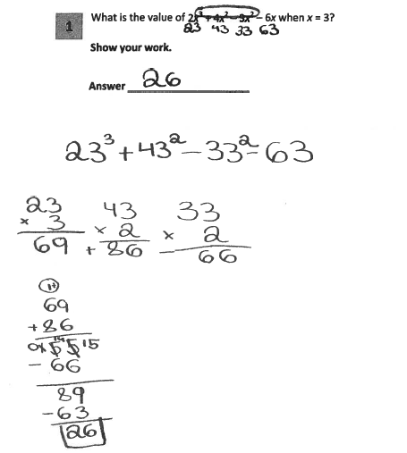
Grade 6 Short-response Guide Paper 8
Score Point 0
Notes:
Refer participants to Guide Paper 8 in the Grade 6 Short-response (2-point) Sample Guide Set packet.
Guide paper 8 demonstrates another way that a student could score a 0 on this task.
The response is incorrect. An incorrect procedure is used for the substitution of 3 into the expression, the exponents are incorrectly simplified, and the answer is incorrect.

Slide 22
Grade 6 Short-response Guide Paper 8 Annotation
Score Point 0
This response is incorrect. An incorrect procedure is used for the substitution of 3 into the expression, the exponents are incorrectly simplified, and the answer is incorrect.
Notes:
Direct the participants to read the annotation; ask if there are any questions. A second training option is to read or paraphrase the annotation for participants while viewing the response slide.

Slide 23
Grades 3-8 Mathematics Assessment Scoring Training
Video 1: Instructional Shifts
Video 2: Holistic Scoring
Video 3: Scoring Policies & the Test Development Process
Video 4: Two Point Holistic Rubric
Videos 5-8: Guide Papers and Practice Sets- 2 Point Rubric
Video 9: Three Point Holistic Rubric
Videos 10-13: Guide Papers and Practice Sets- 3 Point Rubric
Notes:
This concludes the guide paper analysis for the 6th grade 2 point question.
The next section in the Grade 6 Short-response (2-point) Sample Guide Set packet contains the practice papers for this question. Using the 2 point holistic rubric, the scoring policies and these guide papers determine the scores for the practice papers.
Video 6 will review the practice problems and explain the scores assigned to those papers.

Slide 24
Resources
For questions related to assessment:
Email your question to: emscassessinfo@mail.nysed.gov
Check for additional information at the following website http://www.p12.nysed.gov/assessment/ei/eigen.html
For questions related to APPR
Email your question to: educatoreval@mail.nysed.gov
Additional information regarding the common core shifts can be found at the following website:
http://engageny.org/resource/common-core-shifts/
24

