Slide 1
Video 6: Practice Papers for
6th Grade Two Point Question
New York State 2013 Grades 3-8 Common Core Mathematics Rubric and Scoring Turnkey Training
Notes:
Ensure participants have a copy of the Grade 6 Short-response (2-point) Sample Guide/Practice Set packet.
The general purpose of this video:
Now that you have the descriptions of the levels of performance on the two point rubric and have the seen how the guide papers to define what types of work demonstrate the understanding required for each level of the two point rubric, we will use this information to score the 5 practice papers. If you find that your scores are not accurate, it is important to consider why. Once you are able to identify how the practice papers connect to the guide papers, your accuracy will improve.
Time estimate:
4 minutes

Slide 2
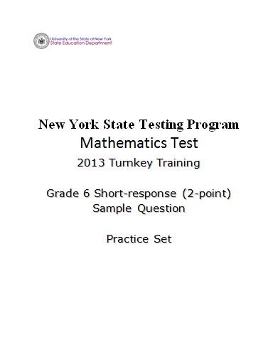
Notes:
Refer participants to the Grade 6 Short-response (2-Point) Sample Question Practice Set packet.
If you have not already scored the practice set, please pause the video so you can read and score the entire practice set prior to reviewing the responses in the set.
Notes for Face to Face Training Sessions:
For each response in the set you may ask teachers to raise their hands when you call the score they assigned.
Ask the group who thought the score of each response was a 0, 1, or 2.
Give teachers time to raise their hand prior to calling the next score point. This will give you an idea of where the bulk of the teachers feel this response fits.
If time allows, you can ask for a teacher to give the reason he or she assigned the selected score. Start with a teacher who assigned the response the approved score.

Slide 3
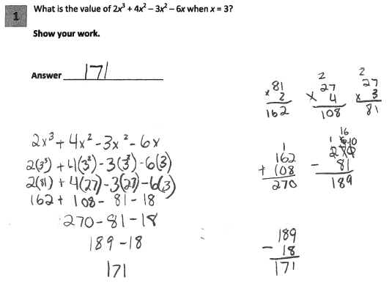
Grade 6 Short-response Practice Paper 1
Score Point 1
Notes:
Refer participants to Practice Paper 1 in the Grade 6 Short-response (2-point) Sample Practice Set packet.
This response is only partially correct so it receives a score of 1.
The substitution is correctly made for x; however, the simplification of exponential terms is incorrect; an extra base value is multiplied by the product (3³ = 81 instead of 27; 3² = 27 instead of 9).
The resultant answer is also incorrect.

Slide 4
Grade 6 Short-response Practice Paper 1 Annotation
Score Point 1
This response is only partially correct and indicates that the student has demonstrated only a partial understanding of the mathematical concepts in the task. The substitution is correctly made for x; however, the simplification of exponential terms is incorrect; an extra base value is multiplied by the product (3³ = 81 instead of 27; 3² = 27 instead of 9). The resultant answer is also incorrect.
Notes:
Direct the participants to read the annotation; ask if there are any questions. A second training option is to read or paraphrase the annotation for participants while viewing the response slide.

Slide 5
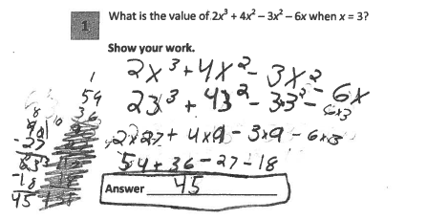
Grade 6 Short-response Practice Paper 2
Score Point 2
Notes:
Refer participants to Practice Paper 2 in the Grade 6 Short-response (2-point) Sample Practice Set packet.
This response answers the question correctly and demonstrates a thorough understanding of the mathematical concepts so it gets a score of 2 points on the rubric.
The order of operations, all calculations, and the final answer are correct. The missing multiplication symbols from 2×3³ and 4×3² do not detract from the demonstration of a thorough understanding.

Slide 6
Grade 6 Short-response Practice Paper 2 Annotation
Score Point 2
This response answers the question correctly and demonstrates a thorough understanding of the mathematical concepts. The order of operations, all calculations, and the final answer are correct. The missing multiplication symbols from 2×3³ and 4×3² do not detract from the demonstration of a thorough understanding.
Notes:
Direct the participants to read the annotation; ask if there are any questions. A second training option is to read or paraphrase the annotation for participants while viewing the response slide.

Slide 7
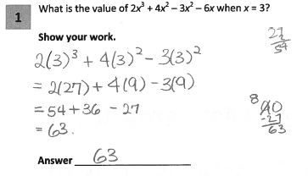
Grade 6 Short-response Practice Paper 3
Score Point 1
Notes:
Refer participants to Practice Paper 3 in the Grade 6 Short-response (2-point) Sample Practice Set packet.
This paper receives a 1 because it is only partially correct. It contains an incorrect solution but applies a mathematically appropriate process. The final term (-6x) is not included in the solution. However, the order of operations for the remaining terms in the expression is correctly followed and all calculations are correct. The answer is correct for the expression used in the work.

Slide 8
Grade 6 Short-response Practice Paper 3 Annotation
Score Point 1
This response is only partially correct and contains an incorrect solution but applies a mathematically appropriate process. The final term (-6x) is not included in the solution. However, the order of operations for the remaining terms in the expression is correctly followed and all calculations are correct. The answer is correct for the expression used in the work.
Notes:
Direct the participants to read the annotation; ask if there are any questions. A second training option is to read or paraphrase the annotation for participants while viewing the response slide.

Slide 9
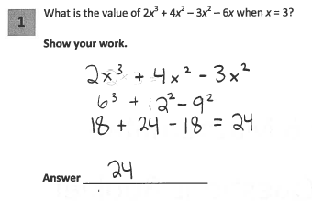
Grade 6 Short-response Practice Paper 4
Score Point 0
Notes:
Refer participants to Practice Paper 4 in the Grade 6 Short-response (2-point) Sample Practice Set packet.
This response is incorrect and receives a score point of 0. The final term is dropped. The order of operations is incorrect; the multiplication steps are completed prior to the exponent calculations. The exponential terms are incorrectly simplified. The answer is incorrect.
This work is similar to the 0 we saw through Guide Paper 7 where the student had multiplied prior to completing the exponent calculations.

Slide 10
Grade 6 Short-response Practice Paper 4 Annotation
Score Point 0
This response is incorrect. The final term is dropped. The order of operations is incorrect; the multiplication steps are completed prior to the exponent calculations. The exponential terms are incorrectly simplified. The answer is incorrect.
Notes:
Direct the participants to read the annotation; ask if there are any questions. A second training option is to read or paraphrase the annotation for participants while viewing the response slide.

Slide 11
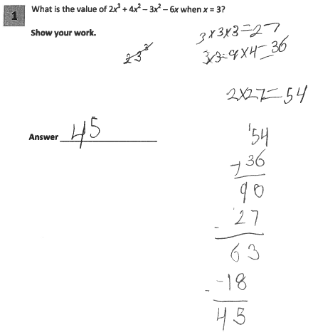
Grade 6 Short-response Practice Paper 5
Score Point 2
Notes:
Refer participants to Practice Paper 5 in the Grade 6 Short-response (2-point) Sample Practice Set packet.
Practice Paper 5 receives a score of 2. This response answers the question correctly and indicates that the student has completed the task correctly, using mathematically sound procedures. The individual operations are calculated separately and correctly in the proper order, resulting in the correct answer. While the work contains a run-on equation (3 × 3 = 9 × 4 = 36), this is considered part of the work process and does not detract from the demonstration of understanding. The step showing that 6 x 3 is 18 is not included, but that was also deemed to not detract from a demonstration of understanding.

Slide 12
Grade 6 Short-response Practice Paper 5 Annotation
Score Point 2
This response answers the question correctly and indicates that the student has completed the task correctly, using mathematically sound procedures. The individual operations are calculated separately and correctly in the proper order, resulting in the correct answer. While the work contains a run-on equation (3 × 3 = 9 × 4 = 36), this is considered part of the work process and does not detract from the demonstration of understanding.
Notes:
Direct the participants to read the annotation; ask if there are any questions. A second training option is to read or paraphrase the annotation for participants while viewing the response slide.

Slide 13
Grades 3-8 Mathematics Assessment Scoring Training
Video 1: Instructional Shifts
Video 2: Holistic Scoring
Video 3: Scoring Policies & the Test Development Process
Video 4: Two Point Holistic Rubric
Videos 5-8: Guide Papers and Practice Sets- 2 Point Rubric
Video 9: Three Point Holistic Rubric
Videos 10-13: Guide Papers and Practice Sets- 3 Point Rubric
Notes:
This concludes video 6.
Videos 7 and 8 will look at an Eighth grade example of a two-point question.

Slide 14
Resources
For questions related to assessment:
Email your question to: emscassessinfo@mail.nysed.gov
Check for additional information at the following website http://www.p12.nysed.gov/assessment/ei/eigen.html
For questions related to APPR
Email your question to: educatoreval@mail.nysed.gov
Additional information regarding the common core shifts can be found at the following website:
http://engageny.org/resource/common-core-shifts/
14

