Slide 1
Video 7: Guide Papers for
8th Grade Two Point Question
New York State 2013 Grades 3-8 Common Core Mathematics Rubric and Scoring Turnkey Training
Notes:
Ensure participants have a copy of the Grade 8 Short-response (2-point) Sample Guide/Practice Set packet.
The general purpose of this video:
Now that you have seen the descriptions of the levels of performance on the two point rubric we will use the guide papers to define what types of work demonstrate the understanding required for each level of the two point rubric
Time estimate:
4 minutes

Slide 2
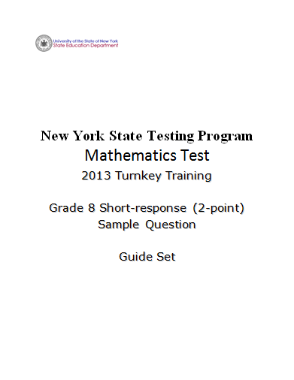
Notes:
Refer participants to the Grade 8 Short-response (2-Point) Sample Question Guide Set packet.
You will also need your 2 Point Holistic Rubric and the Scoring Policies as you work through this section.
The first page after the cover sheet you will see the question.
The second page is the Common Core Learning standard the question assesses. (Show the next slide.)

Slide 3
Grade 8 Short-response Question
1
David currently has a square garden. He wants to redesign his garden and make it into a rectangle with a length that is 3 feet shorter than twice its width. He decides that the perimeter should be 60 feet.
Determine the dimensions, in feet, of his new garden.
Show your work.
Answer ___________________________
Notes:
This is a sample of a grade 8 0- 2-point question that is aligned with Common Core learning standard 8.EE.7b –

Slide 4
Grade 8 Short-response Common Core Learning Standard Assessed
CCLS 8.EE.7b
Solve linear equations with rational number coefficients, including equations whose solutions require expanding expressions using the distributive property and collecting like terms.
Notes:
CCLS 8.EE.7b
Requires students to solve linear equations with rational number coefficients, including equations whose solutions require expanding expressions using the distributive property and collecting like terms

Slide 5
Grade 8 Short-response Question
1
David currently has a square garden. He wants to redesign his garden and make it into a rectangle with a length that is 3 feet shorter than twice its width. He decides that the perimeter should be 60 feet.
Determine the dimensions, in feet, of his new garden.
Show your work.
Answer ___________________________
How would you answer this question?
Notes:
Take a couple minutes to think about how you would answer the question. (Allow participants 3 – 4 minutes to answer the question and reflect.)
Note: Calculators are permitted for all constructed-response questions in grades 6, 7 and 8.
Pause the video and solve this problem
Before we look at the guide papers consider-
Ask yourself what a typical a 2-point student response might look like.
Also consider what a typical 1-point or a common 0-point student response might possibly look like.
Pause the video to discuss or jot down your thoughts.

Slide 6
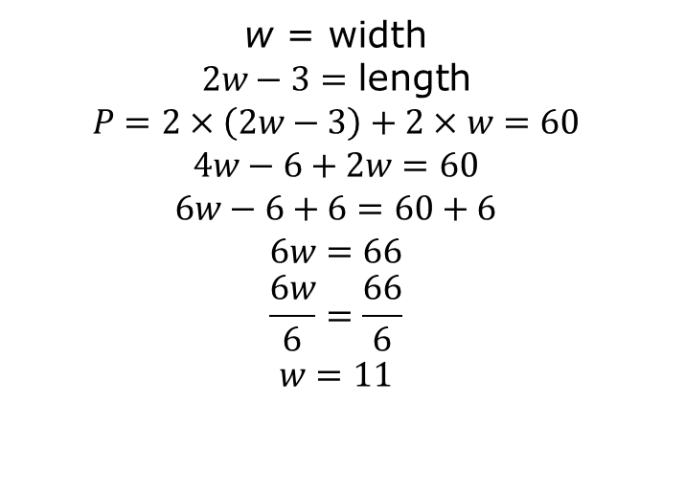
Grade 8 Short-response Exemplar
1
David currently has a square garden. He wants to redesign his garden and make it into a rectangle with a length that is 3 feet shorter than twice its width. He decides that the perimeter should be 60 feet.
Determine the dimensions, in feet, of his new garden.
Show your work.
Answer ___________________________
Width = 11 ft; Length = 19 ft
Notes:
Talk through the response:
w is defined as width and 2w-3 is defined as length. Two times the length (2w-3) and two times the width (w) equals the perimeter, 60. Applies the distributive property and solves for w, w = 11. 11 is substituted into the expression for length and simplified, 2w-3 = 19
This is what we would expect as a common, but not the only, 2-point response.
Guide the discussion by asking a few teachers for other ways this question may be answered correctly or what we might expect as common 1-point and 0-point responses.

Slide 7
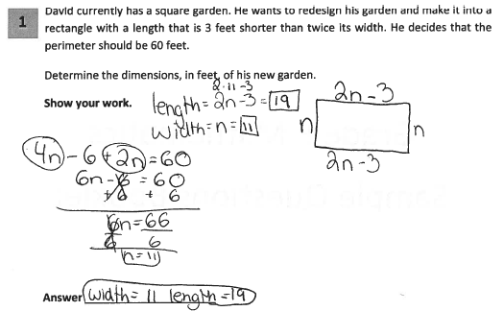
Grade 8 Short-response Guide Paper 1
Score Point 2
Notes:
Refer participants to Guide Paper 1 in the Grade 8 Short-response (2-point) Sample Guide Set packet.
This response answers the question correctly and demonstrates a thorough understanding of the mathematical concepts.
The lengths of each side are shown in terms of n (n, 2n-3) and are correctly used with the given perimeter to solve for n.
They combine the two lengths when writing the equation. They solved the equation to find the width and then when back up to the top and substituted in the width to find the length.
The answer for both dimensions is correct. Units in the answer are not required since the question directs students to “determine the dimensions, in feet….”

Slide 8
Grade 8 Short-response Guide Paper 1 Annotation
Score Point 2
This response answers the question correctly and demonstrates a thorough understanding of the mathematical concepts. The lengths of each side are shown in terms of n (n, 2n-3) and are correctly used with the given perimeter to solve for n. The answer for both dimensions is correct. Units in the answer are not required since the question directs students to “determine the dimensions, in feet….”
Notes:
Direct the participants to read the annotation; ask if there are any questions. A second training option is to read or paraphrase the annotation for participants while viewing the response slide.

Slide 9
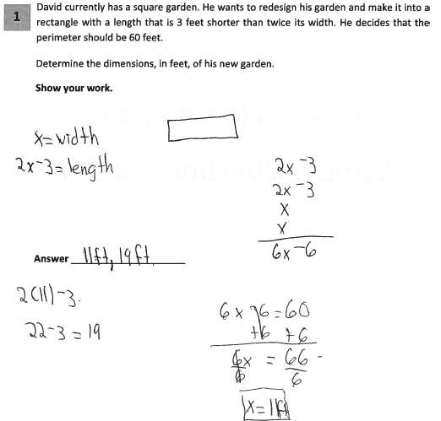
Grade 8 Short-response Guide Paper 2
Score Point 2
Notes:
Refer participants to Guide Paper 2 in the Grade 8 Short-response (2-point) Sample Guide Set packet.
We see here that the lengths of each side are correctly shown in terms of x. The expressions are combined with an understanding of perimeter to create the equation 6x – 6 = 60. The student solves for x correctly and then substitutes that value in the expression for length to correctly determine that the dimensions are 11ft and 19ft.
This response answers the question correctly and indicates that the student has completed the task correctly, using mathematically sound procedures. x and are appropriately used with the given perimeter to solve for x. The answer for both dimensions is correct.

Slide 10
Grade 8 Short-response Guide Paper 2 Annotation
Score Point 2
This response answers the question correctly and indicates that the student has completed the task correctly, using mathematically sound procedures. The lengths of each side are correctly shown in terms of x and are appropriately used with the given perimeter to solve for x. The answer for both dimensions is correct.
Notes:
Direct the participants to read the annotation; ask if there are any questions. A second training option is to read or paraphrase the annotation for participants while viewing the response slide.

Slide 11
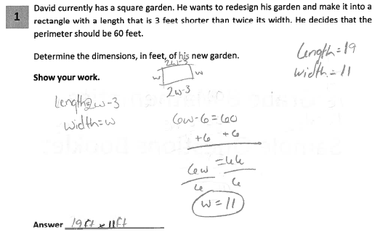
Grade 8 Short-response Guide Paper 3
Score Point 2
Notes:
Refer participants to Guide Paper 3 in the Grade 8 Short-response (2-point) Sample Guide Set packet.
Guide paper 3 is another example of a 2 point paper.
The student writes the expressions that represent the length and width of the rectangle and drew a diagram. The combining of terms was not shown, but the lengths of each side are correctly shown in terms of w and are used correctly with the given perimeter to solve for w.
The student uses this information to find the length even though the substitution of the width into the expression for length was not shown.
This response answers the question correctly and demonstrates a thorough understanding of the mathematical concepts.

Slide 12
Grade 8 Short-response Guide Paper 3 Annotation
Score Point 2
This response answers the question correctly and demonstrates a thorough understanding of the mathematical concepts. The lengths of each side are correctly shown in terms of w and are used correctly with the given perimeter to solve for w.
Notes:
Direct the participants to read the annotation; ask if there are any questions. A second training option is to read or paraphrase the annotation for participants while viewing the response slide.

Slide 13
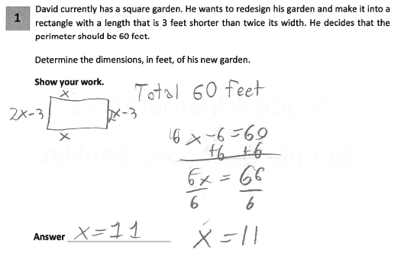
Grade 8 Short-response Guide Paper 4
Score Point 1
Notes:
Refer participants to Guide Paper 4 in the Grade 8 Short-response (2-point) Sample Guide Set packet.
Guide Paper 4 is our first example of a score point 1.
This response is only partially correct and correctly addresses most elements of the task. The length of each side is correctly determined in terms of x and the equation is set up correctly and solved for x. However, the value given for x is not used to calculate the length of the garden, (2x – 3). Therefore, only one dimension – the width – is given in the answer.
The rationale says that absence of units in the answer does not detract from the demonstration of understanding. This is the same rationale given in guide paper 1.

Slide 14
Grade 8 Short-response Guide Paper 4 Annotation
Score Point 1
This response is only partially correct and correctly addresses most elements of the task. The length of each side is correctly determined in terms of x and the equation is set up correctly and solved for x. However, the value given for x is not used to calculate the length of the garden, (2x – 3). Therefore, only one dimension – the width – is given in the answer. The absence of units in the answer does not detract from the demonstration of understanding.
14
Notes:
Direct the participants to read the annotation; ask if there are any questions. A second training option is to read or paraphrase the annotation for participants while viewing the response slide.

Slide 15
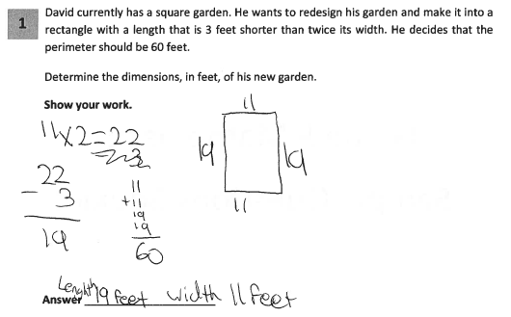
Grade 8 Short-response Guide Paper 5
Score Point 1
15
Notes:
Refer participants to Guide Paper 5 in the Grade 8 Short-response (2-point) Sample Guide Set packet.
This response shows only partial understanding and contains correct numerical answers, but the required work is not provided. The correct numerical answers are given and a check of the answers is provided. However, it is not clear from the work provided how the width (11) was initially determined.

Slide 16
Grade 8 Short-response Guide Paper 5 Annotation
Score Point 1
This response shows only partial understanding and contains correct numerical answers, but the required work is not provided. The correct numerical answers are given and a check of the answers is provided. However, it is not clear from the work provided how the width (11) was initially determined.
16
Notes:
Direct the participants to read the annotation; ask if there are any questions. A second training option is to read or paraphrase the annotation for participants while viewing the response slide.

Slide 17
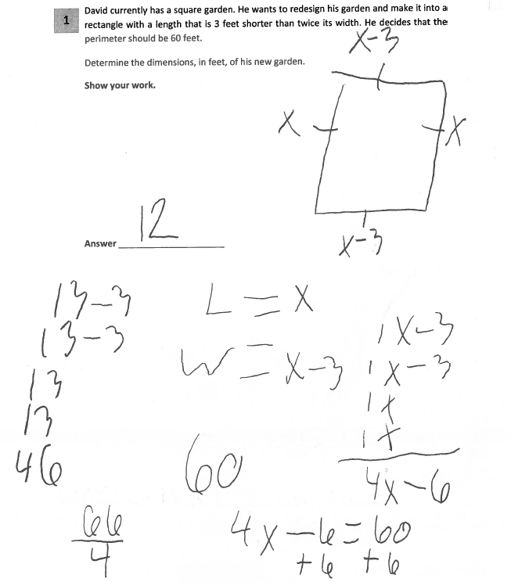
Grade 8 Short-response Guide Paper 6
Score Point 1
17
Notes:
Refer participants to Guide Paper 6 in the Grade 8 Short-response (2-point) Sample Guide Set packet.
Guide Paper 6 is scored as a 1.
This response is only partially correct and demonstrates only a partial understanding of the mathematical concepts. The rectangle’s length and width are incorrectly expressed as x and x-3, respectively.
However, these incorrect expressions are then correctly used in the perimeter equation, solving x = 66/4. The calculations are incorrectly completed to get 12 and the student does not find the value of the other dimension.

Slide 18
Grade 8 Short-response Guide Paper 6 Annotation
Score Point 1
This response is only partially correct and demonstrates only a partial understanding of the mathematical concepts. The rectangle’s length and width are incorrectly expressed as x and x-3, respectively. However, these incorrect expressions are then correctly used in the perimeter equation, solving x = 66/4. The calculations are incorrectly completed.
18
Notes:
Direct the participants to read the annotation; ask if there are any questions. A second training option is to read or paraphrase the annotation for participants while viewing the response slide.

Slide 19
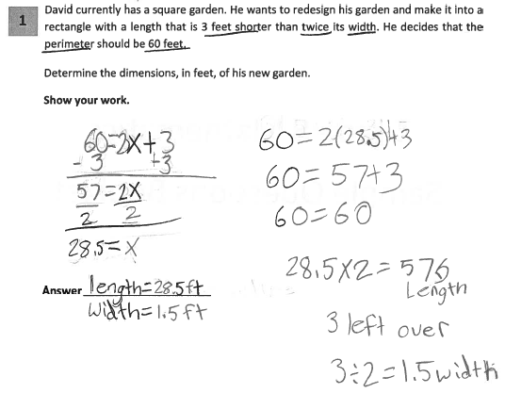
Grade 8 Short-response Guide Paper 7
Score Point 0
19
Notes:
Refer participants to Guide Paper 7 in the Grade 8 Short-response (2-point) Sample Guide Set packet.
This response is incorrect and receives a 0. The incorrect equation is used for perimeter and the procedure used to determine the width. So even though the equation is solved correctly there is not enough connection to the concept of perimeter to demonstrate even a limited understanding of the mathematical concepts.

Slide 20
Grade 8 Short-response Guide Paper 7 Annotation
Score Point 0
This response is incorrect. The incorrect equation is used for perimeter and the procedure used to determine the width is not sufficient to demonstrate even a limited understanding of the mathematical concepts.
20
Notes:
Direct the participants to read the annotation; ask if there are any questions. A second training option is to read or paraphrase the annotation for participants while viewing the response slide.

Slide 21
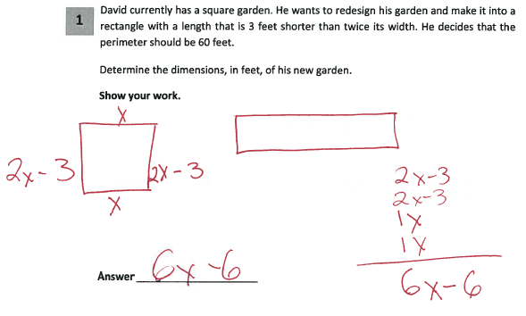
Grade 8 Short-response Guide Paper 8
Score Point 0
21
Notes:
Refer participants to Guide Paper 8 in the Grade 8 Short-response (2-point) Sample Guide Set packet.
This response is incorrect. The correct dimensions are determined in terms of x and the four sides are added. However, this expression (6x-6) is never equated to the value given for the perimeter and no final values are determined for the dimensions. While this response contains some correct mathematical procedures (they labeled the dimensions and combined them), there is not enough work completed to demonstrate even a limited understanding of the mathematical concepts embodied in the task.

Slide 22
Grade 8 Short-response Guide Paper 8 Annotation
Score Point 0
This response is incorrect. The correct dimensions are determined in terms of x and the four sides are added. However, this expression (6x-6) is never equated to the value given for the perimeter and no final values are determined for the dimensions. While this response contains some correct mathematical procedures, there is not enough work completed to demonstrate even a limited understanding of the mathematical concepts embodied in the task.
22
Notes:
Direct the participants to read the annotation; ask if there are any questions. A second training option is to read or paraphrase the annotation for participants while viewing the response slide.

Slide 23
Grades 3-8 Mathematics Assessment Scoring Training
Video 1: Instructional Shifts
Video 2: Holistic Scoring
Video 3: Scoring Policies & the Test Development Process
Video 4: Two Point Holistic Rubric
Videos 5-8: Guide Papers and Practice Sets- 2 Point Rubric
Video 9: Three Point Holistic Rubric
Videos 10-13: Guide Papers and Practice Sets- 3 Point Rubric
Notes:
This concludes the guide paper analysis for the 8th grade 2 point question.
The next section in the Grade 8 Short-response (2-point) Sample Guide Set packet contains the practice papers for this question. Using the 2 point holistic rubric, the scoring policies and these guide papers determine the scores for the practice papers.
Video 8 will review the practice problems and explain the scores assigned to those papers.

Slide 24
Resources
For questions related to assessment:
Email your question to: emscassessinfo@mail.nysed.gov
Check for additional information at the following website http://www.p12.nysed.gov/assessment/ei/eigen.html
For questions related to APPR
Email your question to: educatoreval@mail.nysed.gov
Additional information regarding the common core shifts can be found at the following website:
http://engageny.org/resource/common-core-shifts/
24

