Slide 1
Video 8: Practice Papers for
8th Grade Two Point Question
New York State 2013 Grades 3-8 Common Core Mathematics Rubric and Scoring Turnkey Training
Notes:
Ensure participants have a copy of the Grade 8 Short-response (2-point) Sample Guide/Practice Set packet.
The general purpose of this video:
Now that you have seen the descriptions of the levels of performance on the two point rubric we will use the guide papers to define what types of work demonstrate the understanding required for each level of the two point rubric
Time estimate:
4 minutes

Slide 2
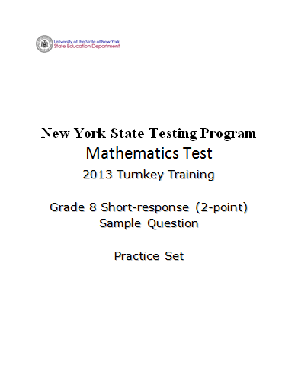
2
Notes:
Ensure participants have a copy of the Grade 8 Short-response (2-Point) Sample Question Guide/Practice Set packet.
The general purpose of this video:
Now that you have the descriptions of the levels of performance on the two point rubric and have the seen how the guide papers to define what types of work demonstrate the understanding required for each level of the two point rubric, we will use this information to score the 5 practice papers. If you find that your scores are not accurate, it is important to consider why. Once you are able to identify how the practice papers connect to the guide papers, your accuracy will improve.

Slide 3
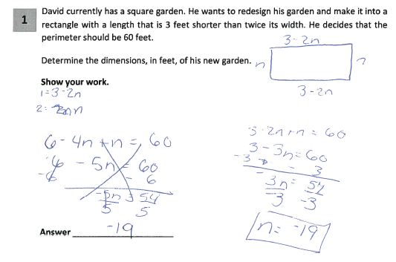
Grade 8 Short-response Practice Paper 1
Score Point 0
3
Notes:
Refer participants to Practice Paper 1 in the Grade 8 Short-response (2-point) Sample Practice Set packet.
Practice Paper 1 is a score point 0
This response is incorrect. The incorrect dimension for length is determined in terms of n (3-2n). The perimeter equation to solve for n is incorrect (3 - 2n + n = 60) the student only accounted for 2 of the 4 sides in the equation they wrote and it was solved incorrectly. Additionally, only the incorrect, physically impossible answer for the width is given.

Slide 4
Grade 8 Short-response Practice Paper 1 Annotation
Score Point 0
This response is incorrect. The incorrect dimension for length is determined in terms of n (3-2n). The perimeter equation to solve for n is incorrect (3 - 2n + n = 60) and it is solved incorrectly. Additionally, only the incorrect, physically impossible answer for the width is given.
4
Notes:
Direct the participants to read the annotation; ask if there are any questions. A second training option is to read or paraphrase the annotation for participants while viewing the response slide.

Slide 5
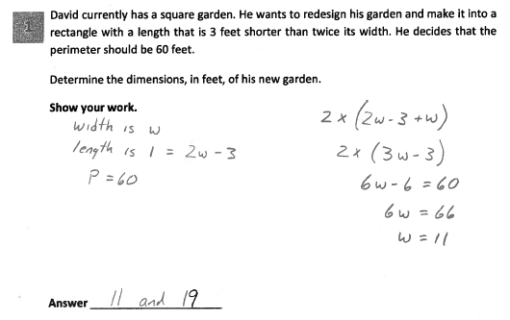
Grade 8 Short-response Practice Paper 2
Score Point 2
5
Notes:
Refer participants to Practice Paper 2 in the Grade 8 Short-response (2-point) Sample Practice Set packet.
Practice Paper 2 receives a score point of 2.
This response answers the question correctly and indicates that the student has completed the task correctly, using mathematically sound procedures.
The dimensions are expressed in terms of w and are identified over here and are used appropriately in the equation for perimeter; the equation is correctly solved for w. The student doesn’t show exactly what was done at each step of the equation but the next step indicates what had happened. The absence of calculating 19 does not detract from the level of understanding.
Under the previous rubric and scoring policy, even though this response demonstrates a thorough understanding, it would have been scored a 1 because the required bridging step is not shown. The bridging step policy was removed. Multiplying 11 by 2 and subtracting 3 is a grade 8 mental arithmetic computational fluency skill.

Slide 6
Grade 8 Short-response Practice Paper 2 Annotation
Score Point 2
This response answers the question correctly and indicates that the student has completed the task correctly using mathematically sound procedures. The dimensions are expressed in terms of w and used appropriately in the equation for perimeter; the equation is correctly solved for w. The absence of calculating 19 does not detract from the level of understanding.
6
Notes:
Direct the participants to read the annotation; ask if there are any questions. A second training option is to read or paraphrase the annotation for participants while viewing the response slide.

Slide 7
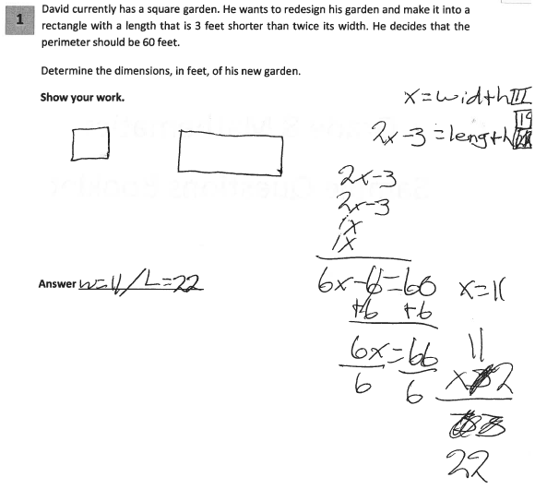
Grade 8 Short-response Practice Paper 3
Score Point 1
7
Notes:
Refer participants to Practice Paper 3 in the Grade 8 Short-response (2-point) Sample Practice Set packet.
Practice Paper 3 receives a score point of 1.
This response shows only partial understanding of the mathematical procedures in the task. The length of each side is correctly determined in terms of x and the perimeter equation is appropriate, resulting in the correct value for x. However, the value given for x is multiplied by 2 rather than being substituted back into the initial expression for the length (2x-3). Therefore, only the width dimension is correct. The absence of units does not detract from the demonstrated level of understanding.
You can see that in the student’s work the length has been changed to 19, however the value recorded on the answer line also needs to be a 19 for this student to receive full credit.

Slide 8
Grade 8 Short-response Practice Paper 3 Annotation
Score Point 1
This response shows only partial understanding of the mathematical procedures in the task. The length of each side is correctly determined in terms of x and the perimeter equation is appropriate, resulting in a correct value for x. However, the value given for x is multiplied by 2 rather than being substituted back into the initial expression for the length (2x-3). Therefore, only the width dimension is correct. The absence of units does not detract from the demonstrated level of understanding.
8
Notes:
Direct the participants to read the annotation; ask if there are any questions. A second training option is to read or paraphrase the annotation for participants while viewing the response slide.

Slide 9
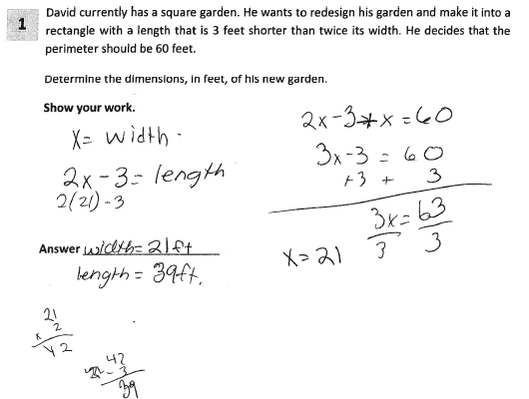
Grade 8 Short-response Practice Paper 4
Score Point 1
9
Notes:
Refer participants to Practice Paper 4 in the Grade 8 Short-response (2-point) Sample Practice Set packet.
Practice Paper 4 receives a score point of 1.
This response demonstrates only a partial understanding of the mathematical concepts. The dimensions are correctly expressed in terms of x (x = width; 2x – 3 = length). However, the perimeter equation is incorrect (2x – 3 + x = 60); two sides instead of four are added together. The equation written is correctly solved for x and the value of x (21) is used in the expression for length (2x – 3) to determine the length’s value.

Slide 10
Grade 8 Short-response Practice Paper 4 Annotation
Score Point 1
This response demonstrates only a partial understanding of the mathematical concepts. The dimensions are correctly expressed in terms of x (x = width; 2x – 3 = length). However, the perimeter equation is incorrect (2x – 3 + x = 60); two sides instead of four are added together. The equation written is correctly solved for x and the value of x (21) is used in the expression for length (2x – 3) to determine the length’s value.
10
Notes:
Direct the participants to read the annotation; ask if there are any questions. A second training option is to read or paraphrase the annotation for participants while viewing the response slide.

Slide 11
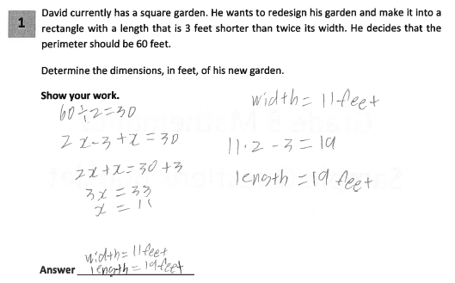
Grade 8 Short-response Practice Paper 5
Score Point 2
11
Notes:
Refer participants to Practice Paper 5 in the Grade 8 Short-response (2-point) Sample Practice Set packet.
Practice Paper 5 receives a score point of 2.
This response answers the question correctly and indicates that the student has completed the task correctly, using mathematically sound procedures. The fact that the student did not define the expressions for length and width did not pose a concern in this response because the rest of the work indicates that the student understood how those expressions related to the dimensions.
The perimeter is divided in half and then equated to the sum of the expressions for the length (2x-3) and width (x). This is an appropriate mathematical procedure for completing this task and the final dimensions are determined correctly.

Slide 12
Grade 8 Short-response Practice Paper 5 Annotation
Score Point 2
This response answers the question correctly and indicates that the student has completed the task correctly, using mathematically sound procedures. The perimeter is divided in half and then equated to the sum of the expressions for the length (2x-3) and width (x). This is an appropriate mathematical procedure for completing this task and the dimensions are determined correctly.
12
Notes:
Direct the participants to read the annotation; ask if there are any questions. A second training option is to read or paraphrase the annotation for participants while viewing the response slide.

Slide 13
Grades 3-8 Mathematics Assessment Scoring Training
Video 1: Instructional Shifts
Video 2: Holistic Scoring
Video 3: Scoring Policies & the Test Development Process
Video 4: Two Point Holistic Rubric
Videos 5-8: Guide Papers and Practice Sets- 2 Point Rubric
Video 9: Three Point Holistic Rubric
Videos 10-13: Guide Papers and Practice Sets- 3 Point Rubric
Notes:
This concludes the training on the Practice Sets for the 8th grade 2 Point Rubric.
The next sections of the scoring training will explore the three point holistic rubric.

Slide 14
Resources
For questions related to assessment:
Email your question to: emscassessinfo@mail.nysed.gov
Check for additional information at the following website http://www.p12.nysed.gov/assessment/ei/eigen.html
For questions related to APPR
Email your question to: educatoreval@mail.nysed.gov
Additional information regarding the common core shifts can be found at the following website:
http://engageny.org/resource/common-core-shifts/
14

