Slide 1
A Story of Units
Module 1 Overview
Grades K-5
Notes:
NOTE THAT THIS SESSION IS DESIGNED TO BE 60 MINUTES IN LENGTH;
This opening session will be followed by a session on assessment in A Story of Units, Module Focus sessions on each of the first modules for grades K through 5, Module in Practice sessions emphasizing instructional choices in delivery of instruction, and a coherence session on Number and Operations—Base Ten.
TIME ALLOTTED FOR THIS SLIDE:
0 minutes
MATERIALS NEEDED:
X

Slide 2
Session Objectives
  Use the structure of the resources provided through the modules produced by New York State to analyze the progression of mathematics presented in the first module for your grade level.
  Solve and connect the assessment questions to the standards of the module.
  Identify how the process of planning lessons with the modules differs from planning lessons using other resources.
Notes:
Our objective for this session is to _______
TIME ALLOTTED FOR THIS SLIDE:
1 minutes
MATERIALS NEEDED:
X

Slide 3
The combined cost of a ball and bat is $1.10. If the bat costs one dollar more than the ball, what is the cost of the ball?
Notes:
Give teachers 1 minute to solve this problem.
Give teachers 1 minute to discuss.
Give 1 minute talk about Think Fast and Slow.
TIME ALLOTTED FOR THIS SLIDE:
3 minutes
MATERIALS NEEDED:
X

Slide 4
Instructional Shifts
Remains
Shift 1
Focus
Focus
Remains
Shift 2
Coherence
Coherence
Fluency
Combine to Form
Shift 3
Shift 4
Shift 5
Shift 6
Deep Understanding
Rigor
Applications
Dual Intensity
Notes:
Start with the standards… why…
The authors of the Common Core State Standards tell us that the “standards are not intended to be new names for old ways of doing business. They are a call to take the next step.” (CCSSM, page 5) Student Achievement Partners, the writers of the Common Core State Standards, has described some examples of the “old ways of doing business,” articulating the kind of instruction to avoid.
In order to move away from these old ways, a new approach to mathematics education was needed. This new plan was articulated in the form of the Instructional Shifts, which describe how to implement the Standards as they were intended so that all students will be career and college ready when they leave high school.
NOTE TO FAILITATOR: If your audience is not familiar with these Instructional Shifts, take time to discuss each one.
These shifts have been a driving force in creating A Story of Units.
Each grade-level focuses on the major work.
Material is organized into coherent topics, emphasizing natural connections that exist both within and across grades.
A balance of rigor is maintained in the daily lesson components as well as in the assessments.
Practice standards are meaningfully connected to the content standards.
TIME ALLOTTED FOR THIS SLIDE:
3 minutes
MATERIALS NEEDED:
X

Slide 5
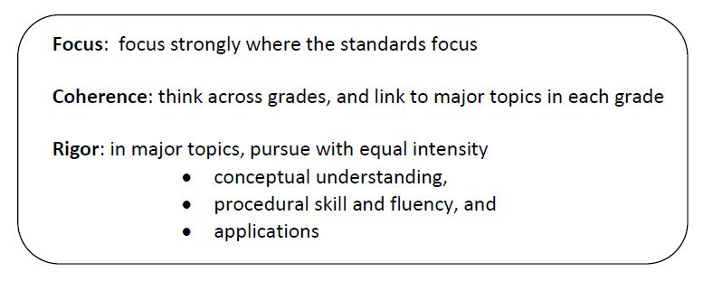
Curriculum Modules: Designed to Address the Shifts
Notes:
Throughout the NTI, as you examine these modules, you will find the same careful and intense balance of rigor that you saw in previous modules.
You might recall that our sessions during both the November NTI and the February NTI were structured around rigor. Both times, we presented a three-part Rigor Breakdown series, where each session focused on one component of rigor and provided examples from the featured modules.
During this NTI our attention to rigor may be less explicit in that you will not see the familiar structure of the Rigor Breakdown series. While our explicit focus is on examining modules, attention to rigor is embedded in those sessions and will continue to be a natural part of discussion. We anticipate that you will recognize and share examples of rigor as they are uncovered.
THIS SESSION WILL BE IMMEDIATELY FOLLOWED BY A SESSION ON ASSESSMENT IN A STORY OF UNITS.
TIME ALLOTTED FOR THIS SLIDE:
3 minutes
MATERIALS NEEDED:
X

Slide 6
Philosophy and Workflow of A Story of Units
Lesson Objectives
Common Core Standards: The Progressions
A Story of Units: Curriculum Map
Module Overviews
and Assessments
Topic Openers
Elementary Mathematics
Notes:
From the field of mathematics, learning progressions have been clearly defined for us in the Common Core Learning Standards. From those, we developed a framework for the P-5 curriculum. This is illustrated in the curriculum map and articulated in the accompanying grade-level descriptions of the Curriculum Overview. From this established sequence of modules, overview and assessments are created. Each topic is then fully developed to include daily objectives that describe a teaching sequence towards mastery.
TIME ALLOTTED FOR THIS SLIDE:
3 minutes
MATERIALS NEEDED:
X

Slide 7
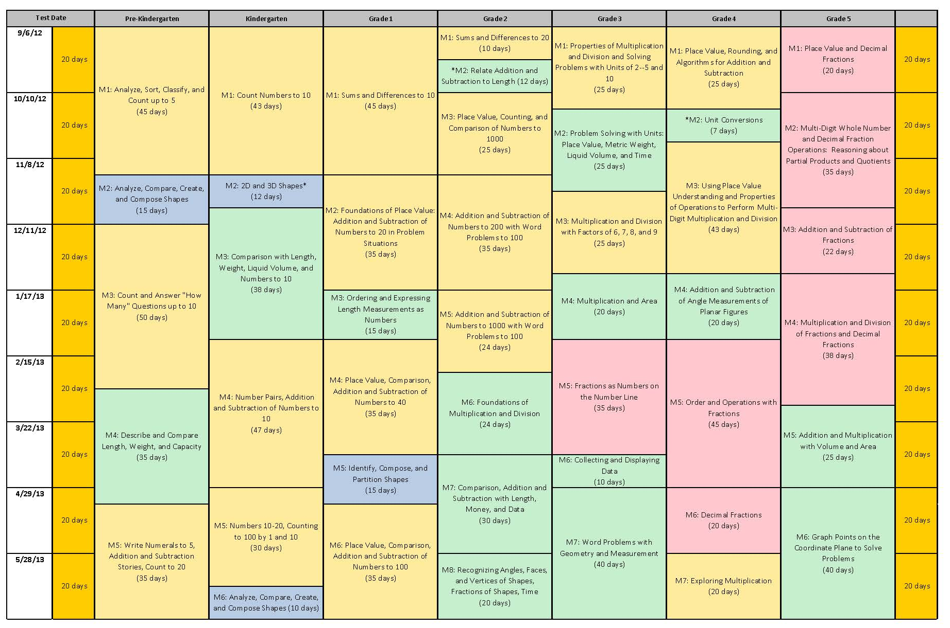
A Story of Units
Notes:
Slides 10-13, Facilitator will describe the tight alignment to the Standards, the progression of mathematics, and intentionality that support and unify the P-5, 6-8, and 9-12 curricula being developed by the Common Core, Inc. team.
Facilitate a discussion about this progression from A Story of Units to A Story of Ratios to A Story of Functions.
TIME ALLOTTED FOR THIS SLIDE:
1 minutes
MATERIALS NEEDED:
X

Slide 8
Modules for the Fall
Getting Ready for September:
  GK–M1 Count Numbers to 10
  G1–M1 Module 1 Sums and Differences to 10
  G2–M1 Sums and Differences to 20
  G2–M2 Relate Addition and Subtraction to Length
  G3–M1 Properties of Multiplication and Division and Solving Problems with Units of 2–5 and 10
  G4–M1 Place Value, Rounding, and Algorithms for Addition and
  Subtraction
  G5–M1 Place Value and Decimal Fractions
Notes:
The focus of this NTI is centered around the first module for each grade, K through 5. Listed here are the seven new modules that are now complete and are currently being posted on EngageNY. In your binder, we have provided material that will be useful in our discussions about preparing for implementation of A Story of Units. This includes the Module Overview, Assessments, and Topic Openers for each of these seven modules.
Review binder and agenda.
TIME ALLOTTED FOR THIS SLIDE:
4 minutes
MATERIALS NEEDED:
X

Slide 9
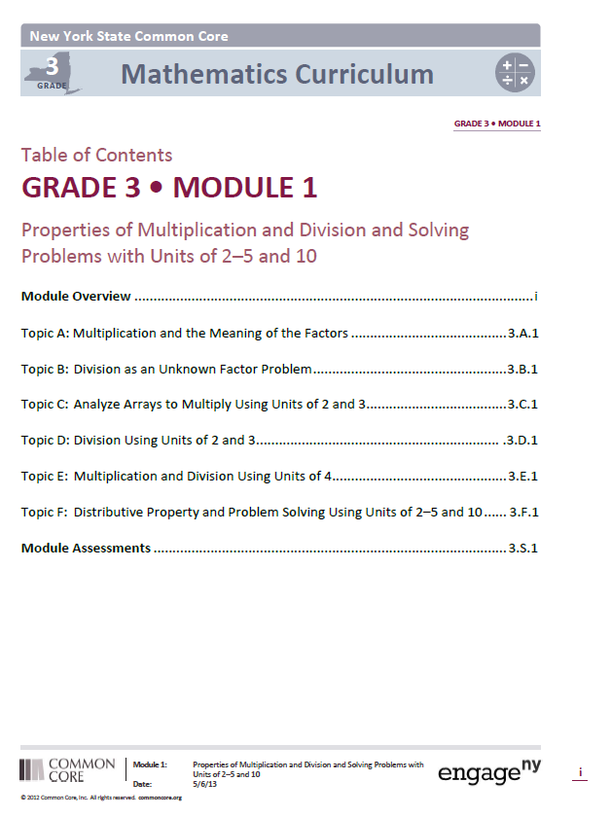
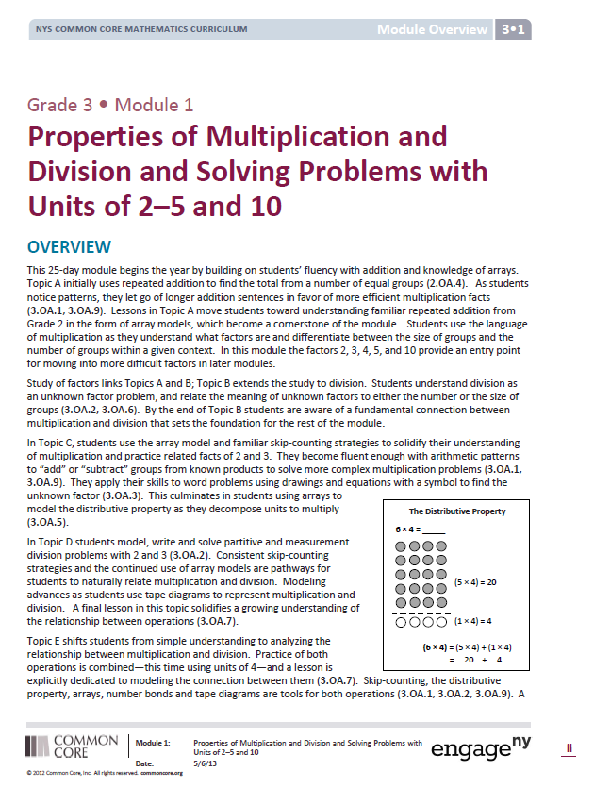
Title Page and Overview
Connections?
How can these pages help you plan?

Slide 10
Focus Standards
Read the focus standards for your module
How do you see the focus standards addressed in the Module Overview?

Slide 11
Mathematical Practices
Which mathematical practices will be specifically addressed in this module?
How will the mathematical practices come to life with the content of this module?
Note next to each Mathematical practice the lesson(s) that will address it.
(Hint: Distribution of Instructional Minutes Chart)

Slide 12
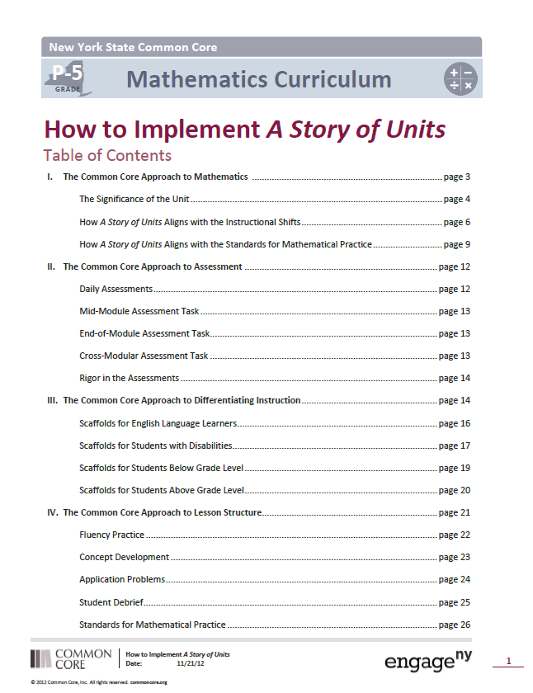
“How to Implement a
Story of Units”
Models (26-44)
Differentiation (14-20)
Assessments (12-14)

Slide 13
Philosophy of Differentiation
Read pages 14-15 in “How to Implement a Story of Units”
Note portions of the text that reveal the modules philosophy of differentiation
      What does UDL stand for?
      Instead of a task frame the modules employ ______________.
      Select a UDL chart from pg 16-20 to examine

Slide 14
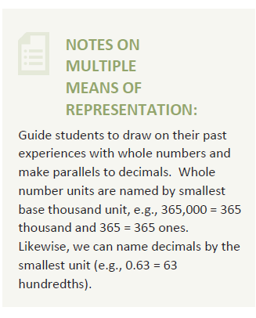

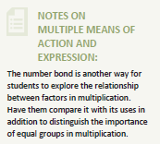
UDL Boxes

Slide 15
Module Assessments
Read pg 12-14
What do you learn about the module’s approach to assessment?

Slide 16
Informal Assessment in A Story of Units
Assess
Analyze
Plan
Teach
Notes:
3 minutes is allotted for this slide.
1 minute teacher discussion in pairs
What are your thoughts about the use of informal assessment. Talk to your peers.
Each participant share 1 strategy for informal assessment they have observed
2 minutes discussion
Assess: Exit Tickets, Mid and End of Module Assessments, Cross Modular Assessment
Analyze: Mid and End of Module: School Structures for Rubric Scoring, Data Systems including Item Analyses, Identification of Grade Level Trends, Standards Based Trends, Individual Teacher’s Strengths and Weaknesses
Plan: Remedial days, small group instruction, need for application problems or fluency practice to “patch holes” and address conceptual gaps. Might also include professional development, lesson study, peer coaching, expert coaching, inter-classroom visitations, and collaboration with school sites having success in current area of weakness. Decisions can be made based on the feedback for alternate structures: team teaching, departmentalizing, etc.
Teach: Plan is implemented and…
Assessed…. And the cycle repeats.

Slide 17
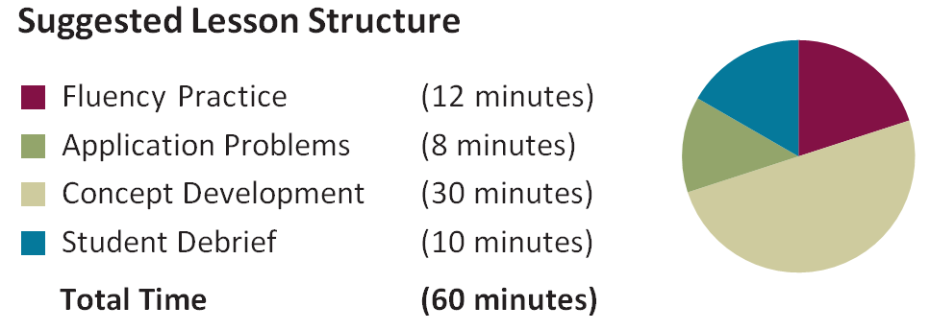
  Informal Assessment within Lesson Components
Are students aware of the purpose of each portion of the lesson ?
Notes:
1 minute is allotted for this slide
Informal assessments are found in many of the lesson components and allow the teacher to know how students are progressing and to make immediate instructional decisions

Slide 18
Fluency Work
T: (Write 4 x 2 ones = __.) Write the multiplication sentence.
S: 4 x 2 = 8.
T: Say the multiplication sentence in unit form.
S: 4 x 2 ones = 8 ones.
Notes:
2 minutes are allotted for this slide.
Exit ticket data is immediately taken into consideration for the next day’s fluency component. Replace maintenance and review fluencies first.
That might mean selecting a different activity or adjusting the sequence detailed within the curriculum
4 x 2 bananas
4 x 2 = 8
4 x 2 bananas = 8 bananas
Be alert to maintaining forward momentum and acknowledging success and improvement in very specific ways.

Slide 19
What Can We Learn From Fluency?
4 x 2
5 x 3
3 x .2
4 x 0.2
5 x 0.3
3 x 0.03
4 x 0.02
5 x 0.03
3 x 0.23
2 x 0.14

Slide 20
What Can We Learn From Fluency?
4 x 2
5 x 3
3 x .2
4 x 0.2
5 x 0.3
3 x 0.03
4 x 0.02
5 x 0.03
3 x 0.23
2 x 0.14

Slide 21
Application- Read, Draw, Write (RDW)
Mathematicians and teachers suggest a simple process applicable to all grades:
1) Read.
2) Draw and Label.
3) Write a number sentence. (equation)
4) Write a word sentence. (statement)
MP1
MP2
Grade 3- X Grade 5 - IV

Slide 22
Application- Read, Draw, Write (RDW)
The more students participate in reasoning through problems with a systematic approach, the more they internalize those behaviors and thought processes.
  What do I see?
  Can I draw something?
  What conclusions can
  I make from my drawing?
Modeling with Interactive Questions
Guided Practice
Independent Practice

Slide 23
Application Problems (G3 M1 L4)
The student council holds a meeting in Mr. Chang’s classroom. They arrange the chairs in 3 rows of 5. How many chairs are used in all? Use the RDW process.
Notes:
3 minutes are allotted for this slide.
The delivery of application problems may be adjusted to meet the needs of the students in a given classroom.
The content may be adjusted most obviously by changing the numbers or by changing the number of steps.
Be alert to the pitfalls of creating problems “at the board.”
Give teachers 1 minute to break it down and 1 minute to stretch it out.
96 hundredth grams

Slide 24
Application Problems (G5 M1 L2)
A school district ordered 247 boxes of pencils. Each box contains 100 pencils. If the pencils are to be shared evenly amongst 10 classrooms, how many pencils will each class receive? Draw a place value chart to show your thinking.
Notes:
3 minutes are allotted for this slide.
The delivery of application problems may be adjusted to meet the needs of the students in a given classroom.
The content may be adjusted most obviously by changing the numbers or by changing the number of steps.
Be alert to the pitfalls of creating problems “at the board.”
Give teachers 1 minute to break it down and 1 minute to stretch it out.
96 hundredth grams

Slide 25
The Concept Development
Problem 4
5.1 x 6 = 30.6
T: What is the smallest unit in 5.1?
S: Tenths.
T: How many tenths are the same as 5.1?
S: 51 tenths.
T: Suppose our multiplication sentence was 51 x 6. What is the product?
S: (Pause as students work.) 306.
T: Is 306 a reasonable product for our actual problem of 5.1 x 6? Turn and talk.
Notes:
2 minutes are allotted for this slide.
The vignettes are not meant to be rigid dictates but rather thoughtful examples of sequences of instruction.
Circulate as students work on problem sets independently.
Be alert to the importance of momentum, while sensitive to the depth of the “holes.”

Slide 26
The Debrief
How can whole number multiplication help you with decimal multiplication?
Notes:
2 minutes are allotted for this slide.
Circulate, observe, listen as students during both phases of the error correction process.
Question with those observations in mind.
Be alert to the ways in which today’s objectives strengthen yesterday’s.
(Elicit from students that the digits in a product can be found through whole number multiplication. The actual product can be deduced through estimation based logic and/or composing smaller units into larger units.)

Slide 27
Finding Patterns
Concept Development
Problem Set
Debrief

Slide 28
Problem Sets-
Solve the questions in your problem set
Consider what understanding each question is designed to reveal
Which problems would you ask all students to complete first? (balanced set)
Find the lesson in your module and look at the debrief questions. How does the debrief “stretch” student understanding of the problem set questions?

Slide 29
The Exit Ticket:
A Formal Tool for Informal Assessment
The Exit Ticket closes each lesson from Grade 1 to Grade 5.
The Exit Ticket is part of the Student Debrief, comprising 3 minutes of the approximately 10 minute component.
Information is used to make subsequent instructional decisions.
Notes:
1 minute is allotted for this slide.
After the third bullet, review the analysis from the Exit Tickets administered at the beginning of the session.
Based on the analysis and having planned, time to teach during fluency the following day.
Inform the participants that based on the earlier exit ticket we will be doing a little fluency.

Slide 30
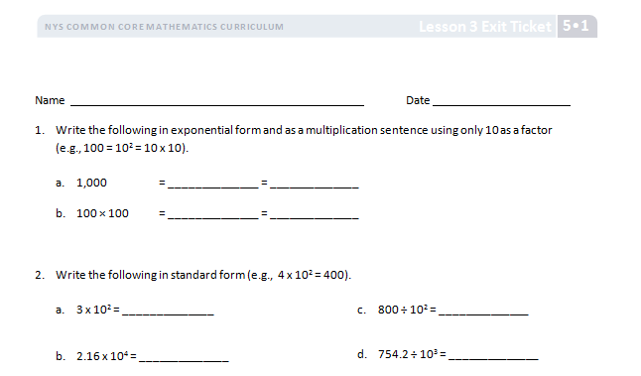
Do Now! Exit Ticket
Please complete an Exit Ticket on your tables for two minutes.
Notes:
3 minutes is allotted for this slide.
As monitors circulate, they make notes as to what they are hearing as people do the exit ticket. This “informal” feedback plus the actual results will be analyzed to make instructional decisions prior to administering the end of module assessment later in the session.

Slide 31
Exit Ticket Debrief
Share your ticket with your group for 3 minutes, 1 minute for each lesson’s ticket.
(Go in order of the lessons.)
What does each exit ticket reveal in regards to students’ understanding?
Note how the complexity builds across the lessons.
Consider the instructional decisions the teacher might make from the results.
Notes:
4 minutes is allotted for this slide.
As monitors circulate, they make notes as to what they are hearing as people do the exit ticket. This “informal” feedback plus the actual results will be tallied to make instructional decisions prior to administering the end of module assessment later in the session.
Task for monitors:
Notice questions causing the most difficulty. Sort the tickets into three groups by Lessons 3, 4, and 5. Pass a summation of the analysis to session leader by simply passing all the exit tickets with one copy on top with a quick needs analysis.

Slide 32
Reflect
Thinking about informal assessment during the 4 major components of the lesson, share your take-always with a partner.
Notes:
Take a minute and think about what we have just discussed. Then turn to your table partner and share your takeaways

Slide 33
Formal Assessment in A Story of Units
Assess
Analyze
Plan
Teach
Notes:
2 minutes is allotted for this slide.
Assess: Mid and End of Module Assessments, Cross Modular Assessment
Analyze: Mid and End of Module: School Structures for Rubric Scoring, Data Systems including Item Analyses, Identification of Grade Level Trends, Standards Based Trends, Individual Teacher’s Strengths and Weaknesses
Plan: Remedial days, small group instruction, need for application problems or fluency practice to “patch holes” and address conceptual gaps. Might also include professional development, lesson study, peer coaching, expert coaching, inter-classroom visitations, collaboration with school sites having success in current area of weakness. Decisions can be made based on the feedback for alternate structures: team teaching, departmentalizing, etc.
Teach: Plan is implemented and…
Assessed…. And the cycle repeats.

Slide 34
Formal Assessment
Mid-Module Assessment Task
      (depending on the length of the module)
End-of-Module Assessment Task
Notes:
1 minute is allotted for this slide.
Summative of student learning outcomes for a given module to the point of administration
Typically one class period in length with one full day for responding to the data instructionally.
New to the students and not preceded by analogous problems

Slide 35
Assess
Complete End-of-Module Assessment
Label each question with the module standard it addresses.
3rd- IV ; 5th – III, IV
Notes:
15 minutes is allotted for this slide.
After 10 minutes have the participants share with a partner about the assessment for 3 minutes.

Slide 36
Plan
Write down at least one question you would ask each student to either:
Further assess in order to know how deeply to scaffold.
Advance their thinking.
Share your questions with your group.
Notes:
3 minutes

Slide 37
Plan
What decisions would you make instructionally based on the assessment for:
Your day of review?
Fluency components?
Application Problems?
Concept Development?
Homework?
Professional development opportunities?
Notes:
4 minutes is allotted for this slide.

Slide 38
Key Points
Assess
Analyze
Plan
Teach
Notes:
2 minutes
Our response to informal and formal assessment is the heart and soul, bread and butter of our teaching.
It also tells us much about how we work within the curriculum.

Slide 39
Next Steps
What obstacles do you anticipate
in effectively implementing the
informal assessments?
Thinking about the culture of your school(s),
what obstacles do you anticipate in
effectively implementing the formal
assessments?
How can you surmount those
obstacles?
Notes:
5 minutes
As we end this session, take a moment to reflect, either privately or with your colleagues, on these next steps:
How can you transfer what you know about __________and its key components to next steps in the planning process?
What is your plan for sharing with the administrators/teachers at your school(s)/districts(s)?
What is your plan for redelivery of this session?

Slide 40
Planning
What have you discovered about planning?
How can you see where you need to end up in each lesson?

