Slide 1
A Story of Units
Grade 1 – Module 4
Notes:
NOTE THAT THIS SESSION IS DESIGNED TO BE 195 MINUTES IN LENGTH.
Welcome! In this module focus session, we will examine Grade 1 – Module 4.
TIME ALLOTTED FOR THIS SLIDE:
0 minutes
MATERIALS NEEDED:
X

Slide 2
Session Objectives
  Examination of the development of mathematical understanding across the module using a focus on Concept Development within the lessons.
  Introduction to mathematical models and instructional strategies to support implementation of A Story of Units.
Notes:
Our objectives for this session are to:
Examination of the development of mathematical understanding across the module using a focus on Concept Development within the lessons.
Introduction to mathematical models and instructional strategies to support implementation of A Story of Units.
TIME ALLOTTED FOR THIS SLIDE:
1 minute
MATERIALS NEEDED:
X

Slide 3
Agenda
Introduction to the Module
Concept Development
Module Review
Notes:
We will begin by exploring the module overview to understand the purpose of this module. Then we will dig in to the math of the module. We’ll lead you through the teaching sequence, one concept at a time. Along the way, we’ll also examine the other lesson components and how they function in collaboration with the concept development. Finally, we’ll take a look back at the module, reflecting on all the parts as one cohesive whole.
Let’s get started with the module overview.
TIME ALLOTTED FOR THIS SLIDE:
0 minutes
MATERIALS NEEDED:
X

Slide 4
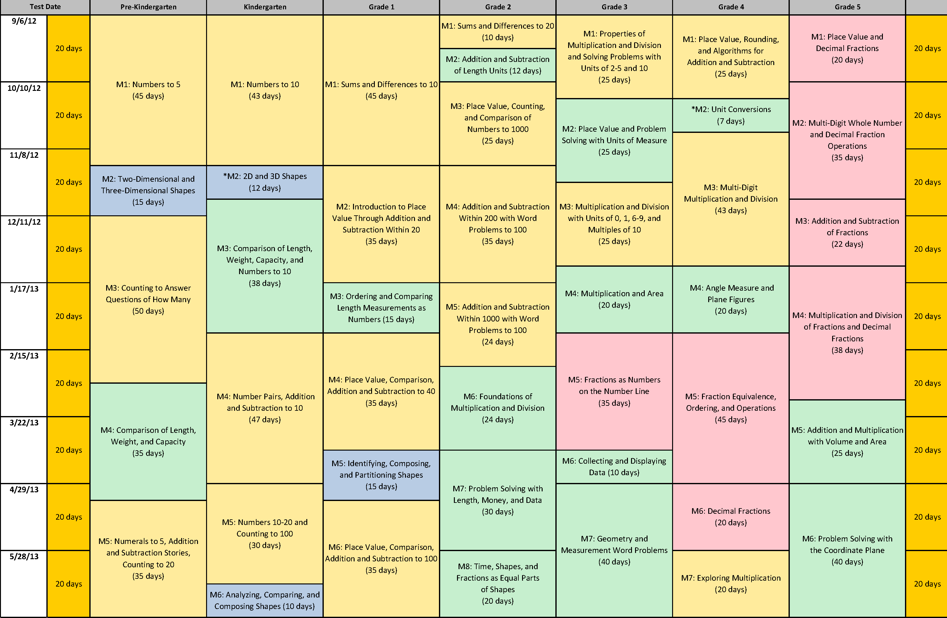
Curriculum Overview of A Story of Units
Notes:
The fourth module in Grade 1 is Place Value, Comparison, Addition and Subtraction to 40. The module includes 29 lessons and is allotted 35 instructional days.
This module builds on understandings established in Modules 1 and 2 and prepares students for their work in Module 6, when they add within 100.
TIME ALLOTTED FOR THIS SLIDE:
0 minutes
MATERIALS NEEDED:
X

Slide 5
Agenda
Introduction to the Module
Concept Development
Module Review
Notes:
Now let’s focus on the concepts being developed.
TIME ALLOTTED FOR THIS SLIDE:
0 minutes
MATERIALS NEEDED:
X

Slide 6
Students’ Prior Knowledge & Understanding
What tools and experiences do students bring with them to Module 4?
Notes:
Ask participants:
Based on what you know, what tools and experiences do students bring with them to Module 4?
Invite participants to share to the whole group for approximately 2-3 minutes.
TIME ALLOTTED FOR THIS SLIDE:
3 minutes
MATERIALS NEEDED:
X

Slide 7
Students’ Prior Knowledge & Understanding
Partners of 10 (M1)
Partners for sums less than 10 (M1)
Number bonds as a written notation for composing and decomposing numbers (M1)
Level 3 strategies of Making Ten (M2)
Level 3 strategies of Taking from Ten (M2)
10 as ten ones and as a unit- 1 “Ten” (M2)
Notes:
Among the learning from Modules 1, 2, and 3, students bring the following prior knowledge and mathematical understanding:
Partners of 10 (Module 1 and fluency & application problem work in Modules 1, 2 & 3)
Partners for sums less than 10 (Module 1 and fluency & application problem work in Modules 1, 2 & 3)
Number bond work (Module 1 and fluency & application problem work in Modules 1, 2 & 3)
Level 3 strategies of Making Ten & Taking from Ten (Module 2 and fluency & application problem work in Modules 2 & 3)
10 as ten ones and as a unit of 1 ten (Module 2 and fluency work in Modules 2 & 3)
Some students may need to continue to strengthen these understandings and skills. Along with daily opportunities for fluency work prior to Module 4, students will also have the opportunity to continue to work on these skills through fluency work during Module 4. Let’s take a look at some of the fluency work that may support children in strengthening these various skills and understandings.
TIME ALLOTTED FOR THIS SLIDE:
1 minute
MATERIALS NEEDED:
X

Slide 8
Fluency Work: Partners of 10 or Less
Get to 10 or 20 (M3-Lesson 12, M4-Lesson 14)
5-Group Flash (M2-Lesson 2)
Break Apart Numbers (M4-Lesson 1)
Addition with Cards
(M3-Lesson 12, M4-Lesson 14)
Notes:
The fluency work described can be found in several different lessons within the Grade 1 modules. We have chosen to list one or two examples of the locations of the fluency activities.
With participants, spend a few minutes engaging in one or more of the fluency activities.
Directions for Get to 10 or 20 as found in G1-M4-Lesson 14:
Get to 10 (or 20)
Materials: (T) Rekenrek
Note: In this fluency activity, students apply their knowledge of partners to ten to find analogous partners to 20, 30 and 40, which will prepare them for today’s lesson.
For the first minute, say numbers from 0-10. Students say partners to ten on your snap. Then take out the Rekenrek.
T: (Show 9.) Say the number.
S: 9.
T: Give me the number sentence to make ten.
S: 9 + 1 = 10
T: (Move 1 bead to make 10. Show 19.)
T: Say the number.
S: 19.
T: Give me the number sentence to make 20.
S: 19 + 1 = 20
Suggested sequence: 29, 39; 5, 15, 25, 35; 8, 18, 28, 38; 7, 17, 27, 37; etc.
Directions for 5-Group Flash as found in G1-M2-Lesson 2:
5-Group Flash: Partners to Ten
Materials: (T) 5-Group cards (S) Personal white boards
Note: This is a maintenance fluency with partners to ten to facilitate the make ten addition strategy.
Flash a card for 1–3 seconds (e.g., 9). Students write 2 expressions that make ten (e.g., 9 + 1 and 1 + 9).
Directions for Break Apart Numbers as found in G1-M4-Lesson 1:
Break Apart Numbers
Materials: (S) Personal white boards with break apart numbers template
Note: Reviewing decomposing numbers 5-9 supports Grade 1’s required fluency of adding and subtracting within 10 and is an essential skill in order to apply the Level 3 addition strategy of making 10. If students struggle with this activity, consider repeating it in lieu of some of the fluency activities that provide practice with numbers to 20 and beyond.
Students complete as many different number bonds as they can in one minute. Take a poll of how many students completed all decompositions for 5s, 6s, etc. and celebrate accomplishments
Directions for Addition with Cards as found in M3-Lesson 12:
Addition with Cards
Materials: (S) 1 pack of numeral cards 0–10 per pair (from G1–M1–Lesson 36), counters (if needed)
Note: This review fluency strengthens students’ abilities to add within and across ten.
Students place the deck of cards face down between them. Each partner flips over two cards and adds the numbers. The partner with the greatest total keeps the cards played by both players. The player with the most cards at the end of the game wins. If there is a tie, players each turn over one final card. The player with the greater number wins. If the cards are of equal value, they continue to turn over a card until there is a winner.
TIME ALLOTTED FOR THIS SLIDE:
4 minutes
MATERIALS NEEDED:
Rekenrek
Break Apart Numbers Template

Slide 9
Fluency Work: Decomposition Work
Take Out 1 (or 2) (M2- Lesson 2)
Number Bond Addition and Subtraction
(M4-Lesson 15)
Notes:
The fluency work described can be found in several different lessons within the Grade 1 modules. We have chosen to list one or two examples of the locations of the fluency activities.
With participants, spend a few minutes engaging in one or more of the fluency activities.
Directions for Take Out 1 as found in M2-Lesson 2:
Take Out 1: Number Bonds (5 minutes)
Materials: (S) Personal white boards
Note: This is an anticipatory fluency for the make ten with an addend of 9. Students take 1 from the other addend and so must be able to do that quickly and accurately.
Say a number within 10. Students quickly write a number bond for the number said, using 1 as a part, and hold up their boards when finished.
Directions for Number Bond Addition & Subtraction as found in M4-Lesson 15:
Number Bond Addition and Subtraction
Materials:(S) Personal white board
Note: This fluency activity builds a student’s ability to add and subtract within 10
While reinforcing the relationship between addition and subtraction.
Write a number bond for a number between 0-10 with a missing part or whole. Students write
An addition and subtraction sentence with a box for the missing number in each equation. They then solve for the missing number.
TIME ALLOTTED FOR THIS SLIDE:
3 minutes
MATERIALS NEEDED:
X

Slide 10
Fluency Work: Make Ten & Take From Ten Strategy
Magic Counting Sticks (M4-Lesson 3)
Make Ten Addition
with Partners (M4-Lesson 14)
Notes:
The fluency work described can be found in several different lessons within the Grade 1 modules. We have chosen to list one or two examples of the locations of the fluency activities.
With participants, spend a few minutes engaging in one or more of the fluency activities.
Directions for Magic Counting Sticks as found in M4-Lesson 3:
Magic Counting Sticks
Materials: (T) Hide Zero cards
Note: This activity reviews the concept of 10 as a unit and as ten ones, which will prepare students for today’s lesson.
T: (Divide students into partners and assign Partners A and B. Show 13 with Hide Zero cards.) How many tens are in 13?
S: 1 ten.
T: (Point to the 1 in 13.) Partner A, show 1 ten with your magic counting sticks. (Partner A holds up a bundled ten.) How many ones should Partner B show?
S: 3 ones.
T: (Point to the 3.) Partner B, show 3 ones. 1 ten and 3 ones is 13. Partner A, open up your ten. How many fingers do you have?
S: 10 fingers.
T: (Take apart the Hide Zero cards to show 10 and 3.) 10 fingers + 3 fingers is?
S: 13 fingers.
Alternate partners and repeat with other teen numbers.
Directions for Make Ten Addition with Partners as found in M4-Lesson 14:
Make Ten Addition with Partners
Materials: (S) Personal white board
Note: This fluency activity reviews how to use the Level 3 strategy of making ten to add two single-digit numbers. Students will learn how to apply this strategy when adding a 1-digit number to a 2-digit number in today’s lesson.
-Assign partners of equal ability.
-Partners choose an addend for each other from 1-10.
On their personal boards, students add their number to 9, 8 and 7.
Remind students to write the two addition sentences they learned in Module 2.
Partners then exchange boards and check each other’s addition sentences they learned in Module 2.
Partners then exchange boards and check each other’s work.
TIME ALLOTTED FOR THIS SLIDE:
6 minutes
MATERIALS NEEDED:
X

Slide 11
Fluency Work: Units of Ten
Change 10 Pennies for 1 Dime (M4-Lesson 1)
Happy Counting by 10s (M4-Lesson 1)
Hide Zero Number Sentences (M3-Lesson 13)
Notes:
The fluency work described can be found in several different lessons within the Grade 1 modules. We have chosen to list one or two examples of the locations of the fluency activities.
With participants, spend a few minutes engaging in one or more of the fluency activities.
Directions for Change 10 Pennies for 1 Dime as found in M4-Lesson 1:
Change 10 Pennies for 1 Dime
Materials: (T) 10 pennies and 1 dime (S) 10 pennies and 1 dime for each pair of students.
Note: This activity helps students to see that 10 cents is equal to 1 dime just as 10 ones are equal to 1 ten. This fluency activity is necessary in order to prepare students to utilize coins as abstract units that represent tens and ones in G1-M1-Lesson 6.
Lay out 10 pennies into five groups as students count (1 cent, 2 cents, etc.). Make sure students include the unit as they count.
Change the 10 pennies for 1 dime and say, “10 pennies is equal to 10 cents.” Repeat the exact same process but this time say, “10 pennies is equal to 1 dime.” Students repeat the activity with a partner.
Directions for Happy Counting By 10s as found in M4-Lesson 1:
Happy Counting: By 10s
Note: Reviewing Happy Counting by 10s prepares students to recognize the efficiency of counting groups of 10 in today’s lesson.
Happy Count by 10s the regular way and Say Ten way from 0-120. To really reinforce place value, try alternating between counting the regular way and the Say Ten way.
Directions for Hide Zero Number Sentences as found in M3-Lesson 13:
Hide Zero Number Sentences
Materials: (S) Hide Zero cards (from G1–M1–Lesson 38, with additional cards found at the end of this lesson)
Note: This fluency activity strengthens the understanding of place value and prepares students for Module 4.
Show students numbers from 10 to 40 with Hide Zero cards (e.g., 15). Students say an addition sentence with 10 as an addend (e.g., 10 + 5 = 15). As students say the sentence, pull apart the Hide Zero cards to model the equation. Alternate asking students to say the numbers the Say Ten way and the regular way.
Suggested sequence: 15, 25, 35; 14, 24, 34; 16, 26, 36; etc.
TIME ALLOTTED FOR THIS SLIDE:
2 minutes
MATERIALS NEEDED:
Pennies & Dimes
Hide Zero Cards

Slide 12
Module Overview
What is the new key learning in Module 4?
What is the reasoning behind working with numbers to 40?
Notes:
With this sense of students’ prior knowledge and experience, we will now delve into Module 4’s overview to look for the new key learning that takes place during this module.
TIME ALLOTTED FOR THIS SLIDE:
1 minutes
MATERIALS NEEDED:
X

Slide 13
Module Overview
Read the narrative and the assessment.
What do you see as key learning for students as they participate in Module 4?
What is the reasoning behind working with numbers to 40?
Notes:
Ask participants to keep these two questions in mind as they read the overview narrative and review the students’ work on the assessments:
What do you see as key learning for students as they participate in Module 4?
What is the reasoning behind working with numbers to 40?
Provide participants with 10-12 minutes to review. Ask them to discuss for 2 minutes at their table and then share as a whole group.
TIME ALLOTTED FOR THIS SLIDE:
16 minutes
MATERIALS NEEDED:
Module Overview

Slide 14
Module Overview
Key Learning in Module 4
Naming digits as tens or ones
Using comparison symbols
Adding/subtracting tens
Adding two-digit numbers using Level 3 strategies
Formal introduction of the tape diagram
Notes:
The key learning in Module 4 includes the following:
Naming digits as tens or ones
Using comparison symbols
Adding/subtracting tens
Adding two-digit numbers using Level 3 strategies
Formal introduction of the tape diagram
All work with numbers stays within 40 because students can more easily visualize these quantities, helping them move towards more abstract representations of the numbers and the computations. When adding two-digit numbers, students are never adding more than 20 and 20. As students grapple with adding two-digit numbers where a new ten is made, they are limited to adding pairs of teen numbers, such as 19 + 19, which helps students focus on their Level 3 strategy work. When each number has only 1 ten, they are better able to mentally hold their tens and add the newly made ten to their total. During Module 6, students will extend this strategy work to larger numbers, such as 49 + 39.
TIME ALLOTTED FOR THIS SLIDE:
1 minutes
MATERIALS NEEDED:
Module Overview

Slide 15
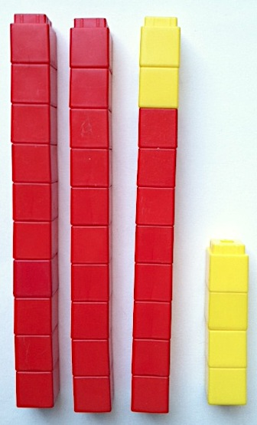




Topic A: Tens and Ones
tens | ones
3 | 8
Lessons 1-6
Notes:
Up to this point, students have had limited work with naming an amount in more than one way. At the end of Module 2, they did some work with 1 ten and some ones. Topic A expands this understanding so that 38 can be expressed or interpreted as 38 ones, 3 tens and 8 ones, 30 + 8, 8 + 30, and 3 dimes and 8 pennies. Students are introduced to the place value chart, where they can record quantities in tens and ones. Students draw 38 using quick tens, where each line represents a full group of ten. All of this work also helps the students mentally add not only 1 more and 1 less, but also 10 more and 10 less.
TIME ALLOTTED FOR THIS SLIDE:
6 minutes
MATERIALS NEEDED:
X

Slide 16
Topic A: Tens and Ones
Key Learning:
Efficiency of 10 as a unit
Use of the place value to represent and decompose 2-digit numbers
Two-digit numbers can be represented as
tens and ones or just ones.
Write two-digit numbers as addition sentences
Use dimes and pennies as representations of tens and ones.
Lessons 1-6
Notes:
The key learning in Topic A includes:
Efficiency of 10 as a unit
Use of the place value to represent and decompose 2-digit numbers
Two-digit numbers can be represented as
tens and ones or just ones.
Write two-digit numbers as addition sentences
Use dimes and pennies as representations of tens and ones.
TIME ALLOTTED FOR THIS SLIDE:
2 minutes
MATERIALS NEEDED:
X

Slide 17
Topic B: Comparison of Pairs of Two-Digit Numbers
19 > 30
What is this students’ misunderstanding?
Lesson 7-10
Notes:
The student pictured incorrectly believes 19 > 30. What is his misunderstanding?
There might be any number of reasons the student has a misunderstanding, including:
He believes the symbol means “less than.”
He is saying “90” and “13” in his mind instead of “19” and “30.”
He doesn’t know how much 19 is or he doesn’t know how much 30 is.
TIME ALLOTTED FOR THIS SLIDE:
6 minutes
MATERIALS NEEDED:
X

Slide 18
Topic B: Comparison of Pairs of Two-Digit Numbers
Key Learning:
Comparison of quantities
Comparing quantities from left to right
Using <, >, and = symbols
Lessons 7-10
Notes:
To accurately use mathematic symbols to compare quantities, students must:
be able to identify a greater quantity of objects as well as identify the quantity of objects that is less.
be able to use the language of “greater than” and “less than” while comparing from left to right.
Connect the correct mathematical symbol to the language of “greater than” and “less than.”
Share with participants an example or two from each of these skills by placing two quantities of objects under the document camera. Count. Write the quantities. Circle the greater amount. Repeat the process and circle the amount that is less. Note that when the group is able to demonstrate that they can accurately compare the quantities, move to practicing the comparisons from left to right. Then move on to using the mathematical symbols using the Hungry Alligator story. The alligator always wants to eat the greater quantity; with teeth marks added inside the comparison symbols, students place the appropriate symbol between two numbers to compare and read left to right. Students then move to the symbols without teeth marks.
TIME ALLOTTED FOR THIS SLIDE:
2 minutes
MATERIALS NEEDED:
Comparison Symbol Cards

Slide 19
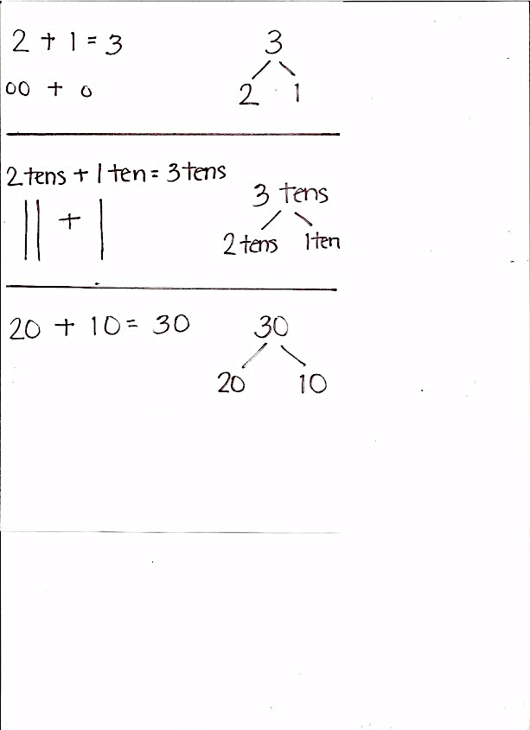
Topic C: Addition & Subtraction of Tens
20 + 10 = 30
30 – 10 = 20
Lessons 11-12
Notes:
During Topic C, students see that they can apply their knowledge of 2 + 1 to adding units of 10. Just as 2 + 1 = 3, 2 tens + 1 ten = 3 tens and 20 + 10 = 30. Students use this understanding to add and subtract tens, and then students move on to add tens to any given number.
TIME ALLOTTED FOR THIS SLIDE:
6 minutes
MATERIALS NEEDED:
X

Slide 20
Topic C: Addition & Subtraction of Tens
Key Learning:
When adding or subtracting tens only the unit changes (e.g., 3 bananas + 1 banana = 4 bananas, just as 3 tens + 1 ten = 4 tens)
When adding and subtracting tens the
ones digit stays the same.
Lessons 11-12
Notes:
Key learning in Topic C includes:
When adding or subtracting tens only the unit changes (e.g., 3 bananas + 1 banana = 4 bananas, just as 3 tens + 1 ten = 4 tens)
When adding and subtracting tens the
ones digit stays the same.
TIME ALLOTTED FOR THIS SLIDE:
2 minutes
MATERIALS NEEDED:
X

Slide 21
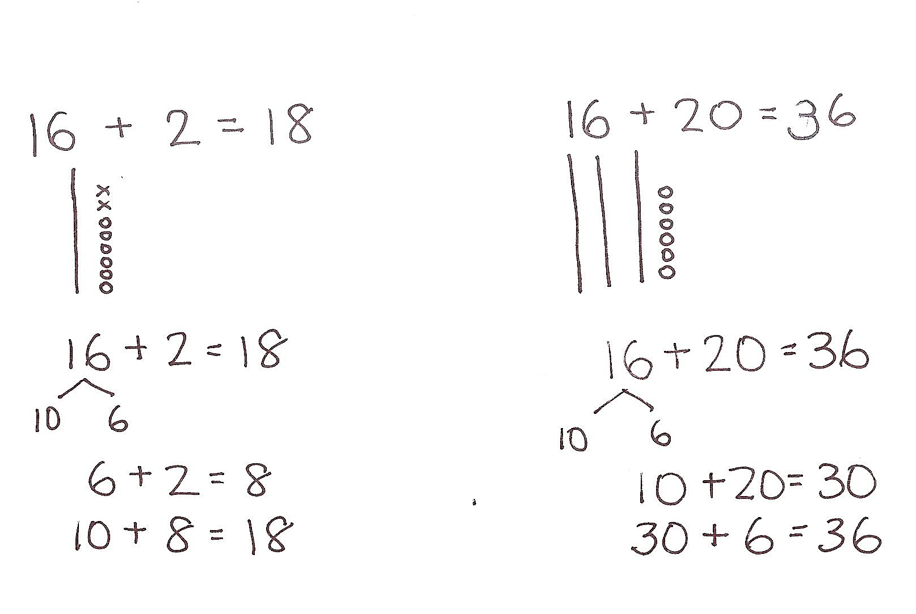
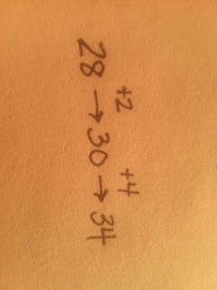
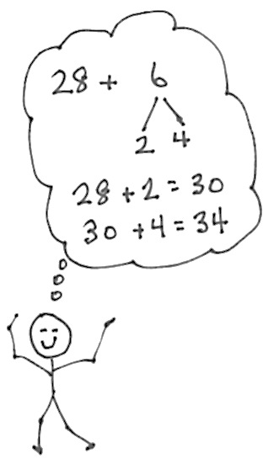
Topic D: Addition of Tens OR Ones
Lessons 13-18
Notes:
During Topic C, students apply their work with the make ten strategy to add a single digit to a two-digit number. Students decompose one number to add more easily. Students may sometimes decompose the single-digit addend to make the next ten first. Students may also decompose the two-digit addend and then either add the ones or add the tens, depending on the number to which it is being added.
TIME ALLOTTED FOR THIS SLIDE:
10 minutes
MATERIALS NEEDED:
X

Slide 22
Topic D: Addition of Tens OR Ones
Key Learning:
Applying counting on and the make ten strategy for larger numbers using concrete manipulatives, number bonds, arrow notation, and quick tens.
Using smaller number sentences to help with
larger number sentences (8+4 is embedded
in 18+4, 28+4)
When adding like units in a two-digit number the
other digit remains constant.
Adding two-digit numbers using coins as
representations of tens and ones.
Lessons 13-18
Notes:
Key learning in Topic D includes:
Applying counting on and the make ten strategy for larger numbers using concrete manipulatives, number bonds, arrow notation, and quick tens.
Using smaller number sentences to help with
larger number sentences (8+4 is embedded
in 18+4, 28+4)
When adding like units in a two-digit number the
other digit remains constant.
Adding two-digit numbers using coins as
representations of tens and ones.
TIME ALLOTTED FOR THIS SLIDE:
2 minutes
MATERIALS NEEDED:
X

Slide 23
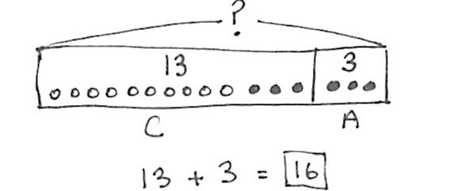
Topic E: Varied Problem Types within 20
Thirteen children are on the roller coaster. Three adults are on the roller coaster. How many people are on the roller coaster?
Lessons 20, Concept Development
Notes:
During Topic E, students are more formally introduced to the tape diagram as a way of drawing the mathematics taking place within the story problem. During Modules 1 and 2, students were already introduced to using simple shapes such as circles or squares to represent each object in the story. They were also introduced to the benefits of labeling each part, as well as the total, and to circling, or putting a rectangle around each part. Students now more formally combine these strategies to create tape diagrams. Some children will be ready to represent each part using only numbers while others will continue to need the assistance of both countable objects as well as numbers. Students continue to put a rectangle around the solution number in their number sentence and write a statement to answer the question.
TIME ALLOTTED FOR THIS SLIDE:
3 minutes
MATERIALS NEEDED:
X

Slide 24
Topic E: Varied Problem Types within 20
Thirteen people are on the roller coaster now. Three adults are on the roller coaster, and the rest are children. How many children are on the roller coaster?
Read the problem.
Draw a tape diagram and label.
Write a number sentence and statement that matches the story.
Lessons 20, Concept Development
Notes:
Invite participants to create their own tape diagram, number sentence, and statement to match the story problem.
TIME ALLOTTED FOR THIS SLIDE:
3 minutes
MATERIALS NEEDED:
X

Slide 25
Topic E: Varied Problem Types within 20
Key Learning:
Students continue to organize their drawings to assist them in solving increasingly complex and varied story problems.
Students learn and use the elements
of the tape diagram.
Lessons 19-22
Notes:
Copy and paste, as appropriate, from lesson plan…
TIME ALLOTTED FOR THIS SLIDE:
2 minutes
MATERIALS NEEDED:
X

Slide 26
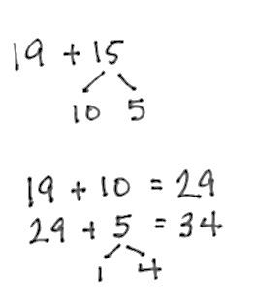
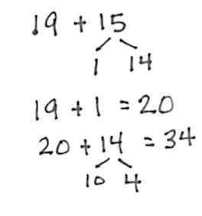
Topic F: Addition of Tens and Ones
Adding on ten first
Adding to make the next ten first
Lessons 23-29
Notes:
During Topic F, students apply the “make ten” strategy to the addition of pairs of two-digit numbers in two distinct ways. First, students decompose the second addend into tens and ones. They add the tens first and then the ones. Later, students decompose the second addend so that they can make the next ten and then add the remaining part.
After explaining the two examples on the slide, provide participants with two or three addition problems to try using both strategies.
18 + 22; 19 + 13; 17 + 14
Allow students 2 minutes to solve and practice these strategies.
TIME ALLOTTED FOR THIS SLIDE:
10 minutes
MATERIALS NEEDED:
X

Slide 27
Topic F: Addition of Tens and Ones
Key Learning:
As long as students attend to the place value of each number, they can use varied strategies to accurately add within 40.
The strategy of “making ten” can be applied to addition of two-digit numbers.
Lessons 23-29
Notes:
Key learning in Topic F includes:
As long as students attend to the place value of each number, they can use varied strategies to accurately add within 40.
The strategy of “making ten” can be applied to addition of two-digit numbers.
TIME ALLOTTED FOR THIS SLIDE:
2 minutes
MATERIALS NEEDED:
X

Slide 28
Module Overview
Key Learning in Module 4
Naming digits as tens or ones
Using comparison symbols
Adding/subtracting tens
Adding two-digit numbers using Level 3 strategies
Formal introduction of the tape diagram
Notes:
Now that we have engaged in the key learning of the module, let’s take a closer look at the students’ experiences with this learning.
TIME ALLOTTED FOR THIS SLIDE:
1 minute
MATERIALS NEEDED:
Module Overview

Slide 29
Students’ Experiences in Module 4
Read the Topic Opener and attached materials.
Blue Team: CONCEPT FOCUS
How many lessons?
How is the learning sequenced, or split, among the lessons?
Prepare a portion of a lesson to enable us to “feel” the students’ experience with the topic.
Orange Team: FLUENCY FOCUS
What concepts or procedures will benefit from fluency work during the topic?
Read the Concept Development excerpt. Choose a fluency activity from those provided that you feel your students would benefit from
Notes:
We will now look more closely at the Topic Openers and a Concept Development from each topic to get a feel for the students experience.
Each group has been assigned a Topic and a color team. If you are the Blue Team, we’d like you to read the Topic Opener and report back to the group on how many lessons are in the topic and how the learning is split among those lessons. From within the Concept Development provided, select a portion of the lesson to present to the room so that we can get a sense of the students’ experience.
If you are on the Orange Team, we’d like you to read the same material. However, your task will be to consider what concepts, skills, or procedures might students in your class (or hypothetical class) need more fluency work with, either leading up to the topic or during the topic. Choose a fluency activity to share with the group and be prepared to share why you selected it.
Allow participants approximately 16-18 minutes to work at their tables on the assigned tasks.
TIME ALLOTTED FOR THIS SLIDE:
20 minutes
MATERIALS NEEDED:
Topic Openers
Experts of Concept Developments for the following lessons: 2, 8, 11, 14, 19, 26
Excerpts of Fluency from lessons: 2, 8, 11, 14, 19, 26
Chart paper for each group

Slide 30
Student Experiences of Each Topic
Lesson 2
Notes:
Blue and Orange Teams assigned Topic A present.
Topic A has 6 lessons. Students start by recognizing the efficiency of counting by tens instead of only counting by ones (particularly when there is a large number of items). On the next day, they are introduced to the place value chart and name tens and ones in a number. Then students name an number as either all ones or as tens and ones. In Lesson 4, students express two-digit numbers as addition sentences that are combining tens and ones. Lesson 5 has students work with ten more, ten less, one more, and one less. Finally, in Lesson 6, students represent two-digit numbers using dimes and pennies. Students work from concrete experiences to more abstract experiences as they move through the 6 lessons.
TIME ALLOTTED FOR THIS SLIDE:
10 minutes
MATERIALS NEEDED:
Module Overview

Slide 31
Student Experiences of Each Topic
Lesson 8
Notes:
Blue and Orange Teams assigned Topic B present.
Topic B has 4 lessons. First students work with comparing groups of objects and numbers. Then they compare from left to right. In the third lesson, the students are introduced to the comparison symbols and use them for the last two days of the lessons.
TIME ALLOTTED FOR THIS SLIDE:
10 minutes
MATERIALS NEEDED:
Module Overview
Comparison symbol cards

Slide 32
Student Experiences of Each Topic
Lesson 11
Notes:
Blue and Orange Teams assigned Topic C present.
Topic C has 2 lessons. Students work with tens as a unit, first adding and subtracting from a multiple of ten, and then adding tens to any given number.
TIME ALLOTTED FOR THIS SLIDE:
10 minutes
MATERIALS NEEDED:
Module Overview

Slide 33
Student Experiences of Each Topic
Lesson 14
Notes:
Blue and Orange Teams assigned Topic D present.
Topic D has 6 lessons. Students begin with concrete materials and use both counting on and making ten strategies to add ones to a two-digit number. Throughout the lessons, students record and solve pictorially and abstractly. By the last lesson, students discuss and critique various strategies for adding tens or ones to a two-digit number.
TIME ALLOTTED FOR THIS SLIDE:
10 minutes
MATERIALS NEEDED:
Module Overview

Slide 34
Student Experiences of Each Topic
Lesson 19
Notes:
Blue and Orange Teams assigned Topic E present.
Topic E has 4 lessons. Students learn how to construct a tape diagram. The first day, they work only with total or result unknown. They move to various problem types in the 3 subsequent lessons.
TIME ALLOTTED FOR THIS SLIDE:
10 minutes
MATERIALS NEEDED:
Module Overview

Slide 35
Student Experiences of Each Topic
Lesson 26
Notes:
Blue and Orange Teams assigned Topic F present.
Topic F has 7 lessons. It begins with work interpreting numbers as tens and ones, such as 31 as 3 tens 1 one and also as 2 tens and 11 ones. When moving to adding pairs of two-digit numbers, the first lesson adds a pair of two-digit numbers who ones digits have a total less than or equal to 10. Subsequent lessons practice the add ten strategy and then the make the next ten strategy. The last two lessons continue to practice adding pairs of two-digit numbers within 40.
TIME ALLOTTED FOR THIS SLIDE:
10 minutes
MATERIALS NEEDED:
Module Overview
Sprint from M4-Lesson 25

Slide 36
Sample Fluency Work for New Learning
Take out 1 or 10 (M4-Lesson 21)
Add Tens (M4-Lesson 24)
Longer/Shorter (M4-Lesson 21)
Notes:
As students continue to build and develop their mathematical skills and strategies, fluency activities are adding or modified to support continued practice.
After engaging in each fluency activity, ask participants what is being reinforced.
Directions for Take Out 1 or 10 as found in M4-Lesson 21:
Take Out 1 or 10
Note: This activity reviews place value in order to prepare students for Topic F.
Choose numbers between 10 and 20 and follow the paradigm below.
T: Say 15 the Say Ten way.
S: Ten 5.
T: Take out 1.
S: Ten 4.
Repeat for 25 and 35. Then, take out 10 from 15, 25, and 35, respectively.
This fluency activity helps students practice mentally adding and subtracting 10 or 1.
Directions for Add Tens as found in M4-Lesson 24:
Add Tens
Materials: (T) 100-bead Rekenrek
Note: Reviewing how to add multiples of 10 enables students to utilize their understanding of place value to add 2 two-digit numbers in today’s lesson.
T: (Show 14 on the Rekenrek.) Add 10.
S: 14 + 10 = 24.
T: Add 20.
S 14 + 20 = 34.
Repeat, displaying other teen numbers and instructing students to add 10 and 20. If students find it challenging to mentally add 20, scaffold by asking them to add 2 tens and modeling with the Rekenrek before asking them to add 20.
This fluency activity enables students to visualize adding tens to a number using the Rekenrek.
Directions for Longer/Shorter as found in M4-Lesson 21:
Longer/Shorter (2 minutes)
Materials: (T) Board or document camera
Note: Working with visualizing proportional relationships between numbers can support students’ number sense development. By using tape diagram models, students can recognize methods for representing numbers in relation to other numbers.
Write one pair of numbers on the board at a time (e.g., 5 and 5). Draw a rectangle under the first number.
T: This rectangle is long enough to hold this row of 5 dots. (Draw 5 dots so that they fill the space.)
T: (Point to the second number, which in this first example is also 5.) I’m going to start drawing a rectangle that is long enough to hold a row of 5 dots of the same size. Tell me when to stop.
T/S: (Begin drawing a rectangle, and give students the chance to say “Stop!” when it is approximately the same size as the first rectangle.)
T: Why did you say stop there?
S: It is about the same size as the first rectangle.
Repeat this process for the following sequence of numbers: 5 and 4, 5 and 10, 1 and 3, 4 and 6, 10 and 20. Only draw the dots for the first example. Have students talk about how the first number relates to the second number using language such as a little longer, a little shorter, much longer, double, etc. Have students who find this challenging use a number line with their left pointer finger on zero and their right on the number (endpoint).
This fluency activity helps students continue to visualize number relationships, which can be useful in problem solving during word problems and computations.
TIME ALLOTTED FOR THIS SLIDE:
8 minutes
MATERIALS NEEDED:
Rekenrek
Sprint from M4-Lesson 19

Slide 37
Agenda
Introduction to the Module
Concept Development
Module Review
Notes:
Let’s review some of the major ideas from today’s session on Module 4.
TIME ALLOTTED FOR THIS SLIDE:
0 minutes
MATERIALS NEEDED:
X

Slide 38
Module Overview
Key Learning in Module 4
Place value
Addition & Subtraction of Tens
Use of place value to add within 40
Continued fluency work
Continued development of problem solving skills
Notes:
The key learning in Module 4 is primarily:
Place value
Addition & Subtraction of Tens
Use of place value to add within 40
Continued fluency work
Continued development of problem solving skills
TIME ALLOTTED FOR THIS SLIDE:
1 minutes
MATERIALS NEEDED:
Module Overview

Slide 39
Biggest Takeaway
Turn and Talk:
What questions were answered for you?
What new questions have surfaced?
Notes:
Take two minutes to turn and talk with others at your table. During this session, what information was particularly helpful and/or insightful? What new questions do you have?
Allow 2 minutes for participants to turn and talk. Bring the group to order and advance to the next slide.
TIME ALLOTTED FOR THIS SLIDE:
3 minutes
MATERIALS NEEDED:
X

Slide 40
Key Points
During Module 4, students use Level 3 strategies to add two-digit numbers within 40.
Students continue to strengthen their fluency with previous concepts.
Tape diagrams are introduced within Module 4.
Notes:
Let’s review some key points of this session.
During Module 4, students use Level 3 strategies to add two-digit numbers within 40.
Students continue to strengthen their fluency with previous concepts.
Tape diagrams are introduced within Module 4.
TIME ALLOTTED FOR THIS SLIDE:
2 minutes
MATERIALS NEEDED:
X

